Slide 1
This project has received funding from the European Union's Horizon 2020 research and innovation programme under grant agreement No 824990

Slide 2
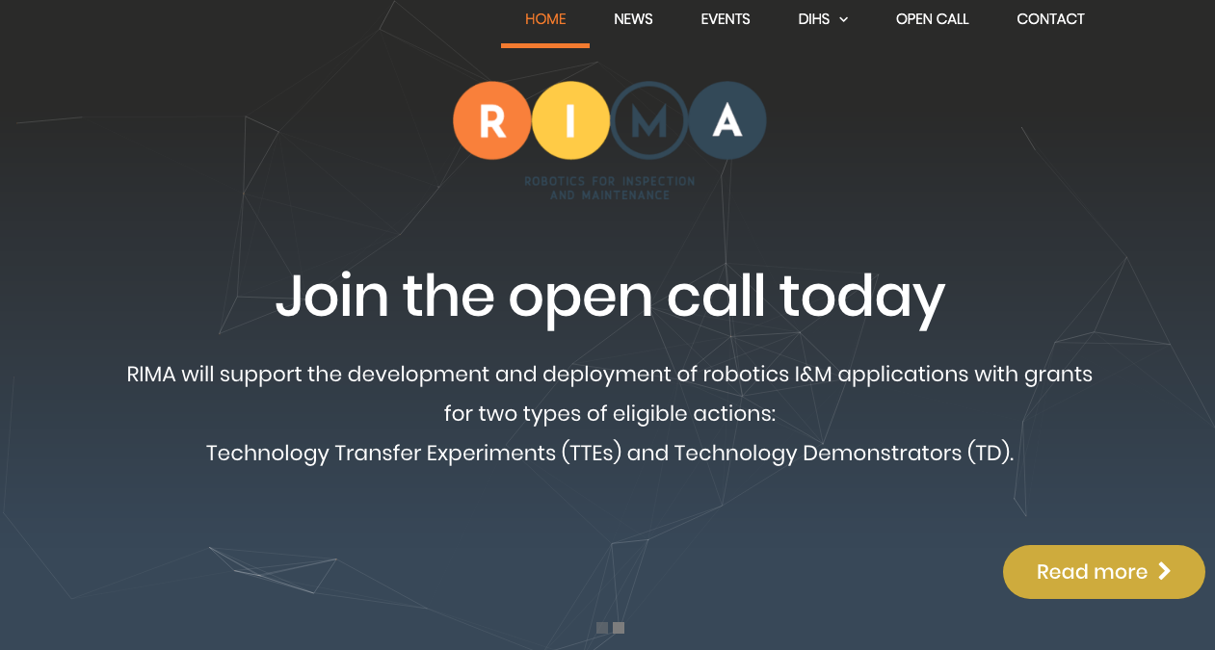

Slide 3
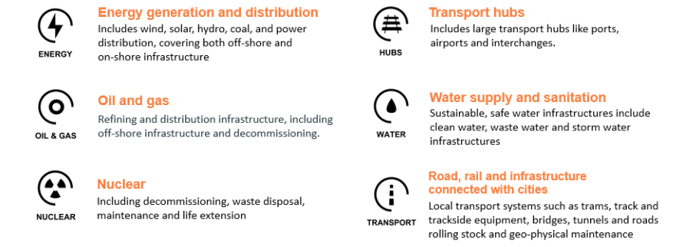
RIMA Target Use Domains

Slide 4
Why should you apply to RIMA’s Open Call
● As a Technology Developer you will have the opportunity to bring your innovative technology closer to the market (from TRL 5 to 7).
● As a Services/Product Provider in the field of Inspection and Maintenance for Infrastructures you will be able to develop new products or services or to innovate existing ones.
● As a System Integrator you will have the opportunity to enlarge your application field.
● As a micro-consortium you will be able to receive financial support of up to € 300K for innovative proposals.
● You will be able to find complementary companies among Technology Developers, Service/Product Providers and System Integrators to develop your innovative business together.

Slide 5
Main Criteria of Eligibility - Type of Activities
Technology Transfer Experiments (TTEs)
Developing, testing and validating the technical and economic viability of a robotic-based representative model or prototype system to be applied in a ‘Target Use Domain’ operational environment.
Technology Demonstrators (TDs)
Validating the technical and economic viability or a new or improved robotic-based technology, product, process, service or solution in a ‘Target Use Domain’ operational environment, whether industrial or otherwise, involving where appropriate a larger scale prototype or demonstrator.

Slide 6
Main Criteria of Eligibility - Beneficiaries
SME’s (or slightly bigger companies) from Target Use Domain’ value chains
SME’s (or slightly bigger companies) - technology suppliers
Number of beneficiaries:
Minimum 2 independent entities should be in a micro consortium (one ‘Service/Product Provider’ and one ‘Technology Supplier’ is compulsory)
Beneficiaries location:
EU Member States or Associated Countries

Slide 7
Financial Support Provided
Technology Transfer Experiments (TTE)
Up to € 300K EU-funding per TTE (duration 14 months, amount per consortium) on the following stages of the program:
• Jury Day mini grant: fixed lump sum of € 1,000
• Technology Development Stage: fixed lump sum of € 100,000
• Technology Experimentation Stage: fixed lump sum of € 100,000
• System Prototype Demonstration Stage: fixed lump sum of € 99.000

Slide 8
Financial Support Provided
Technology Demonstrators (TD)
Up to € 100K EU Funding per TD (duration 6 months, amount per consortium) on the following stages of the program:
• Jury Day mini grant: fixed lump sum of € 1,000
• System Prototype Demonstration Stage: fixed lump sum of € 99,000

Slide 9
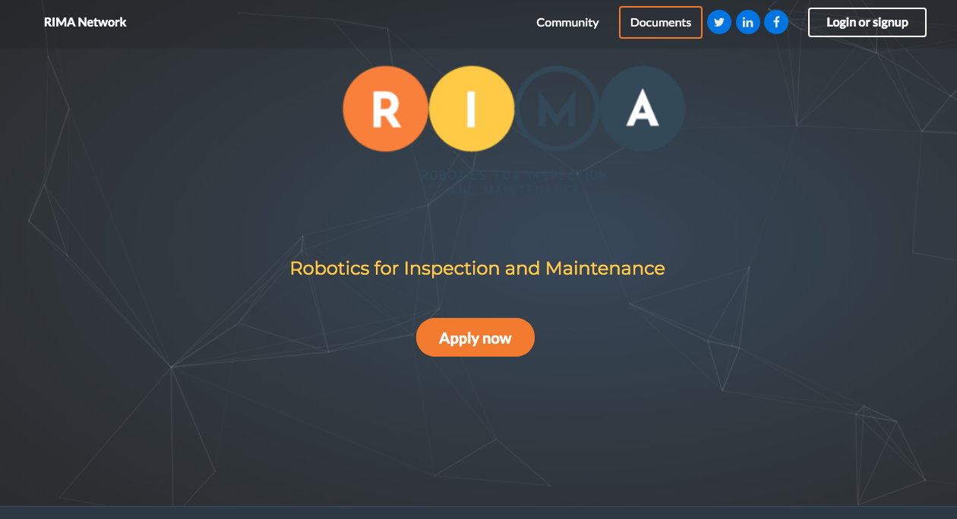

Slide 10
Preparation and submission of the proposals
Proposals have to be submitted through the RIMA Open Call microsite: https://rima-network.fundingbox.com/
Submitted application will include the following sections:
Basic information
Legal information
Consortium composition
Project

Slide 11
Preparation and submission of the proposals
Submitted application will include the following sections:
EXCELLENCE (Scored)
IMPACT (Scored)
IMPLEMENTATION (Scored)
Ethical Issues
Statistical section (optional)
Declaration of honour – confirmation of the exclusion criteria and absence of conflict of interest to be accepted by the Applicants
Processing of personal data – legal requirements related to the processing of the personal data of the Applicants (in accordance with the General Data Protection Regulation, EU 2016/679)
.

Slide 12
anna.dymowska@fundingbox.com

Slide 13
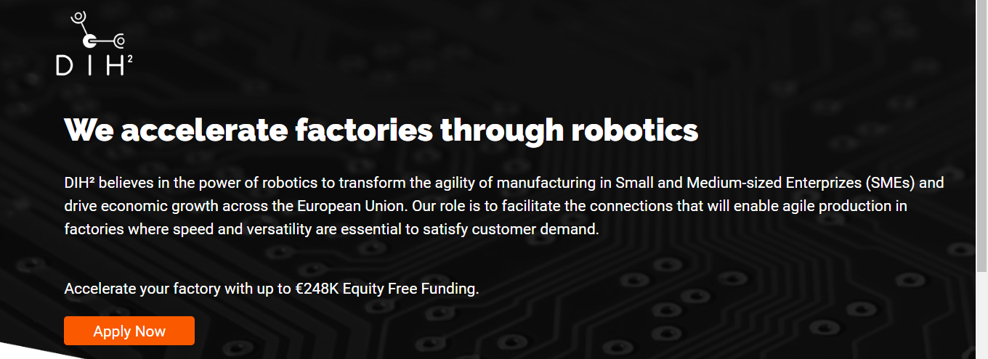
OTHER RELATED FUNDING OPPORTUNITIES

Slide 14
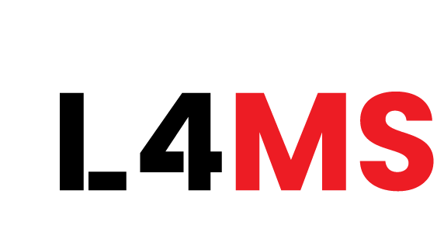

I4MS Open Calls Calendar
Year | Deadline | Project | Technology area
2019 | 30th Nov | L4MS L4MS aims to provide complete virtualization of logistics automation (Open Platform for Innovations in Logistics + 3D simulator) to enable cost effective deployment of logistics solutions | Robotics
 | 1st Nov | AMABLE AMable provides support to SMEs and mid-caps for their individual uptake of additive manufacturing. The AMable services arena offers a set of services to support the evolution of a product idea at all stages of the product creation process | Additive Manufacturing

