Slide 1
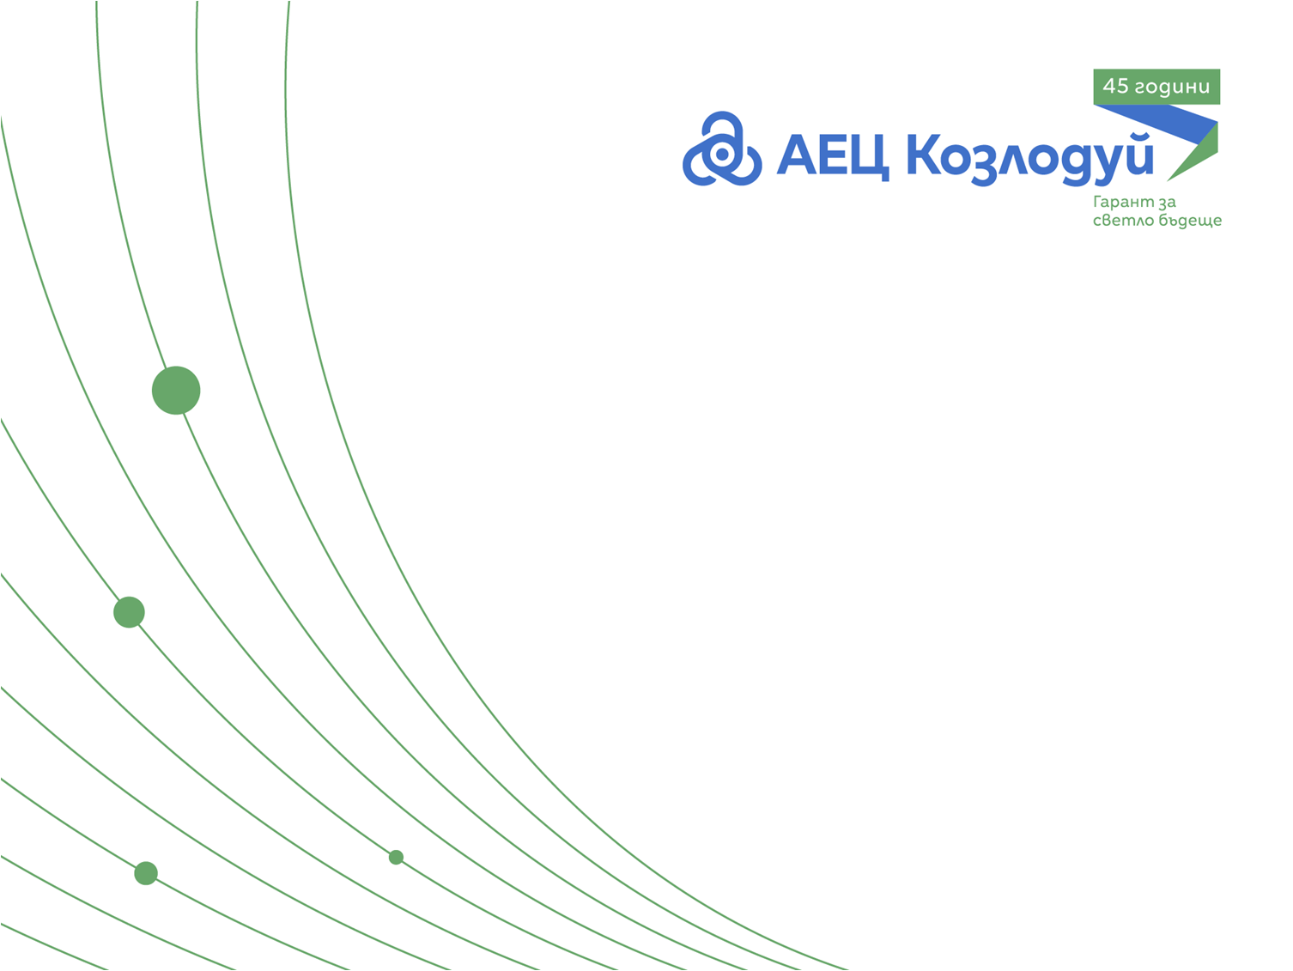
Nuclear power plant Kozloduy
45 years
NPP Kozloduy
Bright future guarantee!
Stilyana Mladenova
Head of Nuclear Safety Department

Slide 2
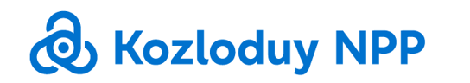
General Information
Bright future guarantee!

Slide 4
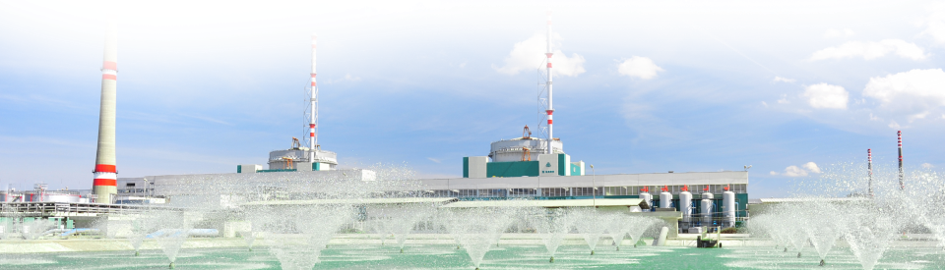
1974 - Beginning – Start of unit 1
First nuclear power plant in south-eastern Europe
The biggest power generating capacity in the country
34,7%
Part of national electricity production
346 513 165 MWh
Production of units 5 and 6 from 1987 to 2019

Slide 5
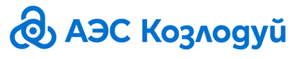
Maintenance program
Outage Scheduled Real
Unit 5 40 days 40 days
Unit 6 40 days 38 days
Гарант
светлого будущего!
Bright future guarantee!

Slide 6
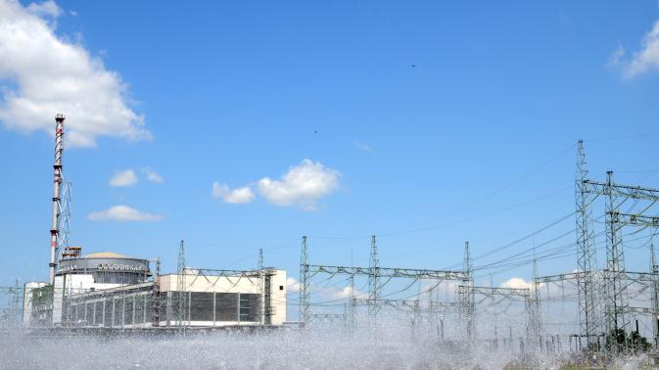
Major projects
Life extension of Units 5 and 6
Increasing the thermal capacity of units 5 and 6 up to 104%
Гарант
светлого будущего!
Bright future guarantee!

Slide 7
WANO Support
Fuccusima accident
29 June 2012 г.
National Action plan
Stress tests EK
23 March 2011 г.
Severe accident management
№ | Measure
FD-2-4-2 | Research of the possibilities of direct water submission to the core from outside
D-3-5 | Research of the possibilities for core melt localization in case of severe accident
Гарант
светлого будущего!
Bright future guarantee!

Slide 8
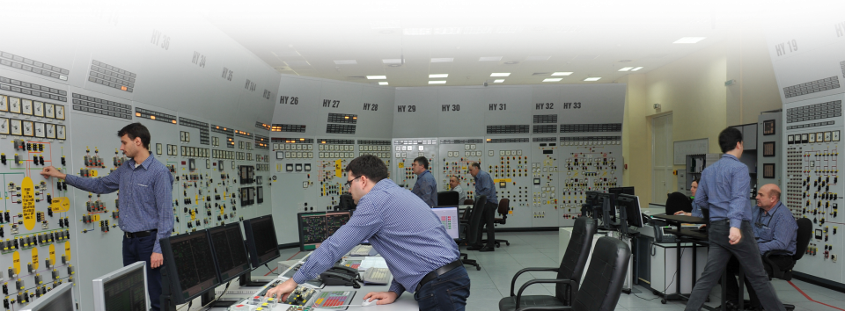
Human recourse development
Training centre
Training center is licensed to conduct specialized training and education.

Slide 9
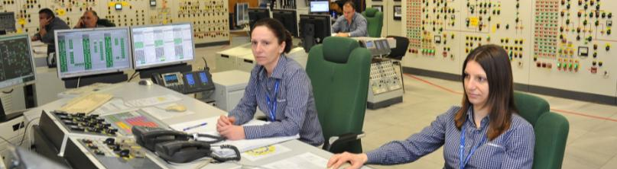
Human resources
People working in NPP 31.12.2018 г. | 3715
Average age | 46 years
Average work experience | 23 years
Education | University degree – 54%
 | Secondary professional – 33% Secondary– 12 %
 | Other – 1%
Notes:
Стари данни

Slide 10
Inspections
Гарант
светлого будущего!
Bright future guarantee!

Slide 11
Methods of control
1
Visual control (VC);
2
TV control (control with remote operated equipment)
3
Color Control (CC) – special liquid
4
Ultrasound control
5
Ultrasound thickness control
6
Radiographic control
7
Eddy currents control
Bright future guarantee!

Slide 12
Inspections and control
Welding control
Visual inspection
Thickness control
Internal inspection of reservoirs and tubes
Electrical cables inspection
Leaks – water and lubricants
Bright future guarantee!

Slide 13
Challenges
Radioactivity
Possibility to be decontaminated
Possibilities for additional equipment
Underwater work
High temperature
High humidity
Bright future guarantee!

Slide 14
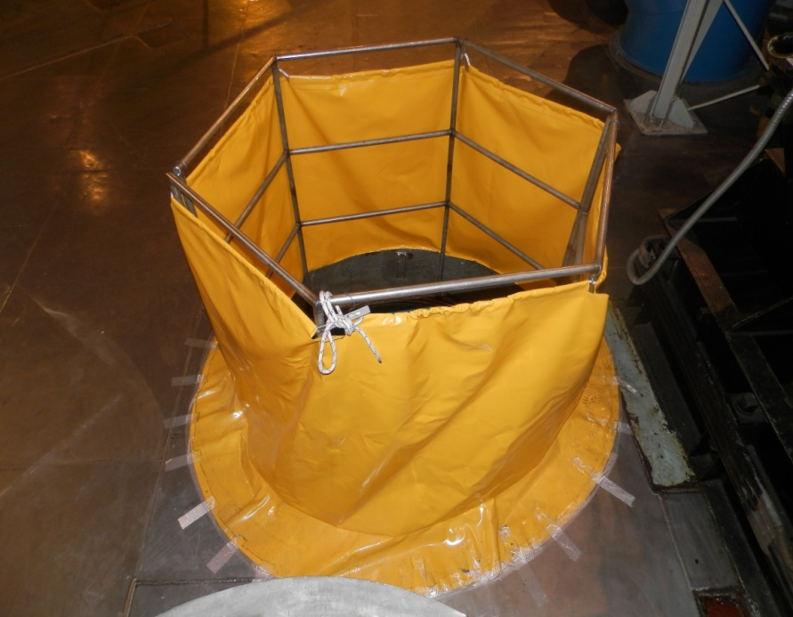
Foreign material exclusion strategy
We have developed many measures to prevent falling the foreign materials in open equipment during maintenance.
However, in case of availability of such material, it should be removed.
The personnel is highly encouraged to report all foreign materials. Following the report, it should be organized removal of the objects.
Bright future guarantee!

Slide 15
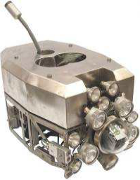
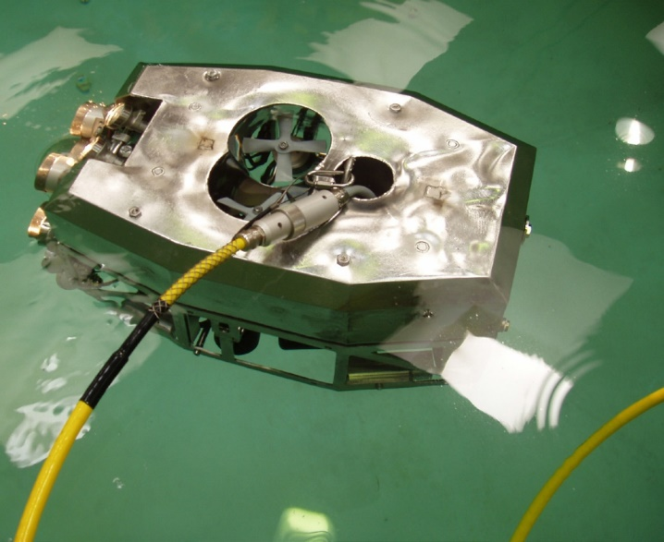
Available equipment
SUSI
Underwater Remotely Operated Video inspection system (ROV) developed specially for the nuclear industry.
Small and lightweight
Radiation resistant and decontable material
Subsurface electronics is minimal with the majority housed on the surface to reduce radiation exposure.
It can be fitted with B&W high resolution camera and articulated arm, grabber
Depth sensor
DVD recorder
Bright future guarantee!

Slide 16
Eddy current control
Control of the Steam-generator tubes
4 SG with 11 100 tubes each. Very precise control.
Breaking even 1 tube will allow small quantities of water from primary circuit to enter into secondary.
Time consuming
Bright future guarantee!

Slide 17
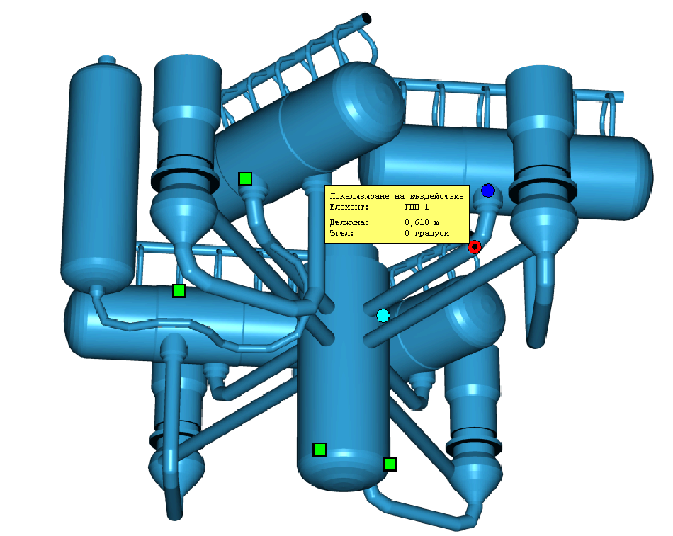
Reactor vessel control
Control of Main metal and weldings

Slide 18
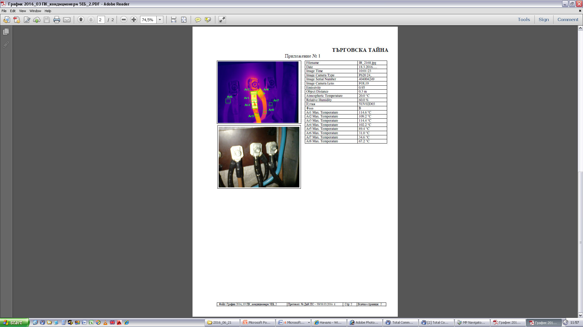
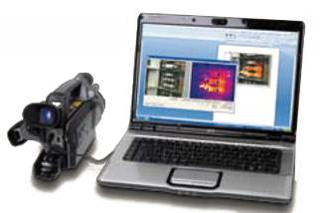
Thermal-vision control
Electrical equipment – high resistance; loose connection;
Mechanical equipment- problems with cooling, isolation, high friction…
Bright future guarantee!
Notes:
Стари данни

Slide 19
Possibilities
Shafts and channels
Underground inspection
In pipes inspection
Repair
Underground
pipes
Bright future guarantee!c

Slide 20
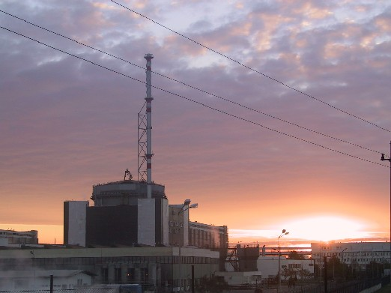
Thank you for your attention!
Bright future guarantee!c

