Slide 1


Inspection and Maintenance Needs in Bulgaria’s Road Infrastructure
Information & Matchmaking Day - Open Call RIMA
Sofia Tech Park, Friday 4 October 2019
Todor Anastassov
Transport Research Institute Ltd.

Slide 2
Content
Problems & Needs
Inspections & Surveys
Maintenance
Operation

Slide 3
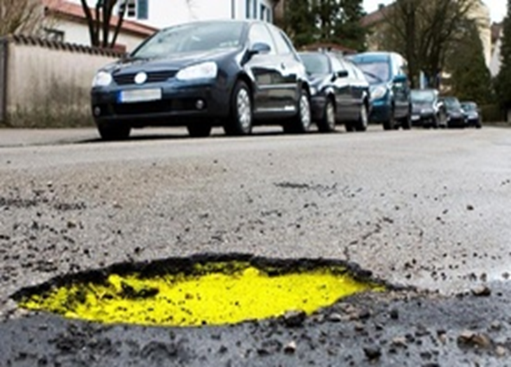
Problems & Needs
For citizens
poor infrastructure & high cost of transportation
significant accident level and poor road safety
poor traffic management and congestions
insufficient travel comfort
FOR STATE AND MUNICIPALITIES
higher costs
competitive transport
public awareness
organization and control
low traffic safety
planning and budgeting

Slide 4
Problems & Needs
In the public interest, we need to provide good road infrastructure
The national road administrations use specific information systems called Pavement Management Systems (PMS)
PMS is a comprehensive system including
inspections, surveys and data collection
models for analysis and forecasting of infrastructure condition
maintenance & operational standards
prioritization of repair works based on their cost-effectiveness

Slide 5
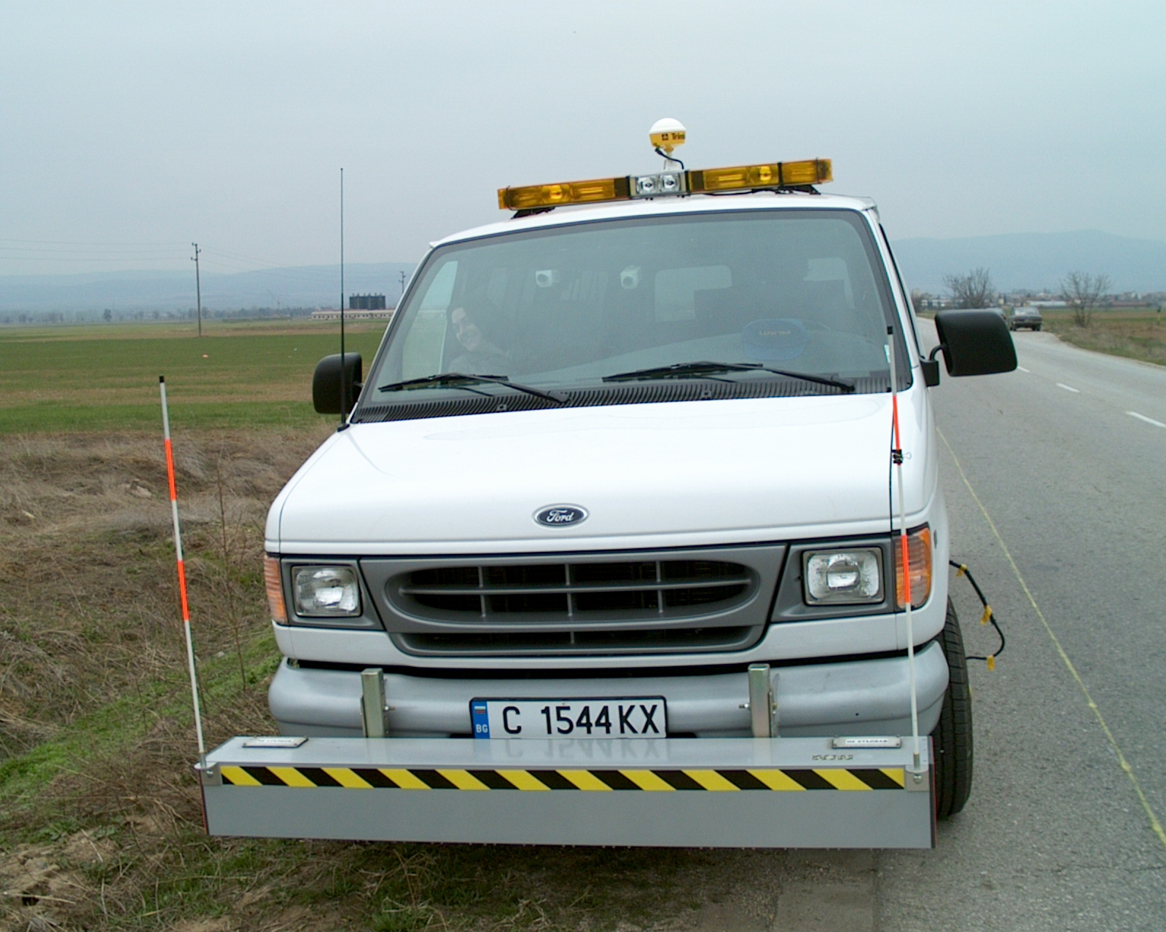
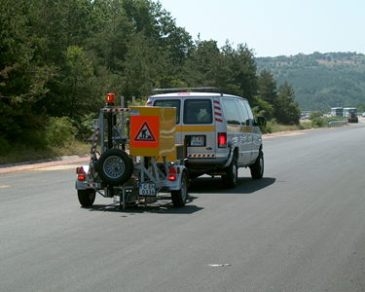
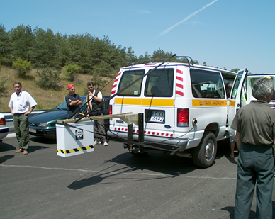
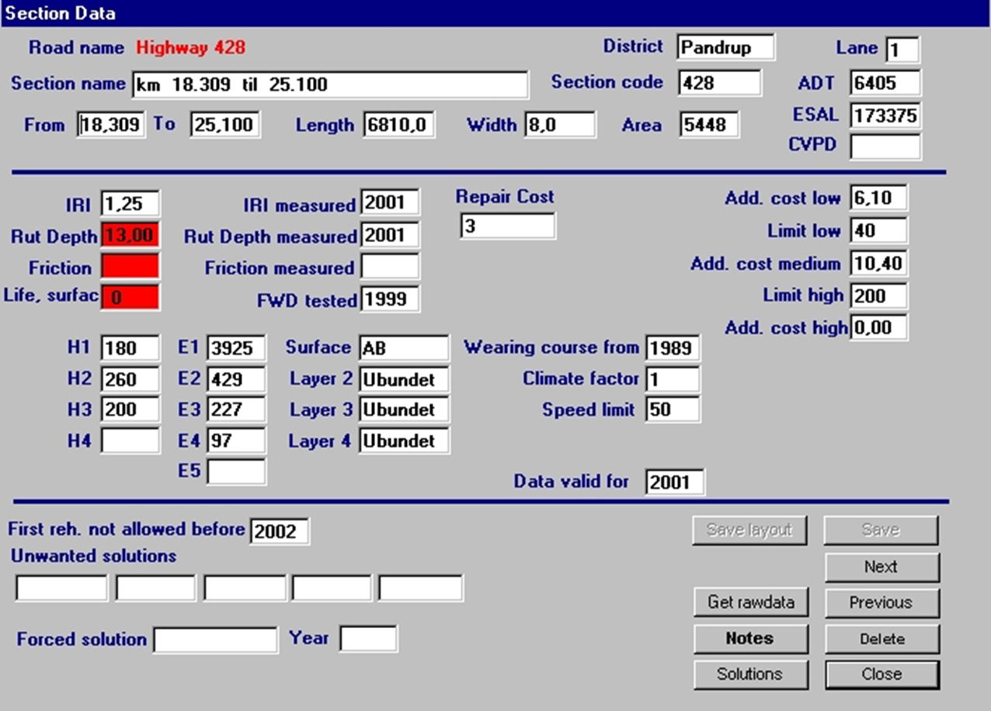
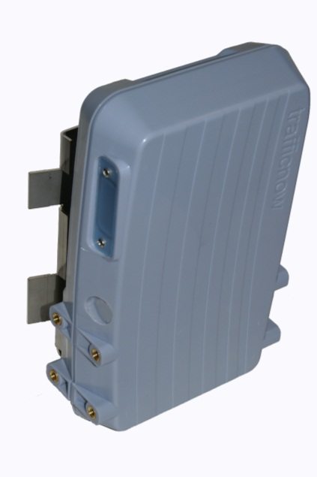
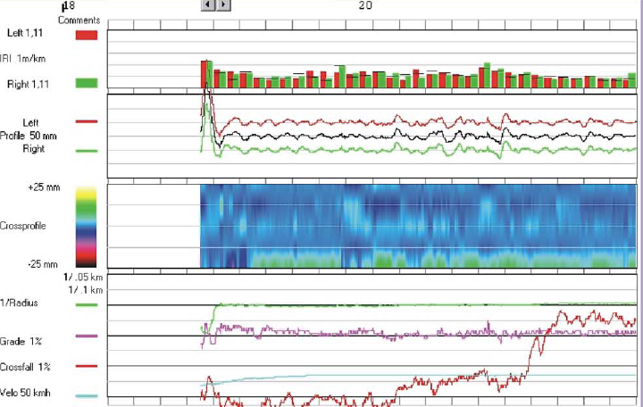
Problems & Needs
PMS need and operate with
specific equipment for inspection or testing
databases and information systems
highly qualified labor

Slide 6
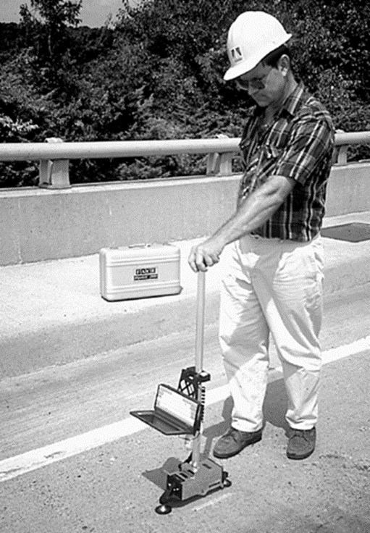
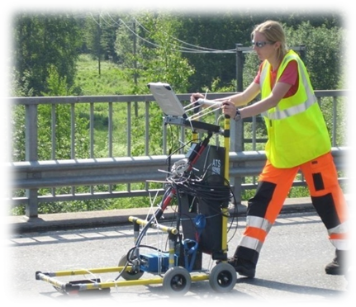




Problems & Needs
PMS are very labor-intensive and require high quality staff
on-site during inspections or surveys
for data processing & analysis
for decision making
AI & Robotics

Slide 7
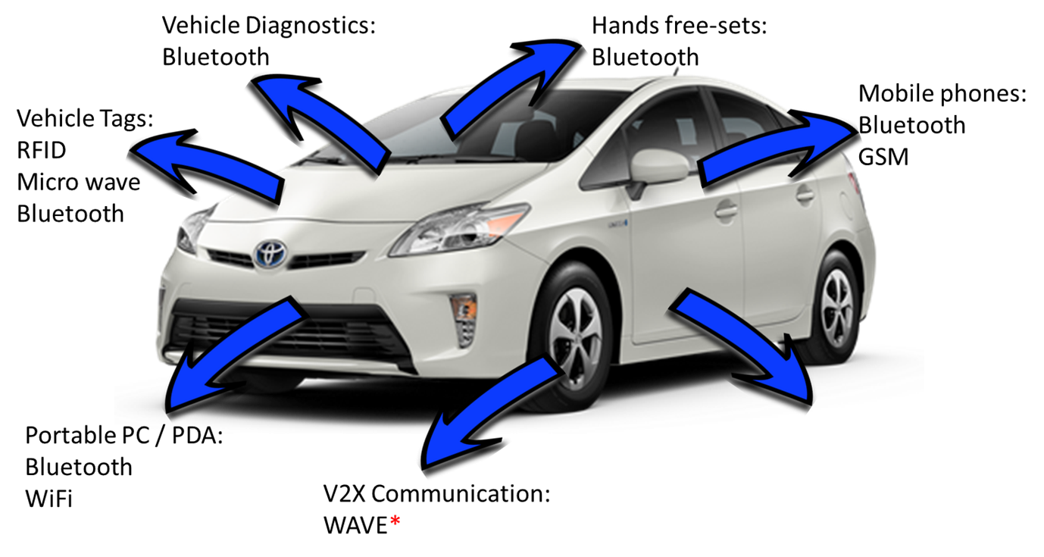
Problems & Needs
The near future
Vehicle-to-Infrastructure(V2I) & Vehicle-to-everything (V2X) communication
from ITS solutions to Smart Roads

Slide 8
Inspections & Surveys
Traffic Surveys
In general this process is highly automated - we have Automatic Traffic Counting Stations (ATCS) traditional Inductive loops & Automatic Number Plate Recognition (ANPR) cameras
Through the call of AI & Robotics we need
Implementation of systems based on deep traffic video analysis
Implementation of all advanced detection technologies like: Radar, Bluetooth, Wi-fi, DSRC, RFID etc.
Use and processing data from mobile phones and operators: cloud & big data solutions

Slide 9
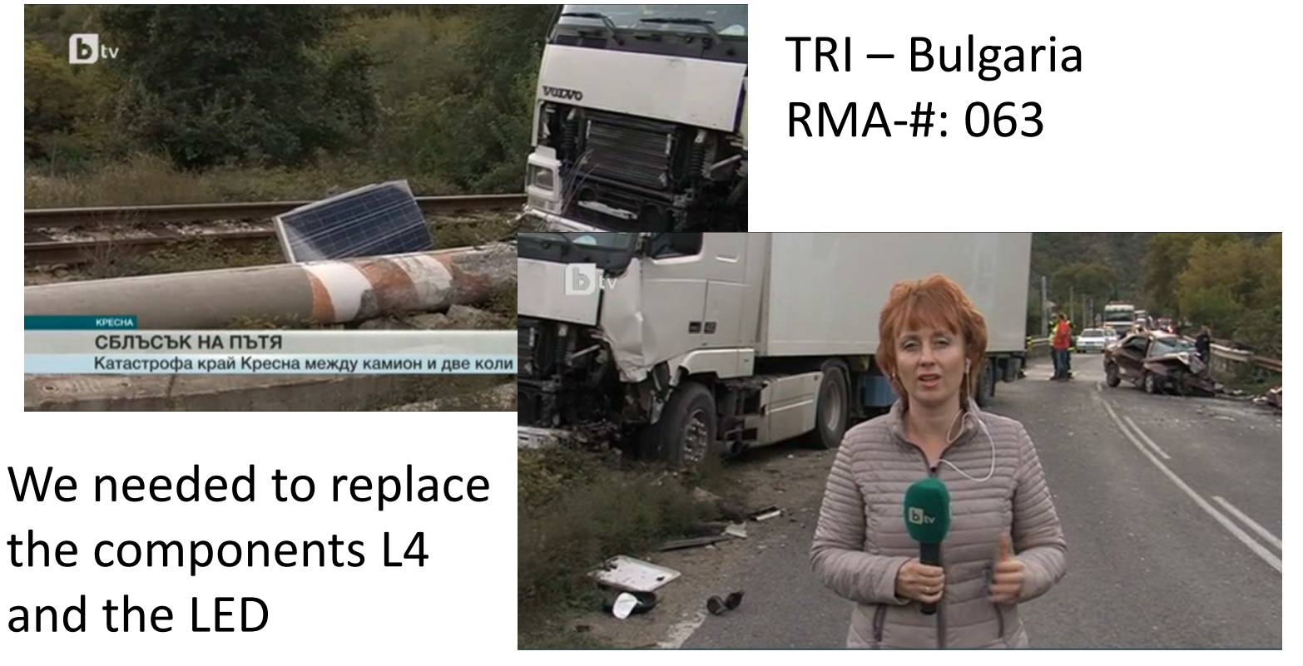





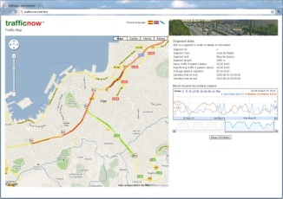
Inspections & Surveys
Traffic Surveys – Bluetooth traffic detection cloud solution
time=07:50:02
Bluetooth Sensor
# - 1
distance= 366 meters
Travel time = 1:13 Minutes
Speed = 18,05 km/h
Bluetooth algorithms server (database)
Visualization
Bluetooth Sensor
# - 2
time=07:51:15

Slide 10
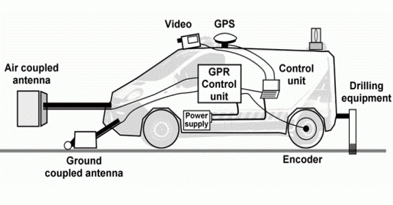
Inspections & Surveys
Pavement and Structures Inspections
In general this process is highly automated too - we have
Profilometer – measure International Roughness Index (IRI)
Automatic Video Distress Recording System – cracks and damages
Ground-penetrating radar (GPR) – for pavement structures
Falling Weight Deflectometer (FWD) – for bearing capacity
PMS
All devices & systems need a human operator

Slide 11
Inspections & Surveys
Pavement and Structures Inspections
New solution for pavement inspection is Autonomous Robot
In BG we do not yet have and do not use such, but have already been developed to inspect
Roughness
Pavement Distress

Slide 12
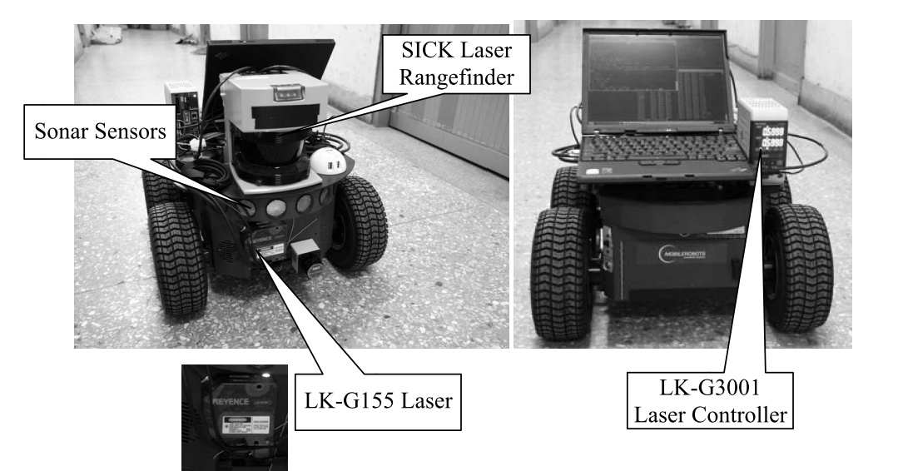
Inspections & Surveys
Pavement and Structures Inspections
Autonomous Robot for Roughness Measurement
source: Measurement of the International Roughness Index (IRI) Using an Autonomous Robot (P3-AT)
Jia-Ruey Chang, Yung-Shuen Su, Tsun-Cheng Huang, Shih-Chung Kang and Shang-Hsien Hsieh, Department of Civil Engineering, National Taiwan University, 2009

Slide 13
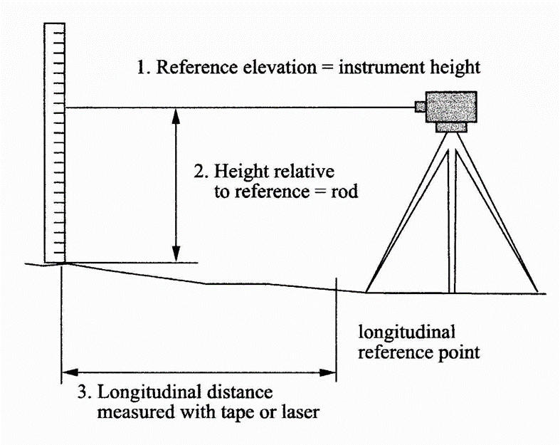
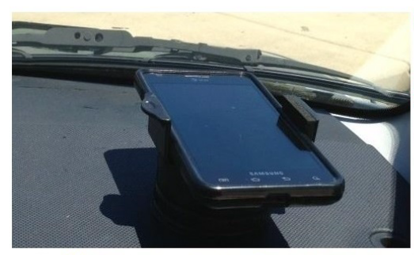
Inspections & Surveys
Pavement and Structures Inspections
Roughness (IRI) Measurement Development
Manually – rod & level
Semi manually - Dipstik
Automated - Laser Profiler
Automated – Smart Phone
Modern smartphones are equipped with a number of sensors including multi-axis accelerometers, GPS, temperature probes, gyroscopes, light intensity sensors, magnetic field sensors, etc.
several hundred thousand $$
thousand $$
Free Android Autonomous Road Roughness Measuring App’s (IRI)
BumpRecorder - BumpRecorder Co Ltd., Japan
RoadBump - Grimmer Software
RoadLab - Developed from the World Bank with Virginia Tech, US
RoaDroid - Roadroid, Sweden

Slide 14
Inspections & Surveys
Pavement and Structures Inspections
Autonomous Robot for Pavement Inspection
uses laser, video, and image processing techniques
can measure cracking, rutting, and longitudinal profile simultaneously, without contact, rapidly and accurately
the data‐processing system can convert the measured data automatically into formats that can be used in the pavement data bank
the robot is capable of inspecting pavement conditions while at the same time planning the upcoming motion path according to the inspection results
this system allows automatic crack recognition that has conventionally only been performed by humans
up to 512 32‐bit microprocessors execute in parallel
source: American Society of Civil Engineers

Slide 15
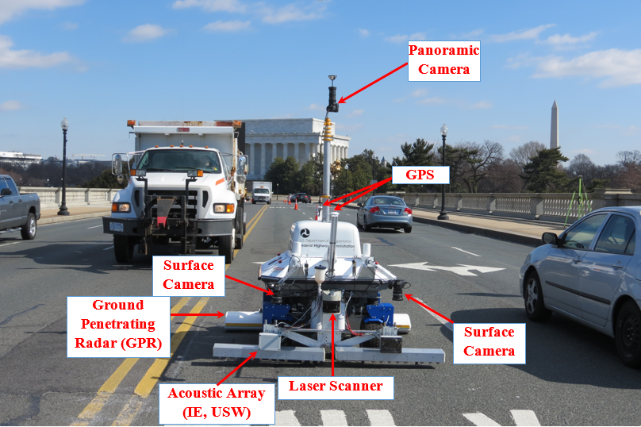
Inspections & Surveys
Pavement and Structures Inspections
Robotics Assisted Bridge Inspection Tool (RABIT)
Developed by scientists at Rutgers University and supported by the Federal Highway Administration (FHWA)

Slide 16
Inspections & Surveys
Pavement Management Systems and not only
New approach - from regular information system to knowledge-based expert systems and AI
Similar systems are already available (not in BG) in the following areas
Traffic monitoring and control
Traffic impact evaluation
Highway analysis and planning
Highway management
source: OECD Workshop on Knowledge-based Expert Systems in Transportation

Slide 17
Inspections & Surveys
Reported expert systems - operational and active use, June 1992
TELMO Timetables Finland
AMTICS – Advanced Mobile Traffic Information & Communications System Japan
Road Traffic Control and Surveillance Japan
Traffic Information System Japan
FRED – Freeway Real-Time Expert System US
ADIS – Accident Information Data System Austria
SAGE – Système expert d’Aide a la Gestion des Embouteillages France
PMS91 – Pavement Management Finland
PAMEX – Pavement Maintenance Management Expert System US
SCEPTRE – Surface Condition Expert for Pavement Rehabilitation US
REHAB – Rehabilitation of Asphalt Concrete Pavement Canada
Pavement Maintenance Management Denmark
source: OECD Workshop on Knowledge-based Expert Systems in Transportation, June 1992

Slide 18
Maintenance
The main goals by robotics and automation is to improve
work productivity and quality
health and safety
planning
process control
reduce labor cost

Slide 19
Maintenance
Examples
US Patent No.: US 6,821,052 B2, Nov. 2004 for
MODULAR, ROBOTIC ROAD REPAIR MACHINE
a combination asphalt/concrete surface repair machine
is a direction-finding, wheeled, transportable vehicle, which is a self-regulating, repair machine, controlled by a complex central computer
technology can also be used to build new roads, racetracks, airport runways, sidewalks, driveways, parking lots, etc.
multiple construction or repair functions are provided within one machine

Slide 20
Maintenance
Examples
Three Dimensional Positioning Automatic Control Asphalt Paver
Mobile Drilling Robot
Mobile Robot for On-site Construction Masonry
Multi-Purpose Mobile Robot for Concrete Surface Processing
Multi-Purpose Mobile Robot for Capable of Traveling along Colum and Beams
A Macro Machine for Large Scale Construction

Slide 21
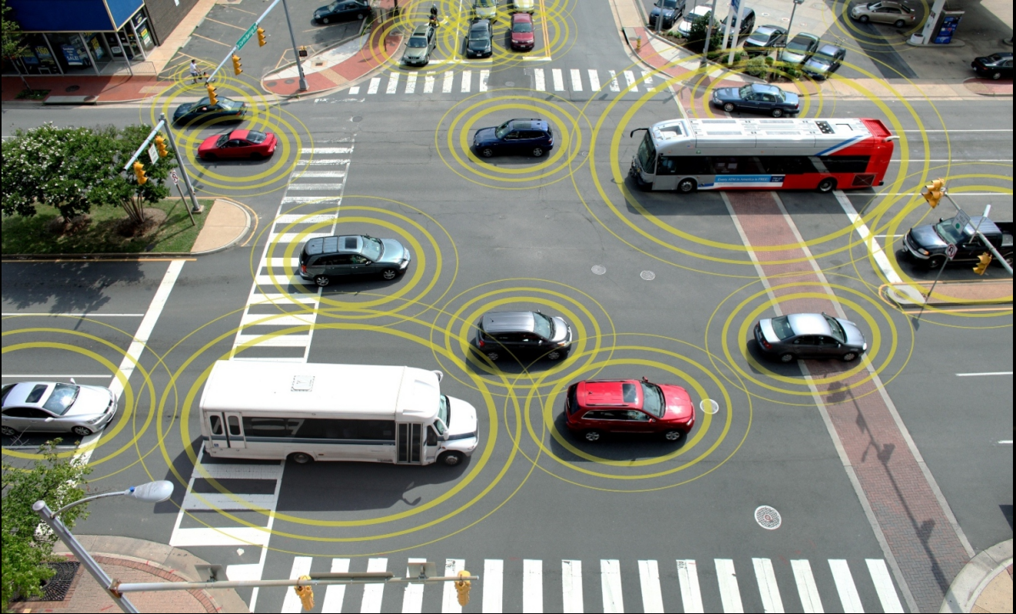
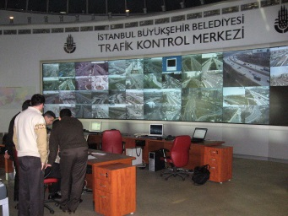
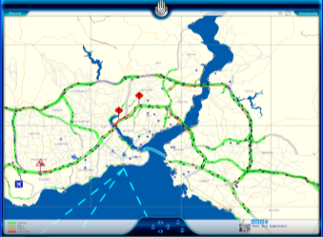
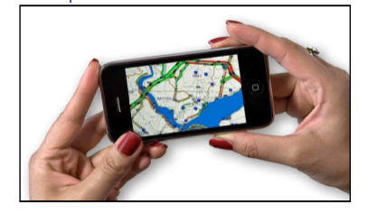
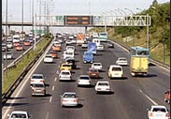
Operation
Smart Infrastructure need and operate with
traffic message channels (TMC)
variable-message signs (VMS)
dedicated short-range communication (DSRC)
traffic management systems to set speed limits and modify signal phase and timing (SPaT)
Internet of Things (IoT)
Bluetooth beacons
5G communication
self-driving vehicles are coming
TMC
web
Mobile
VMS

Slide 22
10X

