Slide 1
This project has received funding from the European Union's Horizon 2020 research and innovation programme under grant agreement No 824990

Slide 2
INDUSTRIAL CHALLENGES
…and how robotics could solve them?

Slide 3
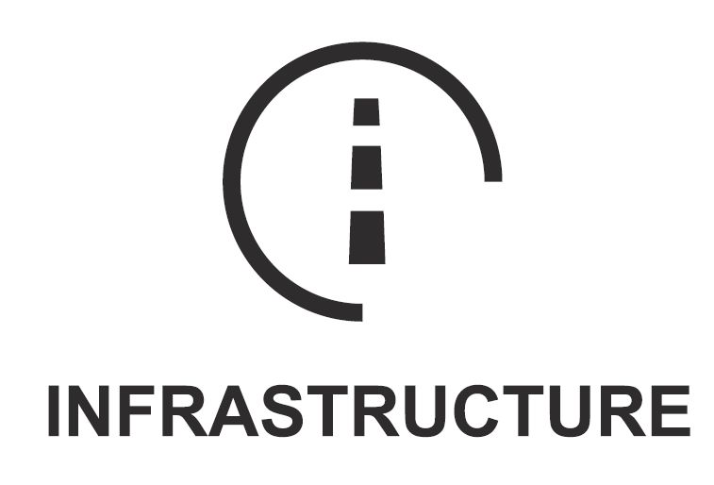
INDUSTRY SECTORS COVERED IN RIMA
Energy generation and distribution
Transport hubs
Includes wind, solar, hydro, coal, and power distribution, covering both off-shore and on-shore infrastructure
Includes large transport hubs like ports, airports and interchanges.
Oil and Gas extraction
Water and waste processing
Refining and distribution infrastructure, including off-shore infrastructure and decommissioning.
Sustainable, safe water infrastructures include clean water, wastewater and storm water infrastructures
Road, rail & civil infrastructure
Nuclear infrastructure
Local transport systems such as trams, track and trackside equipment, bridges, tunnels and roads
rolling stock, stations and geo-physical maintenance
Including decommissioning, waste disposal, maintenance and life extension

Slide 4
Road, rail & civil infrastructure
Road, Rail and Civil infrastructure involve all the road-related and rail-related components that exist inside and outside the cities, as well as any other civil infrastructure within a city
The transportation hubs such as stations, transportation warehouses, ports, airports etc. are not included
The peripheral infrastructure is also included, such as traffic-lights, tolls, tunnels, bridges, lane separation structures, road lights, traffic lights, tunnel fans, power cables, signals and signs.
Three main categories, each one with specific needs and challenges:
Road & rail bridges
Road & rail tunnels
Open road & rail

Slide 5
CHALLENGE #1: INCREASE EFFICIENCY IN THE I&M ACTIVITIES OF CIVIL INFRASTRUCTURE
Current constraints:
Infrastructure is not 100% available to citizens when I&M operations are undertaken
I&M activities need to be undertaken on the outside (exterior) or during the night
I&M activities must be stealthy, especially in urban areas
Manual I&M activities, after an 8-hour shift, lead to low quality results

Slide 6
CHALLENGE #1: INCREASE EFFICIENCY IN THE I&M ACTIVITIES OF CIVIL INFRASTRUCTURE
Development of technologies capable for the following:
Minimize the time that facilities are not available due to I&M activities
Increase cost-efficiency in the accomplishment of I&M activities
Use multi-sensing inspection robots in order to detect defects in different infrastructures
Robotic solutions for approaching unreachable places
Resistance to difficult environmental conditions

Slide 7
CHALLENGE #2: REDUCE RISK FOR WORKERS DURING I&M ACTIVITIES ON CIVIL INFRASTRUCTURES
Typical examples of risks faced by operators:
Need to access and work in high-risk areas such as motorways
Coring or sampling unknown material(s) onsite – Need to preserve the health and safety (H&S)
Difficulty in reaching areas in order to do their job
This challenge is expected to be addressed by:
Increasing supporting tools that will assist the operators during the execution of I&M activities.
Introducing safety resources that will supervise the operators’ activity.
Providing robotic solution that improve safety conditions
Using safety approved devices
Supporting tools and methods for operators during I&M operations.

Slide 8
CHALLENGE #3: ENSURE THAT CIVIL INFRASTRUCTURE IS OPERATIONAL AND SAFE
This challenge aims to involve the following technologies:
Perception technologies to detect defects
Use smart algorithms to process the raw data
Fuse sensor data processing for automating I&M processes
Perform quick detection of defects

Slide 9
CHALLENGE #4: WORKER – MACHINE ON JOBSITE COOPERATION
People are using more and more heavy machinery and automation systems to perform I&M activities on jobsites
High level of autonomy should be reached by each resource in order to cooperate efficiently
This challenge aims to be addressed by the following technologies:
Efficient autonomous navigation and motion planning on jobsites with obstacle avoidance capabilities
Automation tools that follow a predefined path or jobsite cleaning machines that automate repetitive tasks
Task planning, scheduling, and job organization algorithms that can help operators to track any open issues in time

Slide 10
CHALLENGE #5: OPEN (FACILITATING TECHNOLOGIES DEVELOPMENT)
The last challenge refers to:
Generic supporting tools, either robotic or automation system, that is not included in the above challenges
Support the communication of the operators, either among themselves or with their supervisor
Support them in their I&M tasks by providing tools and instructions

Slide 11
Panagiotis Karagiannis | Laboratory for Manufacturing Systems and Automation (LMS)
karagiannis@lms.mech.upatras.gr

