Slide 1
NATIONAL RAILWAY INFRASTRUCTURE COMPANY
Robotics for
Inspection and Maintenance
Sofia Tech Park 04.10.2019

Slide 2
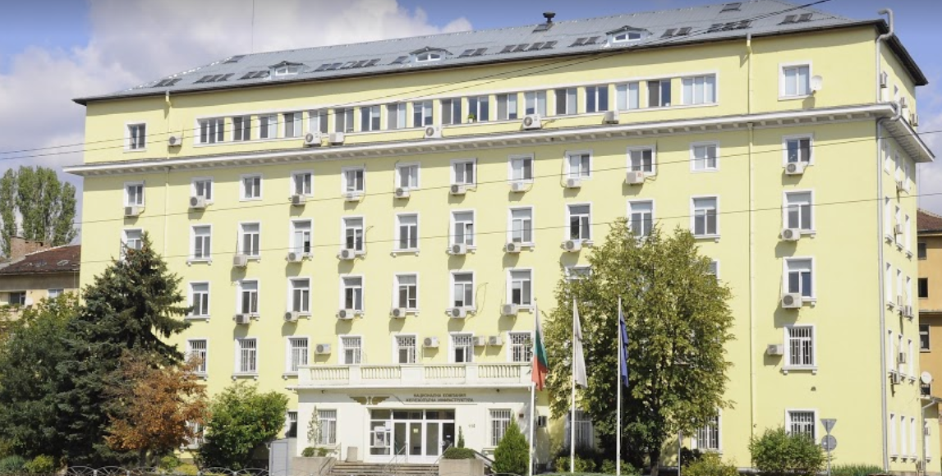
National Railway Infrastructure Company
The National Railway Infrastructure Company (NRIC) was established 1 January 2002.
It is the largest state-owned enterprise and the sole railway infrastructure manager in Bulgaria.
The Company performs its obligations in compliance with a long-term contract with the State. All activities related to railway infrastructure development are governed by this contract.
The Company strives to:
ensure a level playing field for all licensed railway operators;
develop, repair, maintain and exploit the railway infrastructure to ensure transportation safety and secure train movement;
manage train operation in compliance with the safety, reliability and security requirements;
implement investment policy regarding railway infrastructure development, modernisation, maintenance and repair for compliance with the EU standards and criteria;
develop transport links and cooperation with other railway administrations.

Slide 3
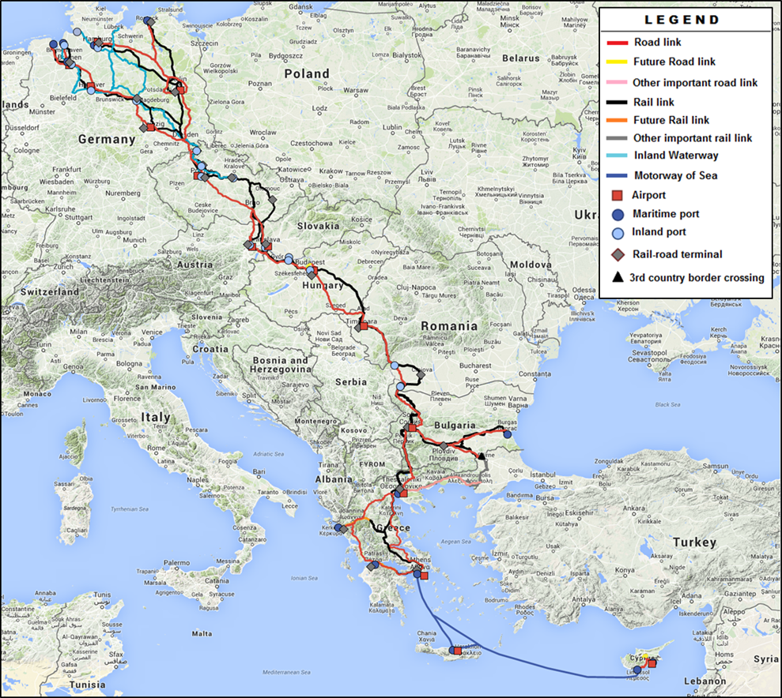
TEN-T on the territory of Bulgaria
Orient/East Med Core Network Corridor
Austria, Bulgaria, Cyprus, Czech Republic, Germany, Greece, Hungary, Romania, and Slovak Republic
5 900 km rail network
5 400 km road network
1 700 km IWW
15 Urban nodes (Sofia)
15 Airports (Sofia)
10 Inland ports (Vidin)
12 Maritime ports (Burgas)
25 Road – Rail Terminals (Sofia & Plovdiv)
OEM direction on the territory of Bulgaria
Vidin-Sofia/Sofia-Plovdiv-Burgas/Plovdiv-Turkish Border/Sofia-Thessaloniki
Rhine-Danube Corridor
The main link between France, Germany, Austria, Slovakia, Hungary, Croatia, Romania and Bulgaria
On the territory of Bulgaria – Danube River only
Notes:
Коридор Западни Балкани ?

Slide 4
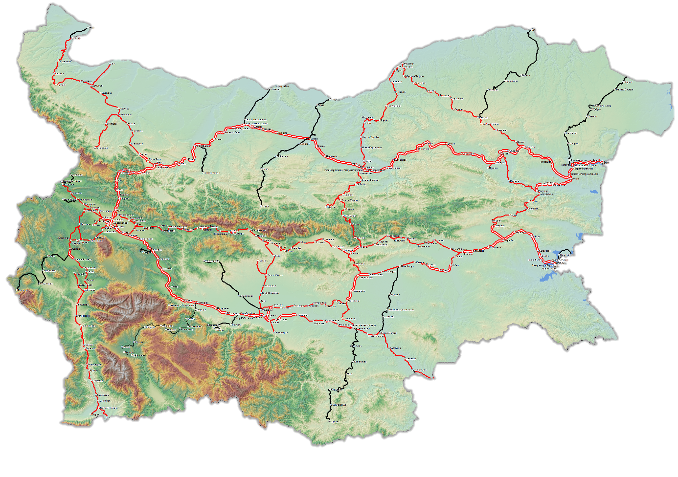
Railway lines in Bulgaria
Craiova
Romania
Bucharest
Constanta
Serbia
Niš
Black Sea
North Macedonia
Legend:
Type of station Railway line
Station double, electrified Halt single, electrified not electrified
track gauge 760 mm
Edirne
Alexandroupoli
Thessaloniki
Greece
Turkey
Notes:
Обща разгъната дължина на железния път – 6458 km

Slide 5
National Railway Infrastructure Company
Railway infrastructure in Bulgaria has the following characteristics:
Total length of railway | 6 460 km, incl.
Single track with standard gauge (1435 mm) | 3 905 km
Double track with standard gauge | 990 km
Station tracks with standard gauge | 1 412 km
Electrified railway lines | 70 %
Single track with gauge (760 mm) | 125 km
Station tracks with gauge (760 mm) | 13 km
Station tracks with gauge (1520 mm) | 15 km
Railway level-crossings | 757
Tunnels with standard track gauge (1435 mm) - 145 with total length of: | 44 862 m
Tunnels with track gauge (760 mm) - 41 with total length of: | 3 068 m
Railway bridges with standard track gauge - 995 with total length of: | 43,1 km
Stations - 281 and sectional posts - 17 | 298
Borderline transitions | 7
Ferry connection at Varna Port | 1

Slide 6
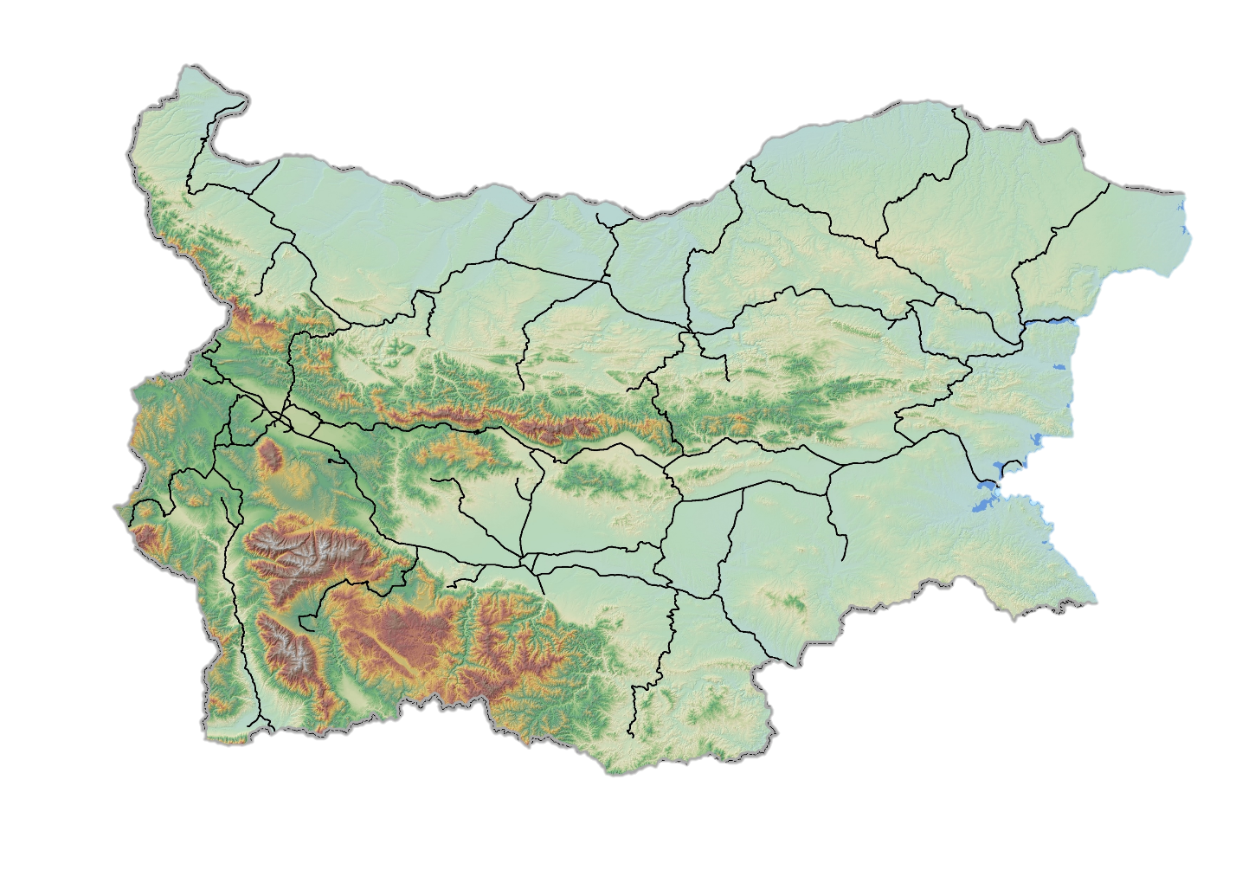
Expert staff involved in projects management
Personnel 11 751 employees
Headquarters 482
Regional Structures
Sofia 4 115
Plovdiv 3 687
Gorna Oryahovitza 3 467

Slide 7
Organisational Structure of Management
MANAGEMENT BOARD
Human Resources Management Department
Legal Department
Classified Information and Internal Security Department
DIRECTOR GENERAL
Public Relations and Protocol Department
Financial Supervisor
Financial control and internal auditing Department
International Affairs Department
Chief Safety Inspector
Deputy Director General Exploitation
Deputy Director General Strategy and Administration
State Property Management and Cadaster Department
Safety Inspectorate
Budget, Finance and Information Systems Directorate
Public Procurement and Administrative Services Directorate
Department for
Programme Implementation with National Financing
Management of Trains and Network Capacity Division
Permanent Way and Structures Division
Strategic Development and Investment Projects Directorate
Headquarters
Project Management and Implementation Units
Division level
Signaling and Telecommunications Division
Power Distribution Division
Professional Training Center
Regional level
Regional division Sofia, Gorna Oryahovitsa, Plovdiv
Railway sections – Sofia, Gorna Oryahovitsa, Plovdiv, Vratsa, Burgas, Shumen
Production level
Railway Stations
Railway Sections

Slide 8
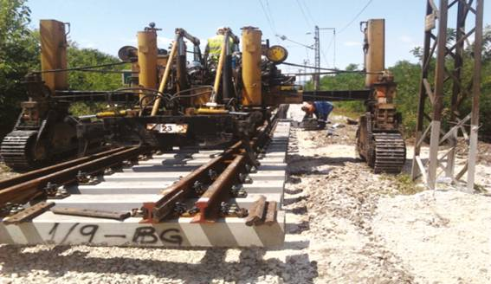
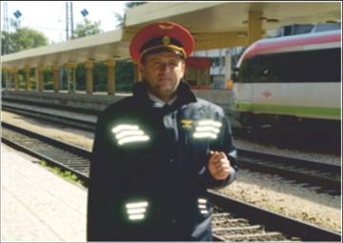
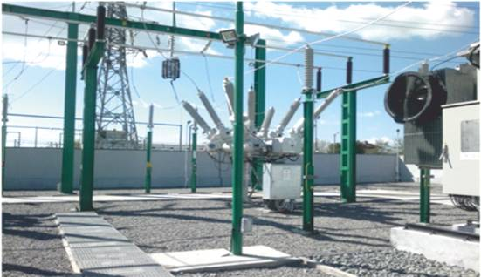
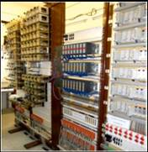
Divisions activities
Permanent Way and Structures Division manages the activities of maintenance and repair of the permanent way and structures.
Train Traffic and Capacity Management Division performs functions in relation to the use of railway infrastructure by licensed operators.
Power Distribution Division organizes, coordinates and controls the activity of traction electricity distribution.
S&T Division ensure the management and safety of train movements in accordance with national and European requirements.

Slide 9
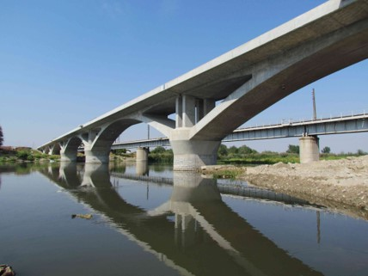
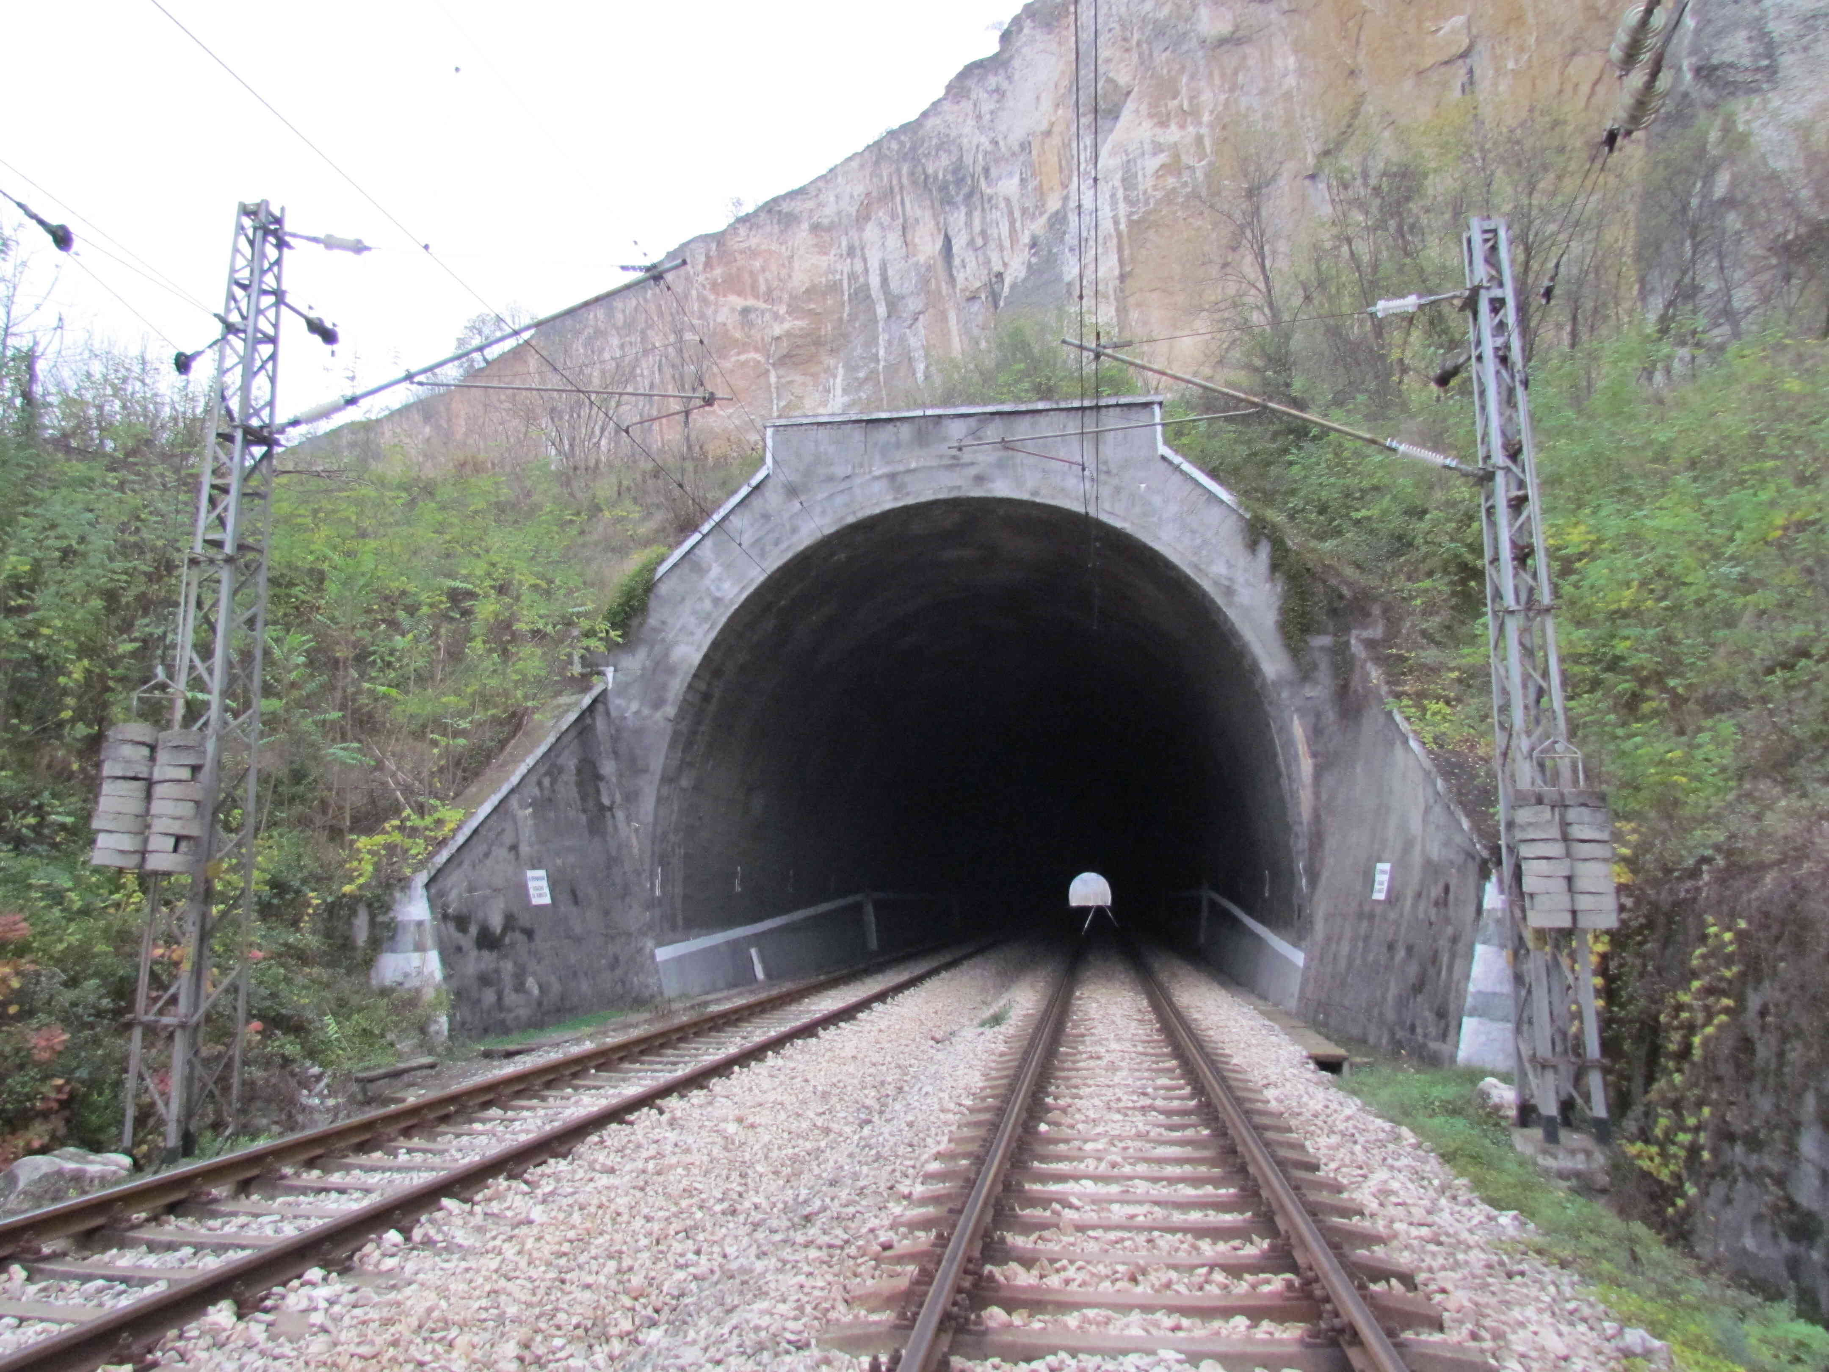
Activities within the competence of
“Permanent Way and Structures division”
natural subgrade (in excavation or embankment, protective layer, drainage facilities)
substructure facilities (bridges, culverts, tunnels, protection and retaining walls)
rails, rail connections and fastenings
sleepers
ballast bed, monolithic base
elements of the super
structure (turnouts and
track connections)

Slide 10
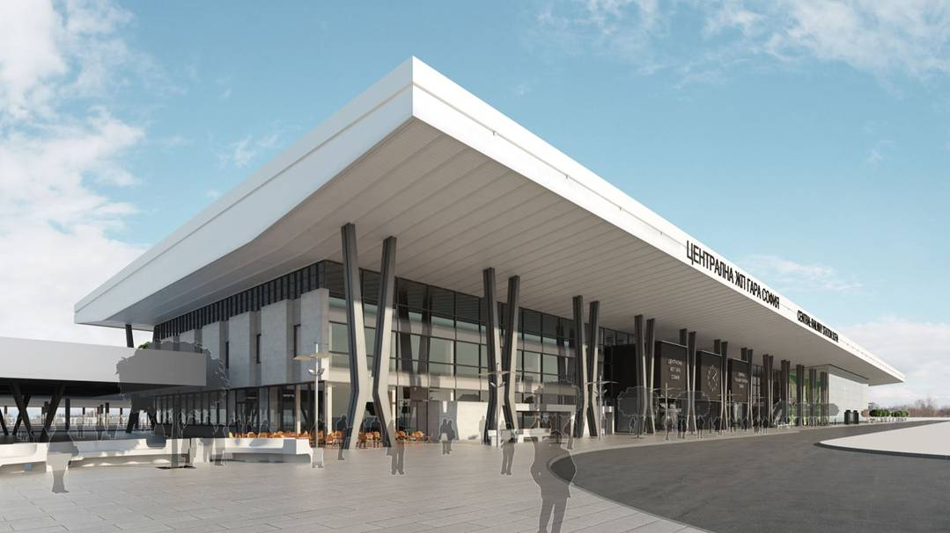
Activities within the competence of
„Management of Trains and Network Capacity division“
stations
stations buildings
platforms
pedestrian underpasses and overpasses

Slide 11
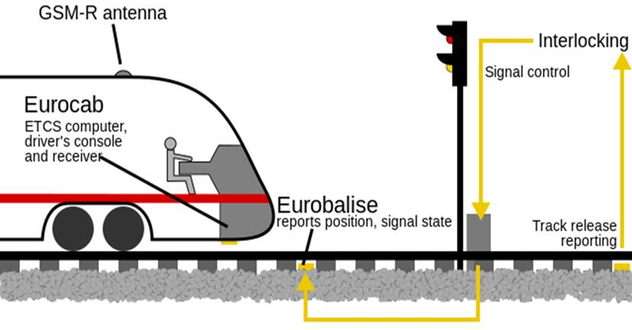
Activities within the competence of „Signaling and Telecommunications division“, part Security Equipment
Computer interlockings at the stations
ETCS – European Train Control System, Level 1, version 2.3.0 d
auto block system with axle counters without passable semaphore signals
Semaphore signals with LED optics
Electric turnout equipment - non-cutting type with external lock

Slide 12
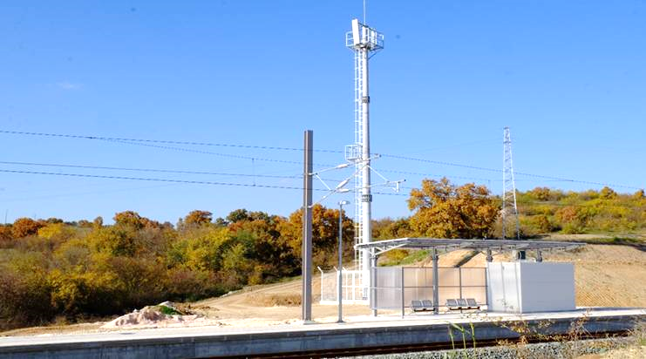
Activities within competence of
„Signaling and Telecommunications division“,
part Telecommunications and non-traction supply
optical network and data transfer
electronic automatic telephone exchanges
telecommunication networks for the voice messages transfer
GSM-R – Global System for Mobile Communications
heating of all interlockings turnouts
defective current control circuits
lighting in the stations

Slide 13
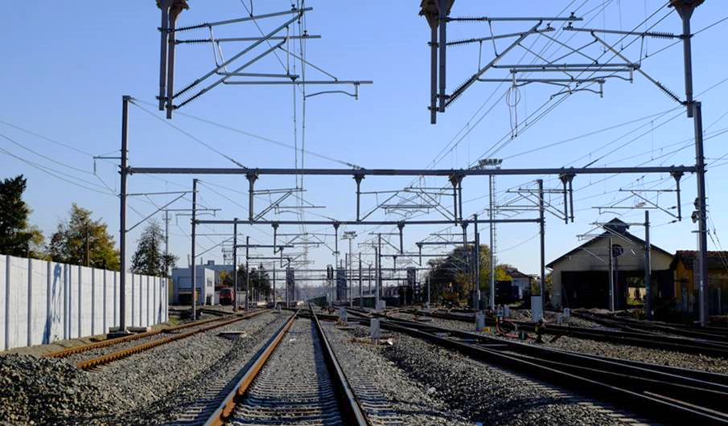
Projects within the competence of
„Power Distribution division“,
part Traction power and traction substations
power lines 110 kV
traction substation 110/25 kV remote control type of SCADA
sectional posts
catenary 25 kV, 50Hz
isolator, cathode-drop arrester, disconnectors
power stations
feeders and groundings

Slide 14
Some projects in development
NATIONAL RAILWAY INFRASTRUCTURE COMPANY

Slide 15
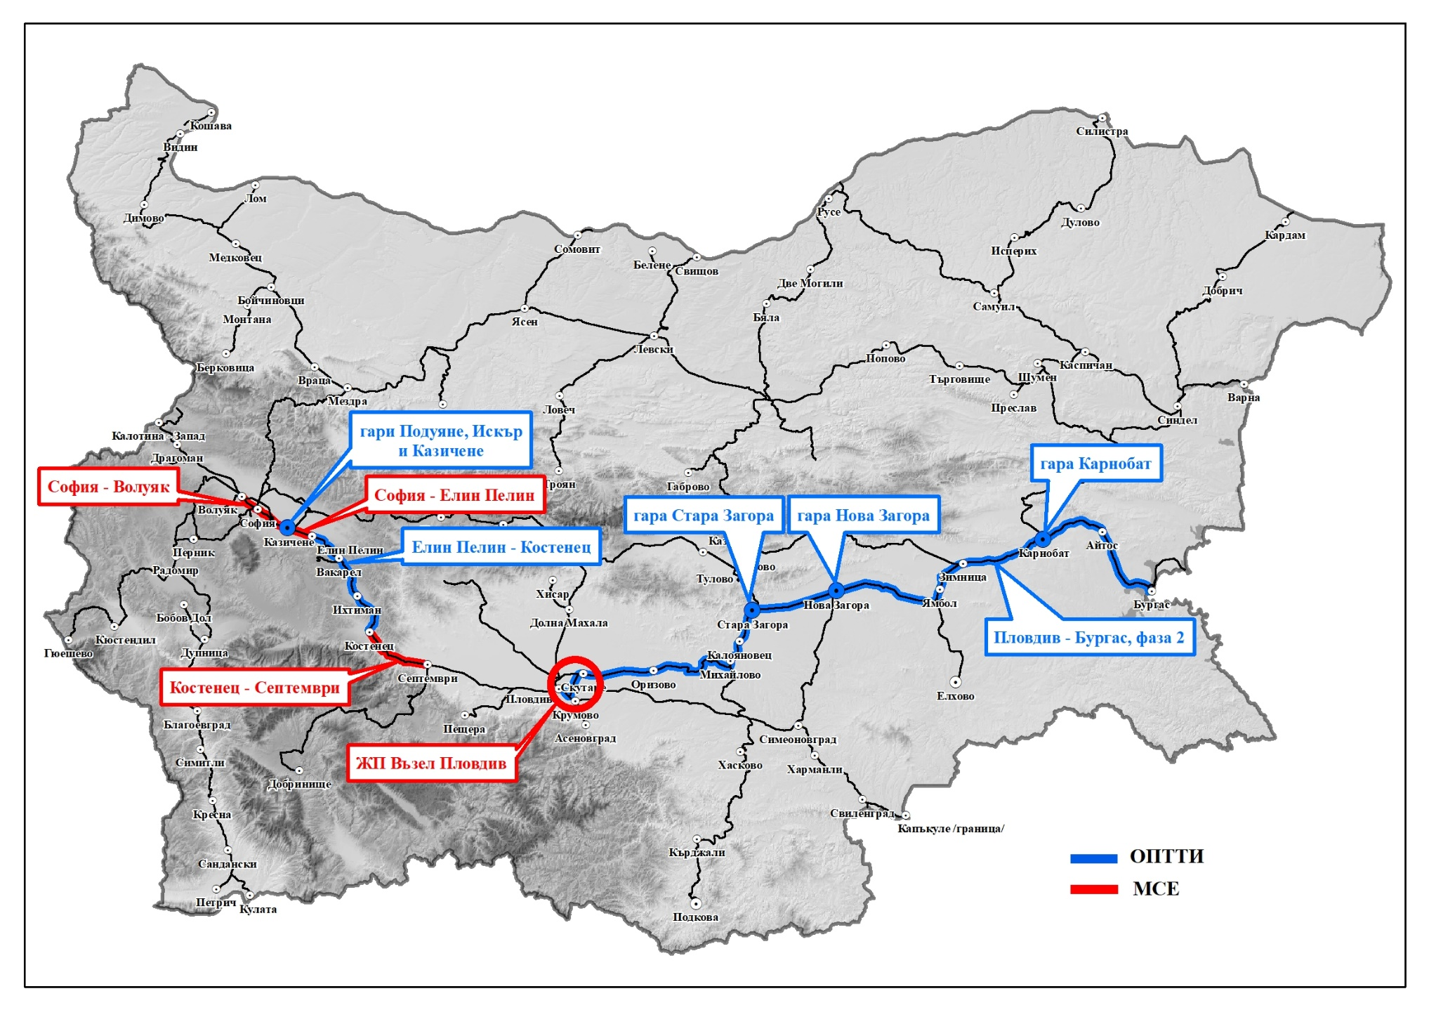
Investment projects of NRIC in process of implementation, financed under ESIF
Stations Poduyane, Iskar and Kazichene
Karnobat Station
Sofia-Voluyak
Sofia-Elin Pelin
Stara Zagora Station
Nova Zagora Station
Elin Pelin-Kostenets
Plovdiv–Burgas, phase 2
Kostenets-Septemvri
Plovdiv node
CEF projects
Projects OPTTI 2014-2020
Notes:
Voluyak – Dragoman

Slide 16
EU Grant for OPTTI
Financing source | Indicative value (EUR)
Priority axis1 OPTTI - Development of railway infrastructure along the major national and Pan-European transport axes | 673 355 778
Priority axis 2 OPTTI - Development of the road infrastructure along the “core” and “comprehensive” TEN-T; | 673 355 776
Priority axis 3 OPTTI - Improvement of intermodality for passenger and freight | 419 182 901
Priority axis 4 OPTTI - Innovation in management and services - implementation of modernized infrastructure for traffic management, improving safety and security of transport | 74 053 597
Priority axis 5 OPTTI Technical Assistance | 47 668 162
Total co-financed projects under OPTTI | 1 214 260 438‬

Slide 17
Some projects financed under OPTTI 2014-2020
Project | Stage of implementation | Indicative value (EUR)
Rehabilitation of Plovdiv - Burgas railway line - Phase 2 | Construction of railway sections Straldzha-Tserkovski (completed) and Skutare-Orizovo (completed) Currently in tender procedures for other activities of the project such as Signalling and telecommunications; Overpasses and underpasses; for more info: https://www.rail-infra.bg/ | 345 122 100
Modernization of railway line Sofia - Plovdiv: Elin Pelin - Kostenets section | Currently in tender procedure Contract is expected to be signed by: January 2020 | 554 240 528
Reconstruction of station complexes: Poduyane, Iskar, Kazichene, Stara Zagora, Nova Zagora and Karnobat | Contracts signed for projects Poduyane, Iskar, Kazichene and Karnobat (in process of implementation), in tender procedures Stara Zagora & Nova Zagora | 13 293 592
Modernization of Sofia - Dragoman - Serbian border railway line, section Voluyak - Dragoman | In tender procedure. Deadline for offers submission: 21.11.2019. For more info: https://www.rail-infra.bg | 177 393 543
Design and implementation of systems for train control in the state enterprise National Railway Infrastructure Company, including systems for monitoring and controlling of the parameters of the rolling stock in motion | In tender procedure. Deadline for offers submission: 30.09.2019. For more info: https://www.rail-infra.bg | 9 123 333

Slide 18
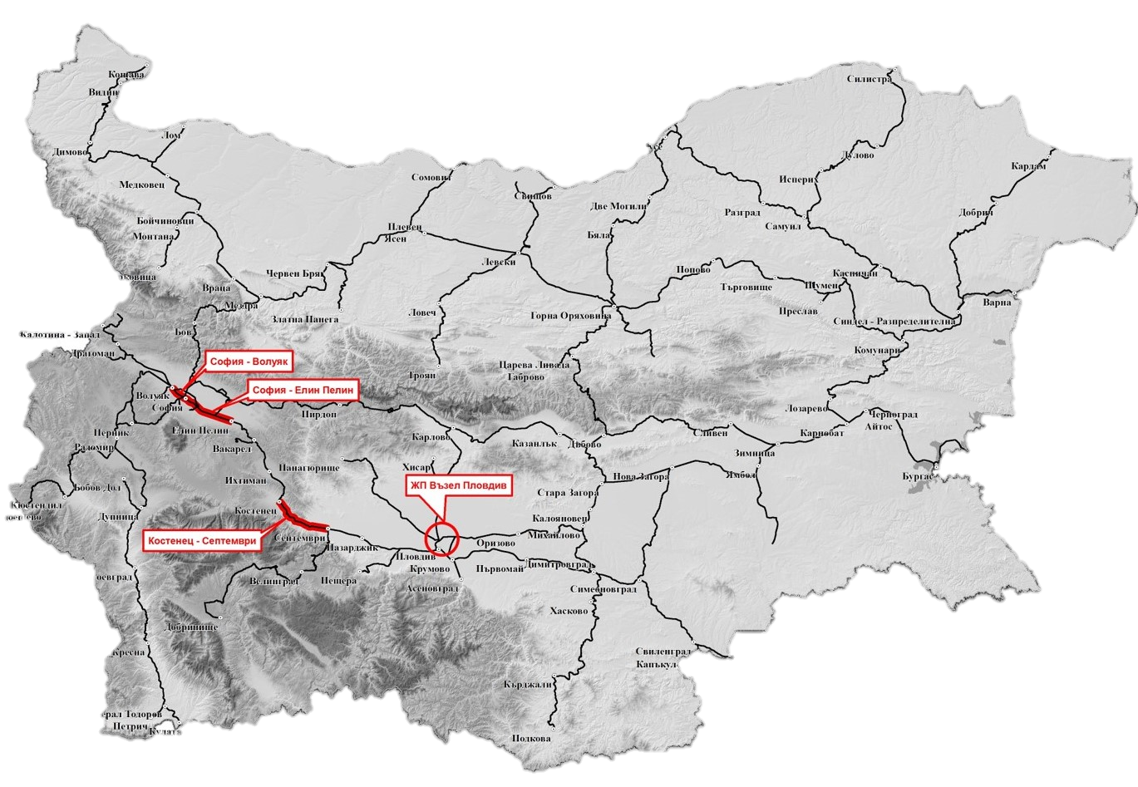
CEF investment projects
Sofia-Voluyak
Sofia- Elin Pelin
Sofia-Elin Pelin
Plovdiv node
Kostenets-Septemvri

Slide 19
Projects under implementation financed under CEF
Project | Stage of implementation | Value (EUR)
Modernization of railway line Sofia-Plovdiv: railway section Sofia - Elin Pelin | Construction (50%) | 61 538 462
Development of Sofia Railway Junction: Sofia - Voluyak railway section | In tender procedures Deadline for awarding of contract: December 2019 | 104 303 568
Modernization of railway line Sofia- Plovdiv: railway section Kostenets - Septemvri | Contract signed: 12 August 2019; In design stage | 194 288 648
Development of Plovdiv railway node | In tender procedure For more info: https://www.rail-infra.bg/ | 103 280 984
Better railway infrastructure projects through better knowledge | Completed | 311 821
From East 2 West. Access to the OEM Corridor through the Core port of Burgas | - | 2 670 000

Slide 20
Integrated Intelligent Transport Systems and digitalization at NRIC
NATIONAL RAILWAY INFRASTRUCTURE COMPANY

Slide 21
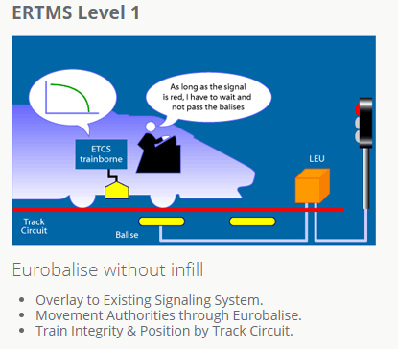
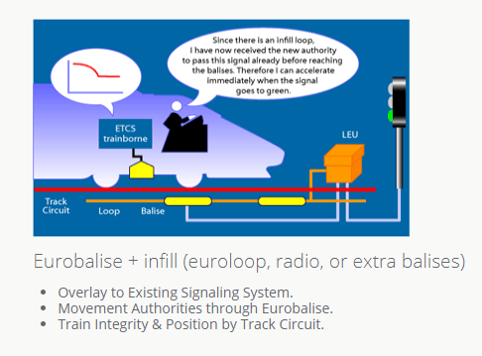
Integrated Intelligent Transport Systems and digitalization at NRIC
ERTMS has two basic components:
ETCS, the European Train Control System, is an automatic train protection system (ATP) to replace the existing national ATP-systems;
GSM-R, a radio system for providing voice and data communication between the track and the train, based on standard GSM using frequencies specifically reserved for rail application with certain specific and advanced functions.
ERTMS aims at replacing the different national train control and command systems in Europe. The deployment of ERTMS will enable the creation of a seamless European railway system and increase European railway's competitiveness.

Slide 22
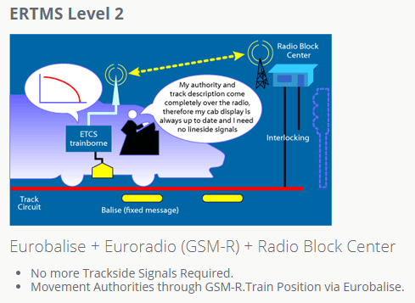
Integrated Intelligent Transport Systems and digitalization at NRIC
ERTMS brings considerable advantages:
Increased capacity
Higher reliability rates
Open supply market
Improved safety
Why does Europe need ERTMS?
Currently there are more than 20 train control systems across the European Union. Each train used by a national rail company has to be equipped with at least one system but sometimes more, just to be able to run safely within that one country. Each system is stand-alone and non-interoperable, and therefore requires extensive integration, engineering effort, raising total delivery costs for cross-border traffic. This restricts competition and hampers the competitiveness of the European rail sector vis-à-vis road transport by creating technical barriers to international journeys.

Slide 23
ERTMS development in Bulgaria
Railway sections Sofia – Septemvri and Plovdiv - Stara Zagora sections - equipped with the EBICAB - 700 system (TSI CCS Annex B) - linear length 184 km;
Railway sections Plovdiv node and Stara Zagora – Burgas – equipped with ETCS Level 1 (SRS ver. 1.2.0 / 1998) - linear length 233 km;
Railway section Plovdiv – Svilengrad – equipped with ETCS Level 1 (SRS ver. 2.3.0d) and GSM-R for voice communication - 143 km;
Railway section Septemvri – Plovdiv – equipped with ETCS Level 1 (SRS ver. 2.3.0d) - linear length 53 km
Railway section Sofia – Plovdiv – equipped wit GSM-R for voice communication – linear length 155 km;
Automatic velocity control system for trains (ALS – Automatic locomotive signalling) railway direction Sofia – Plovdiv – Stara Zagora – Burgas;
Railway section Plovdiv - Stara Zagora (without Plovdiv node) it is equipped with balises, produced by ZAT- Sofia , type of balises suitable for JZG 703 system.
Railway section Stara Zagora - Burgas and Plovdiv node are equipped with an ETCS level 1, name ALTRACS BDZ. The system provider is ALCATEL, Austria, the project is funded by PHARE;
Railway line Plovdiv - Svilengard-Turkish/Greek borders - implementation of ERTMS (ETСS Level 1 + GSM-R).
Integrated Intelligent Transport Systems and digitalization at NRIC
Source: NATIONAL IMPLEMENTATION PLAN
of the technical specification for interoperability
on the Control-Command and Signaling Subsystems
of the rail system in the European Union

Slide 24
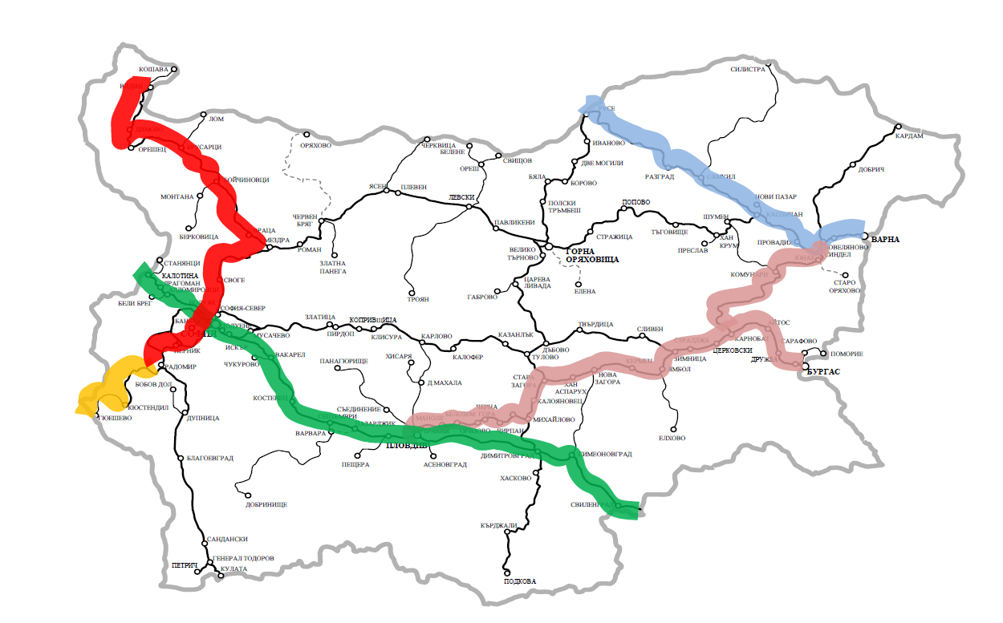
Integrated Intelligent Transport Systems and digitalization at NRIC
Main directions part of the ERTMS deployment plan
Vidin-Sofia-Radomir – ETCS level 1 + GSM-R
Kalotina – Sofia – Plovdiv – Svilengrad - Kapalkule – ETCS level 1 + GSM-R
Plovdiv - Karnobat – Burgas / Sindel ETCS level 1 + GSM – R
Ruse – Varna ETCS level 1 + GSM- R
Radomir - Gyueshevo ETCS level 1 + GSM-R
Source: NATIONAL IMPLEMENTATION PLAN
of the technical specification for interoperability
on the Control-Command and Signaling Subsystems
of the rail system in the European Union

Slide 25
Integrated Intelligent Transport Systems and digitalization at NRIC
Resource Planning and Management System (SAP ERP)
In 2015, NRIC implemented a Resource Planning and Management System (SAP ERP).
RPMS integrates the functions of the old specialized systems for finance, purchase, repair and maintenance of the railway infrastructure, human resources, production, warehouse and replaces them with a single integrated software system, logically divided into modules operating on a single database.
Module controlling (CO)
Module Material Economy (MM)
Maintenance and repair module (PM)
Sales and distribution module (SD)
Financial Management module (FM)
Project Management module (PS)
Human Resources Management module (HR)
Finance module (FI / FIAA)
Reporting information system (BW)
Document management system (DMS)
The goals achieved with the introduction of RPMS are:
Improving the efficiency and effectiveness of the management of SE NRIC in planning and implementing investment projects, as well as accelerating the process of project implementation.
Achieving transparency in the management of SE NRIC and introducing good business practices;
Improvement of management and control over resources and optimization of the processes for maintenance and operation of the constructed railway infrastructure.

Slide 26
Integrated Intelligent Transport Systems and digitalization at NRIC
Geographic information system (GIS)
In 2010 the NRIC has implemented a Geographic Information System (ArcGIS ESRI).
GIS provide an integrated solution to the problems related to the improvement of the efficiency and effectiveness of the work of the NRIC, the ability to consolidate all data related to the objects, facilities and material assets of the NRIC into a single database and update the available information related to them, and all facilities, objects and tangible assets, buildings and properties should be accessible on an electronic map, depending on their location.
This system helps to operate and manage the resources of NRIC, as well as to make decisions related to the design and extension of the railway network. GIS for SE NRIC was designed and implemented with Centralized Architecture, which means creating and maintaining a centralized database and providing on-line access for all users to the functions and capabilities of the system. With GIS for NRIC work over 200 users, as the system has been developed with the following subsystems and modules:
Subsystem „Permanent way”;
Subsystem „Cadastre and property register”;
Module „ Digital drawing archive”;
Module „ Administration”;
WEB Module.
The goals achieved with the introduction of GIS are :
Development and validation of intelligent transport systems;
Specialized railway asset management systems have been developed;
A register for inventory of railway infrastructure assets has been prepared, which is a prerequisite for concluding MACs (multiannual financing contracts) and infrastructure maintenance;
Improved efficiency and effectiveness in managing railway infrastructure;
Collaboration between individual NRIC departments and directorates facilitated.

Slide 27
Integrated Intelligent Transport Systems and digitalization at NRIC
Geographical information system (GIS)
Web module
Subsystem
„Permanent way”
Subsystem
„ Cadastre and property register”
Digital Drawing Archive module
Administration module

Slide 28
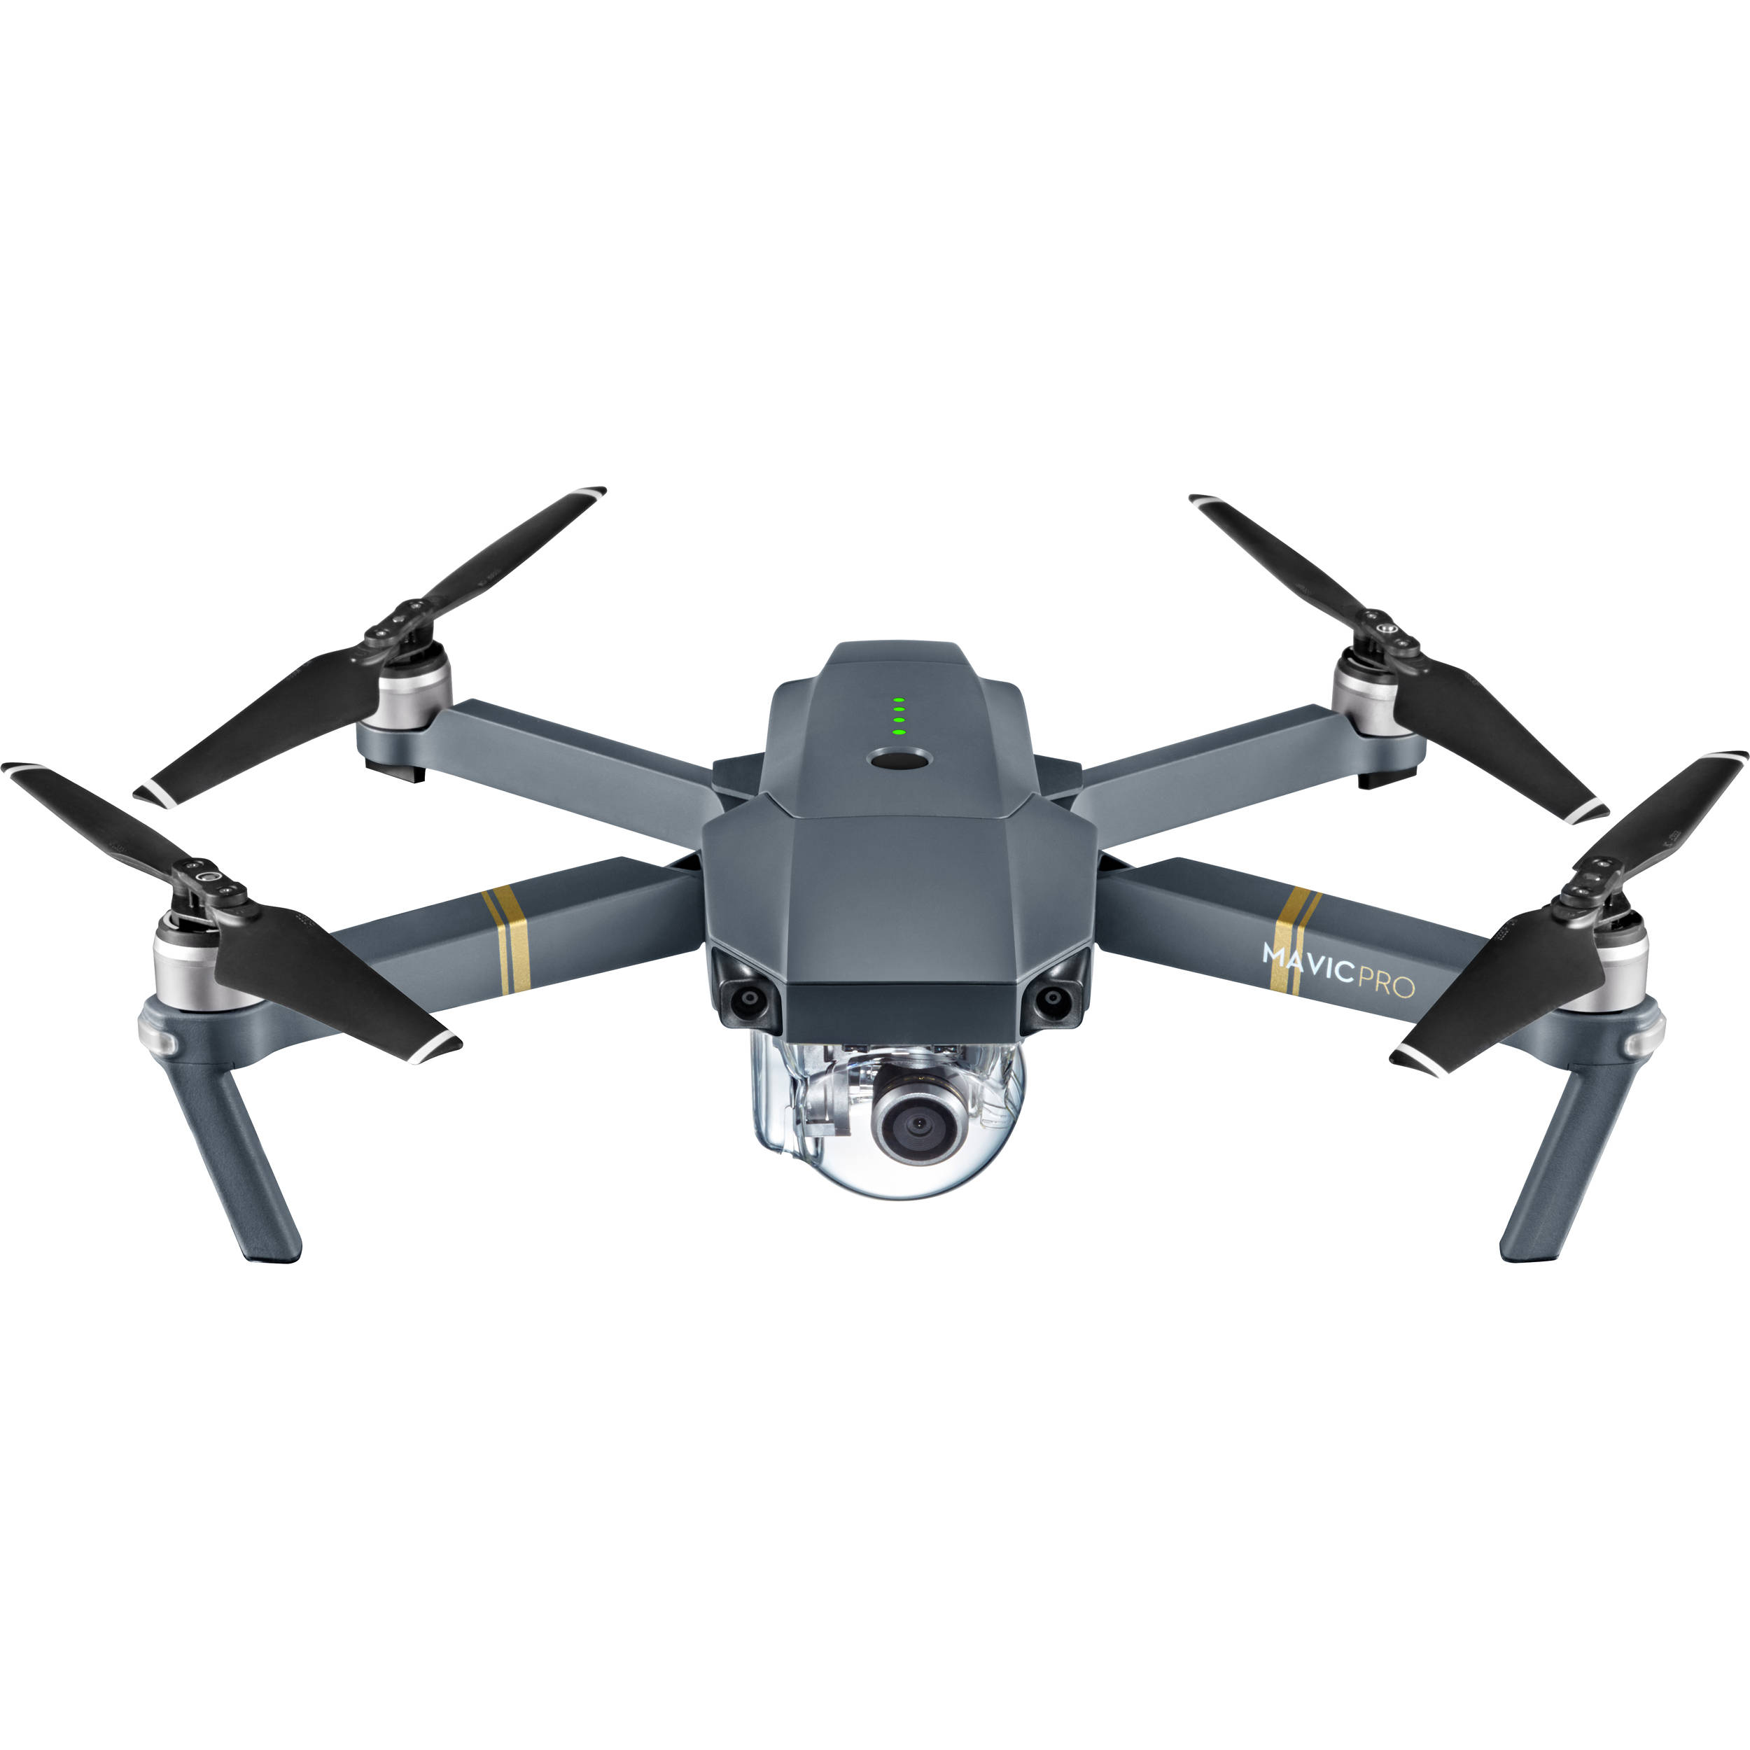
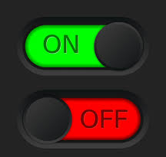
Integrated Intelligent Transport Systems and digitalization at NRIC
Problems and challenges that could be solved by automating and dropping
manual labor or human intervention
Such problems and challenges faced by NRIC are currently:
inspection of the catenary - done by drone from the air;
automation of railway repair and renewal processes;
periodic control of the railway infrastructure – done by drone from the air;
automatic switching on and off of lighting in stations, especially platforms.

Slide 29
THANK YOU FOR YOUR ATTENTION!
www.rail-infra.com

