Slide 1
First Open Call Presentation

Slide 2
to support SMEs/mid-caps by facilitating access to manufacturing digitalization
BOWI 1st Open Call
1.44 M€ among 24 experiments from 6 regions
Propose ambitious projects and receive a sub-grant for conducting technology transfer experiments
Become part of an international community dedicated to cooperate for achieving technological breakthroughs

Slide 3
What is in it for SMEs and mid-caps?
Up to €60k per experiment
Technical support
Access to specific facilities and infrastructure
10-month duration

Slide 4
What technologies should experiments address in Bulgaria?
Low energy computing powering CPS
Cyber-physical and embedded systems
Internet of things
Flexible and Wearable Electronics
Advanced or High-performance computing
Robotics for manufacturing
Additive manufacturing technologies
Modelling and simulation
CPS for manufacturing
Digital twins, data sharing, autonomous factories
Cloud computing
Artificial Intelligence

Slide 5
Eligibility Criteria 1/2
Types of beneficiaries: SMEs¹ or mid-caps²
Established in any of the following EU regions:
Nord-Vest, NUTS code: RO11, Romania,
Latvia, NUTS code LV0 (all regions)
Jihozápad, NUTS code: CZ03, Czech Republic
Małopolskie, NUTS code: PL21, Poland
Yugozapaden, NUTS code: BG41, Bulgaria
Trøndelag, NUTS code: NO06, Norway.
Technology focus
TRL Level: TRL5-7
¹ The criteria which define an SME are:
Headcount in Annual Work Unit less than 250 and annual turnover less than or equal to 50 million € or annual balance sheet total less than or equal to 43 million €.
² Middle-capitalization company or mid-cap is an enterprise that is not an SME and that has up to 3,000 employees, knowing that the staff headcount is calculated in accordance with Articles 3 to 6 of the Annex to Commission Recommendation 2003/361/EC.

Slide 6
Eligibility Criteria 2/2
Applications must be written in English
Multiple submissions are not allowed
Online submission system
Deadline: 15/09/2020 13:00 CEST (Brussels time)
Absence of conflict of interest
Other requirements related to EU legal provisions and IPR
Detailed information GfA section 3

Slide 7
What can be funded?
An experiment is a collaboration project between an SME, proto-hub and mature hub that aims at translating a prototype/proof of concept into a first demonstration in a relevant operational industrial environment.
It can be focused both a product, as well as a manufacturing technology. These experiments will allow SMEs and midcaps to test the use of the technologies offered by the consortium and build a sustainable collaboration mechanism between DIHs from different regions.

Slide 8
Eligible costs
Personnel costs
Mobility
Other costs such as consumables and subcontracting*
Overheads (25% of total costs excluding subcontracting)
Funding rate 70% (H2020 rule for profit organization)
Total funding from BOWI: 60,000€
*Costs for subcontracting or consumables costs need to be clearly explained in the application form and linked to the experiment activities.

Slide 9
How to apply?
Deadline: Tuesday, 15th of Sept 2020 at 13:00(CEST, Brussels time)
Online tool: http://bowi-first-open-call-for-cross-border-experiments.fundingbox.com
In case of questions contact us bowi.helpdesk@fundingbox.com

Slide 10
DIHs Support to Experiments
Each experiment will get both technical and business-related support from the proto-hubs during the 10 months’ experiment.
Mentors will be nominated for each experiment as follows:
1) Technologist in Residence (TiR) for technological support and
2) Entrepreneur in Residence (EiR) for business support.
Moreover, beneficiaries will get access to training sessions offered by the BOWI network partners.
The ways and schedule of communicating between experiments and mentors.
The support that the experiment will receive from local DIH and in some cases from nominated mature DIH.
Support can include, for example:
Access to innovation infrastructure
Access to consultancy in funding
Technology training and consultancy
IPR training and consultancy
Advice in safety and ethical issues
Contacting and networking
Advice, support, and tools regarding project management
Experiment’s Milestones, Deliverables, and KPIs.ent here

Slide 11
Application process
Support Programme
Check eligibility criteria
Submit before Sept 15th, 2020
Online submission
Evaluation in September/October
Selected applicants contacted in November
Starting end of 2020
Up to 10 months
Technology implementation
Technical & Business mentors

Slide 12
Application Process

Slide 13
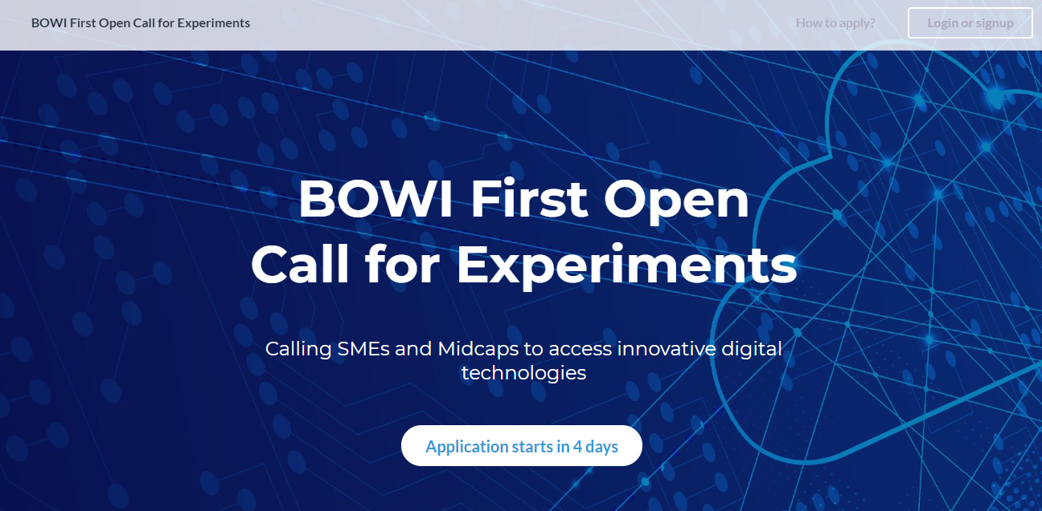

Slide 14
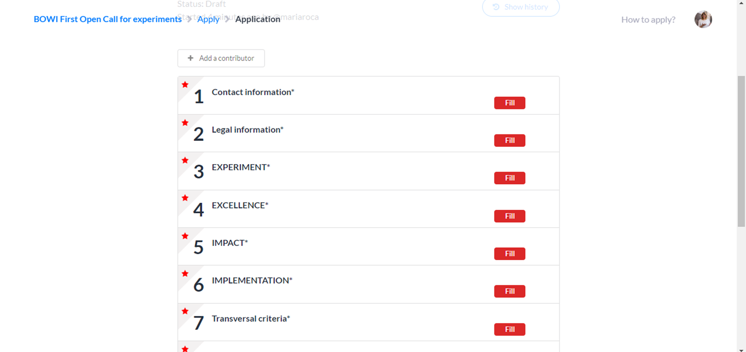

Slide 15
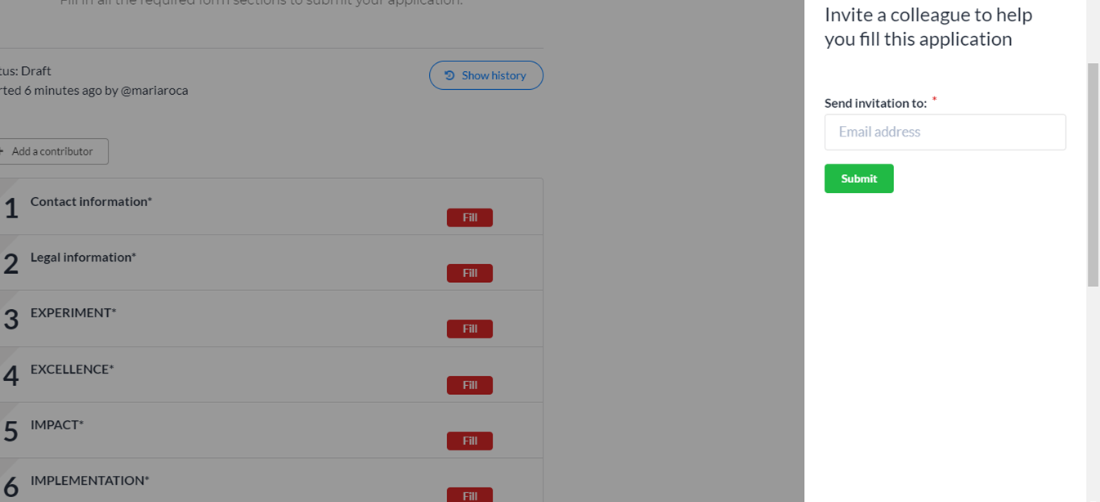

Slide 16
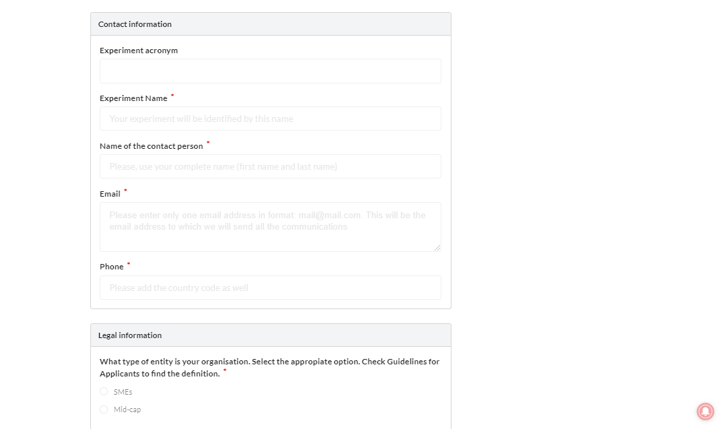

Slide 17
Phases of the selection process

Slide 18
Eligibility check
FBA will check eligibility criteria included in section 3
SMEs and midcap
Region
Technology focus
TRL
Legal statements

Slide 19
Experts’ evaluation
3 Criteria are scored from 0-5
1 Criteria to give additional point to the technologies selected per each region
Average scores

Slide 20
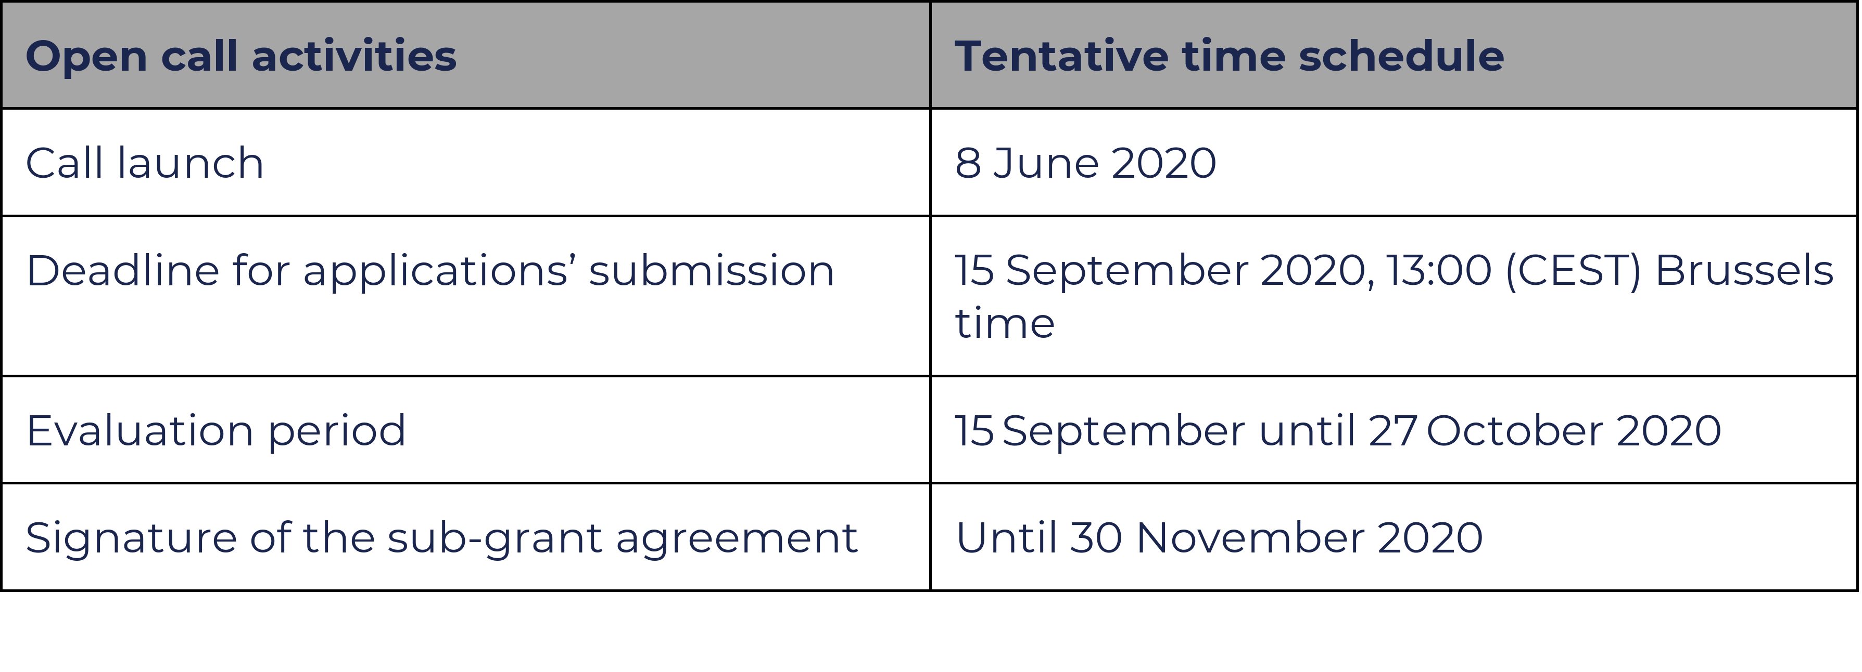
Tentative timeline

Slide 21
Questions? bowi.helpdesk@fundingbox.com

Slide 22
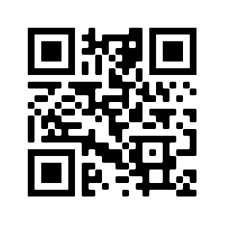
Thank you!
Visit our website for details

