Slide 1
The Advanced Manufacturing Support Centre
Opportunities for European manufacturing SMEs to transform towards Factories of the Future
Paul Peeters
Sr. Expert Advanced Manufacturing
www.agoria.be www.adma.ec
This project has received funding from the European Commission’s Executive Agency for Small and Medium-sized Enterprises (EASME) under Service Contract GRO-SME-17-C-063

Slide 2
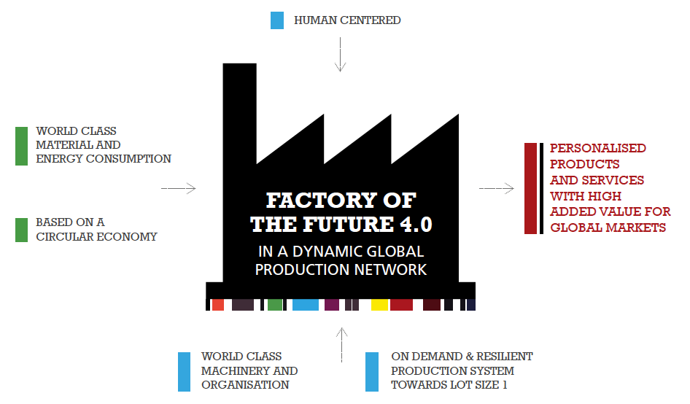

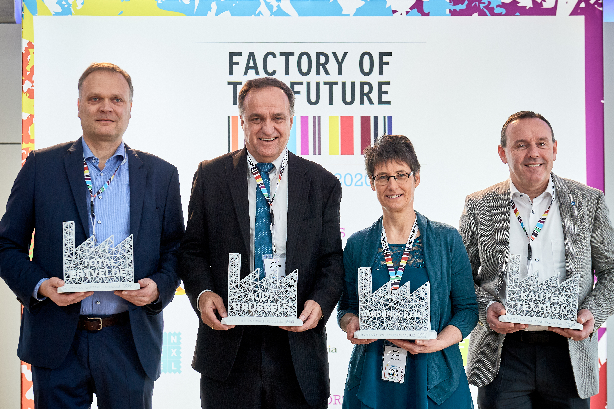
Factory of the Future : what’s in a name?

Slide 3


5
different production steps integrated into one machine
Factories
of the Future
target real
step change implementations
200
new products in production every year, with a First Pass Yield level of
>95%
Reduction from
7 to 3 days
in production throughput time
Notes:
Paul
Efficiency improvements mainly have happend through a combination of a better work organisation, digital support tools and smart automations.
Production throughputtime reduction in most cases is the result of a Quick Response Manufacturing focus.

Slide 4




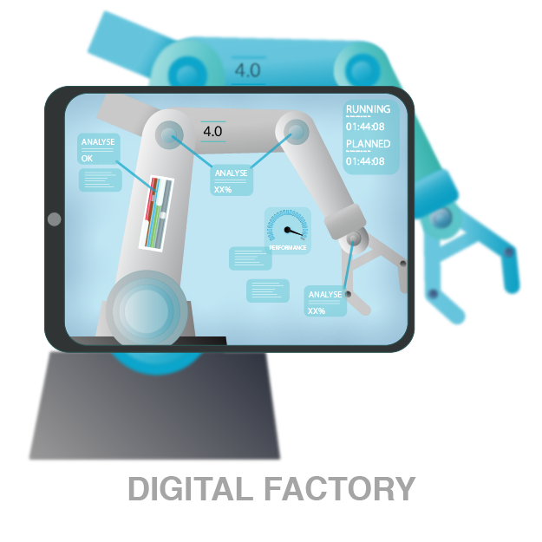

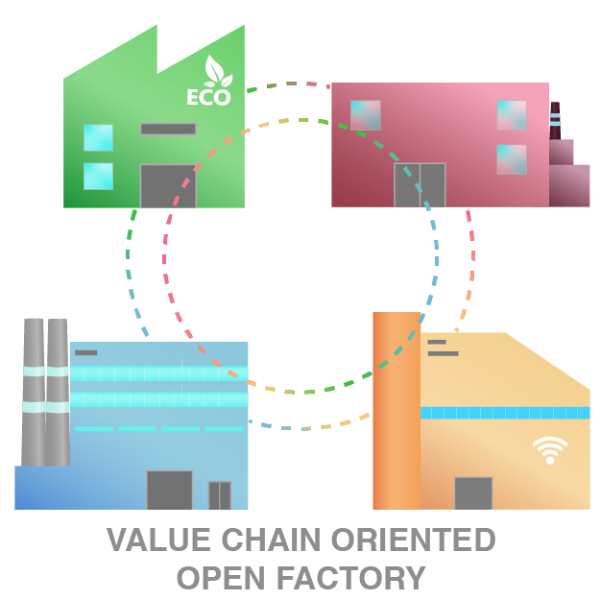
Main SME challenges drive the ADMA transformations
Top 10 manufacturing SME challenges |  | ADMA transformations
attract & develop talent | right qualification of the workforce & level of (expert) knowledge smart connection of employees with technology
change mindset | too much pressure on day-to-day business environment employees’ willingness to change towards a more automated, digital way of working
first time right | move faster and smarter from concept to realisation
entering the digital era | provide real time information on shopfloor a clear strategy to generate added value from (machine) data
create new business opportunities | Value creation through sustainability & resource efficiency how to realise new eco systems with supply chain partners discover and execute servitisation opportunities
Notes:
32 Slovenian companies were included in the survey
Recommendations given by Tecos :
start with the integration of advanced manufacturing technologies as soon as possible preferrably with one or two projects at a time
the full support and understanding of top management is needed
strengthen the company with (external) experts
analyse the situation of finances, existing knowledge, technological support, production and spatial capabilities before the implementation phase
inform all employees about changes that will impact the company and/or their work directly
form (a) project team(s) which should be trained by advanced manufacturing experts
obtain additional information from those companies that have already implement the I4.0 concept

Slide 5

Support tailored to the specific needs of each SME
Seven transformation areas
Customer focus & value proposition
Robust engineering processes
Vision
Capabilities
Implementation
Stakeholder focussed
Resource management
Compliance & innovation
Human-machine interaction
Manufacturing planning & control processes
Individual employee
Team
Leadership
Organisation
Enabling infrastructure
Capabilities
Cooperation & partnerships
External expertise & knowledge management

Slide 6
One support process
ADMA scan
Transformation plan
Implementation plan

Slide 7
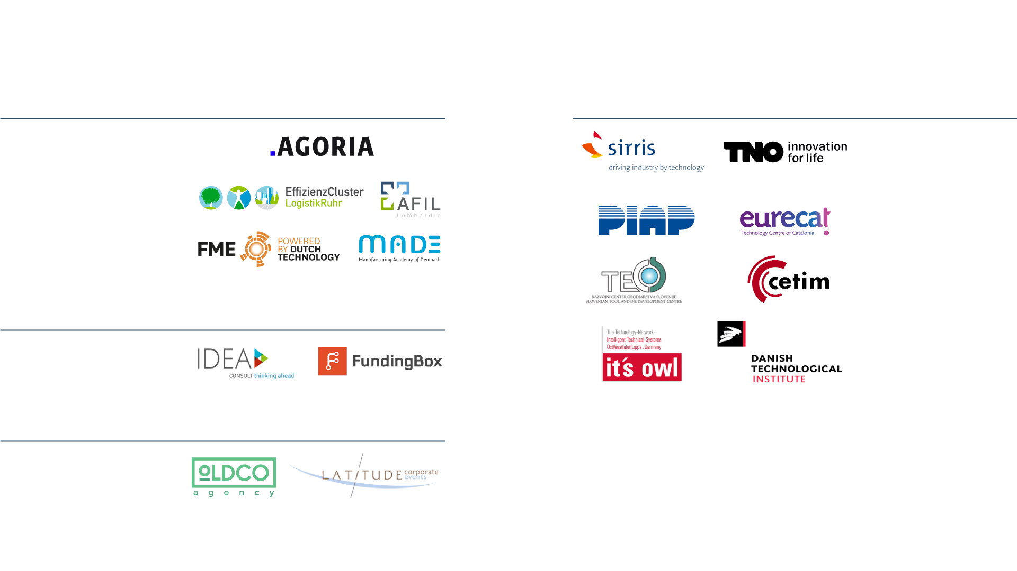

ADMA project partners
www.adma.ec
Core team
Technology partners
Outreach & Learning network partners
Communication experts
Supporting Organisations
129 European clusters, DIH‘s, trade organisations

Slide 8
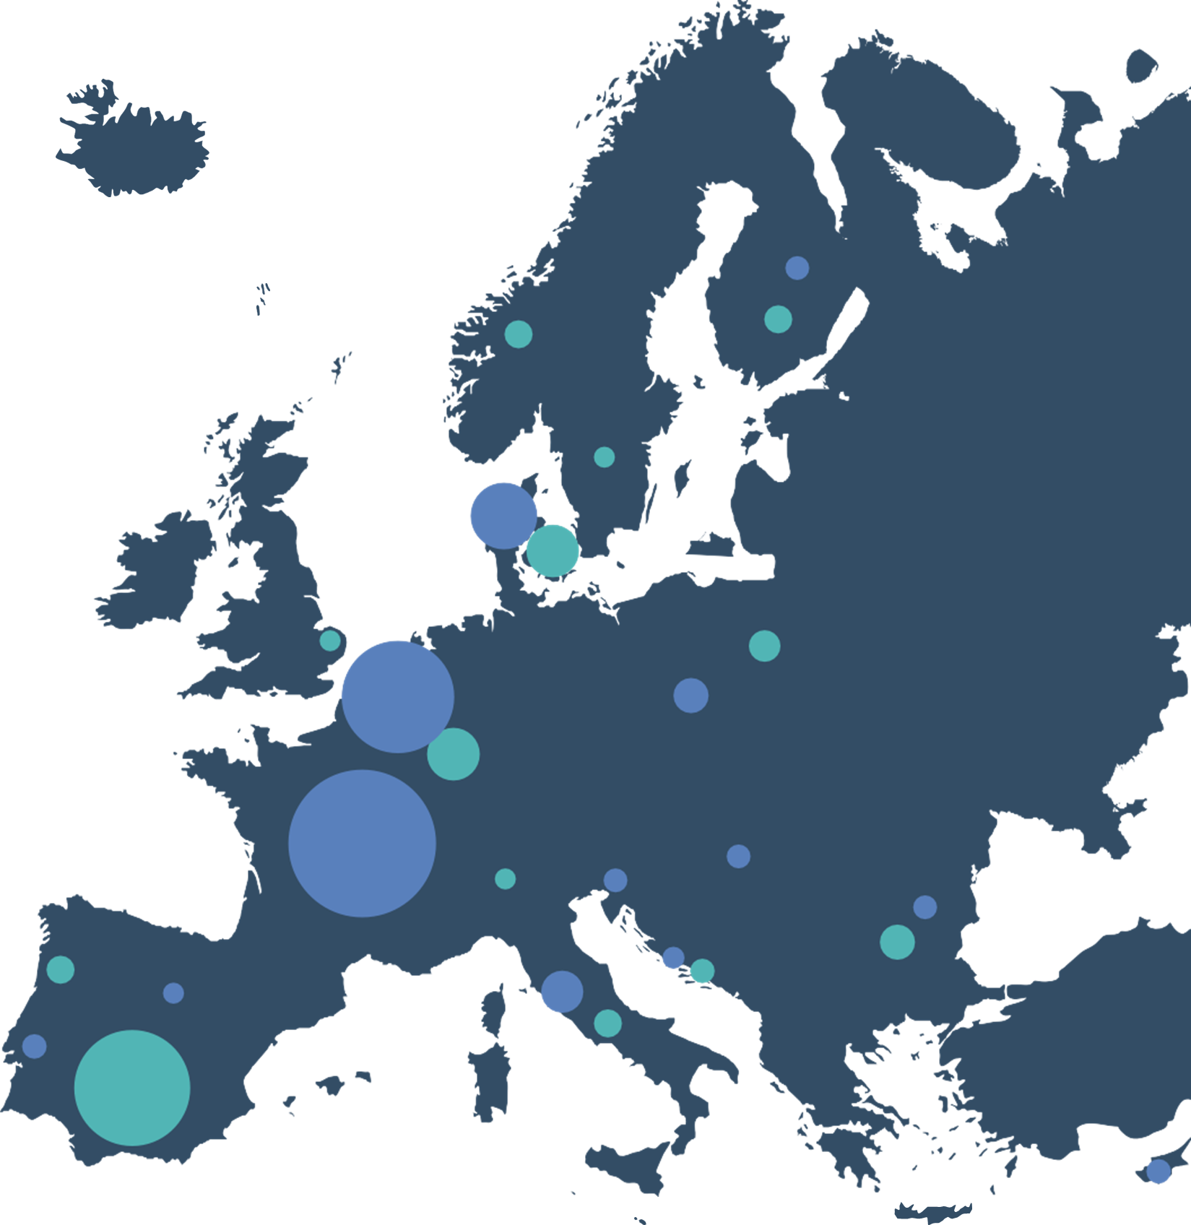
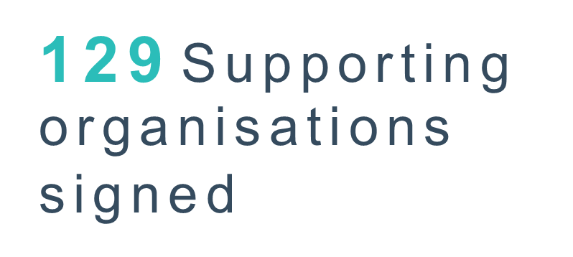

“Best Supporting Organisation Award” :
Mondragon Corporation (Spain) - Q4 2019
IQ Kecskemet Cluster (Hungary) - Q1 2020
ICT Cluster (Bulgaria) – Q2 2020
Quantra (Italy) – Q3 2020
IntechCentras (Lithuania) – Q4 2020
330 S M E s
t o o k t h e ADMA s c a n

Slide 9
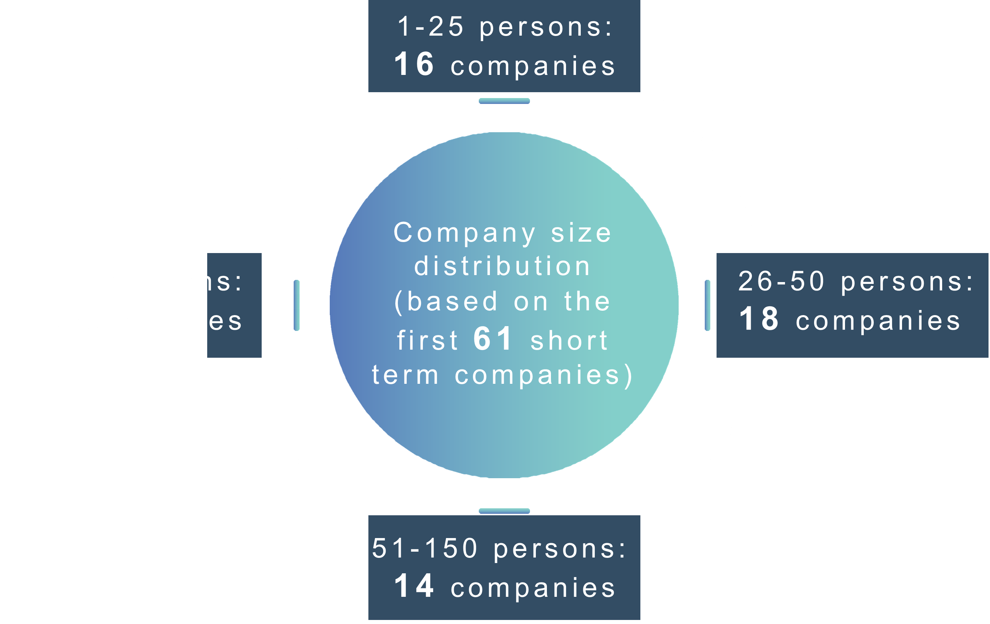

Slide 10

A D M A S c a n
a v a i l a b l e i n 1 1 l a n g u a g e s
E n g l i s h
P o r t u g u e s e
D a n i s h
F r e n c h
G e r m a n
I t a l i a n
B u l g a r i a n
P o l i s h
D u t c h
H u n g a r i a n
Slovenian

Slide 11

1
M o n i t o r p r o d u c t i o n q u a l i t y in real time
Integrate manufacturing processes digitally
2
To p - 5 a r e a s w h e r e S M E ' s are requesting assistance in realizing breakthrough performance:
3
Enhance people involvement
and transparent communication
Improve people skills through
specific trainings
4
5
I n c r e a s e p l a n n i n g a c c u r a c y & delivery reliability

Slide 12
An open network of validated service & training providers
A holistic methodology incorporating the skills and training dimension to the ADMA methodology
An SME-oriented process
  following the same steps defined in the ADMA approach: advisors + coaches + training providers (new role!)
  offering a flexible system based on vouchers [4M Euro]
ADMA+

Slide 13
ADMA+ Methodology
ADMA+ Assistance Framework
ADMA+ Training Programme Framework
OPEN NETWORK: Catalogue of validated ADMA+ Service providers
ADMA+ Advisors
ADMA+ Coaches
ADMA+ Training providers
Manufacturing SMEs
Notes:
Main ideas:
ADMA+ methodology includes ADMA1 approach + training framework
Open network
Role of ADMA1 partners (red boxes)
As experts in the board (contributing to the methodology)
As service providers (advisors, coaches, training providers)=> Automatically validated as service providers from the start of the project (vs other organisations that will need to go through a selection process)

Slide 14
Thank you for your attention
Paul Peeters
Sr. Expert Advanced Manufacturing
www.agoria.be www.adma.ec

