Slide 1
DATE 2021, February, 3rd 2021

Slide 2
CloudiFacturing Project – who we are
H2020 Project funded under GAN 768892
Develops CFG Solution / emGORA Digital Marketplace for Digital Engineering which will facilitate the access to cloud / HPC-based modelling and simulation for SMEs
Consortium of 33 initial partners, 5 DIHs
2 Open Calls, & 3 waves of experiments implementing 21 application experiments
Project duration: Oct 2017 - April 2021
cloudSME is Work Package Leader for Impact & Commercialisation & future operator of the emGORA Digital Marketplace
Project Coordinator: Fraunhofer IGD

Slide 3
Europe’s leading engineering workspace with economic opportunities for every member.
digital services to be used and licensed directly
central management of accounts, consumption and other resources
entity & single account credentials to access several SaaS
ensure interoperability of services, resources
trust, security and privacy
3
Notes:
emGORA‘s Mission:
„To create a diverse and growth-focused engineering workspace
for manufacturing companies, striving for pan-european collaborations and sustainable mechanisms,
to ease the initial adoption and cost-efficiency of advanced ICT solutions by offering on-click executable SaaS, consulting, trainings and matchmaking.“

Slide 4
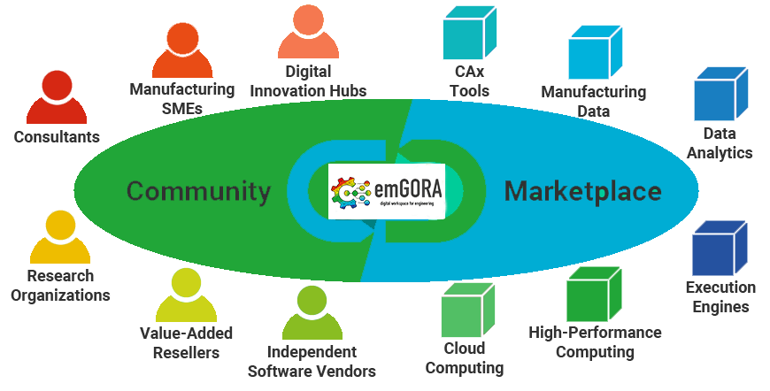
in a nutshell
The Digital Marketplace is the default entry point to the CFG Solution
thematic platform to facilitate the access to cloud / HPC-based modelling & simulation and AI / ML / DL tools as well as cloudified Computer-aided tools (CAx) for SMEs
empower technology providers to offer their solutions in a central marketplace
provide training and consultancy services to facilitate the adoption of the advanced technology,
connect people and facilitate collaboration,
promote the technology across Europe focusing on manufacturing SMEs,
will be the central channel to commercialise the results of the CFG project.
4

Slide 5
Key Stakeholders
Digital Innovation Hubs
CAx
Tools
Manufacturing SMEs
Manufacturing Data
Consultants
Data AnalyticsML / AI / DL
Research Organizations
Execution Engines
Value-Added Resellers
High-Performance Computing
Independent Software Vendors
Cloud Computing

Slide 6
emGORA Image Video
Values 1/3

Slide 7
DIHs – A Key to Success for CFG Project & emGORA

Slide 8
emGORA DM – key enabler for digitalisation & Industry 4.0 in Europe
emGORA aims to
democratise the access to advanced ICT solutions for manufacturing SMEs
expand its network of DIHs and collaborators
become a major service to support DIHs in the collaboration towards digitalisation and Industry 4.0 across Europe
Create an own ecosystem to foster the Digital Economy in Europe
Notes:
“Only, when we are able to support the “CFG solution experts” and the DIHs in a way, that they are able to earn money with the marketplace, the marketplace itself will be able to earn money.”

Slide 9
We seek collaboration with you
We‘re open to support commercialisation of your solution on the emGORA Digital Marketplace.
We seek collaboration through other I4MS H2020 Projects jumping on.
Get in contact!
Andreas Ocklenburg, cloudSME UG,
Future Operator of the
emGORA Digital Marketplace
Available: September 2021!

