Slide 1
Digital Twins for Manufacturing
Andreas Ocklenburg
CEO cloudSME U.G. & Work Package Leader
"Communication & Outreach“ in DIGITbrain
andreas.ocklenburg@cloudsme.eu
+49 203 363 999 55

Slide 2
DIGITbrain - details
Topic: H2020 – ICT-03
Type of action: Innovation Action
Number of partners: 36
Estimated project cost: €9,392,812.09
EU contribution: €8,340,511.48
Start date: 1st July 2020
Duration: July 2020 – December 2023 (42 months)
Grant Agreement No. 952071

Slide 3
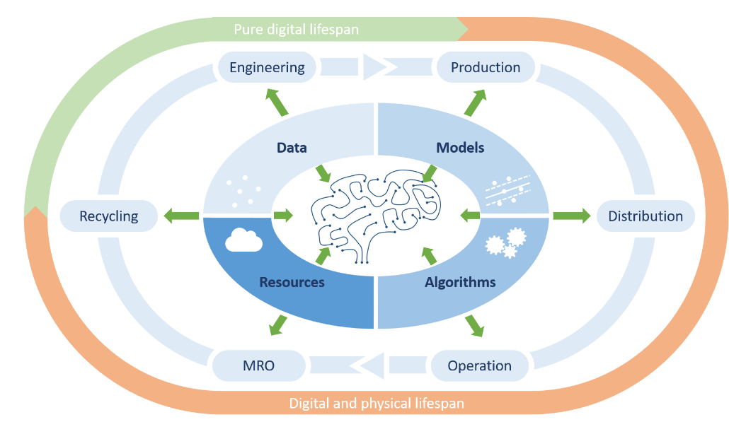
DIGITbrain in a nutshell
The Digital Brain constitutes an evolution of the concept of the digital twin, expanding it to a smart entity, by empowering it with analysis and
decision support capabilities, allowing the agile adaptation and evolution of industrial products.
Main challenge
“…to enable customised industrial
products and to facilitate cost-effective distributed and localised production for manufacturing SMEs…”

Slide 4
DIGITbrain in a nutshell
By extending the Digital Twin concept with memorizing capacity to cover the whole product lifetime
Accelerate adaptation of manufacturing and products to changing conditions
Facilitate flexible manufacturing to strengthen competitiveness
Enable personalized manufacturing in an affordable way
Democratize technology access for manufacturing SMEs

Slide 5
DIGITbrain Open Calls
2 Open Calls, 3 waves of experiments
Number of new experiments: 14 (7 per Open Call)
1st Open Call: 31st March – 30th June
Budget: 1 400 000 €
up to 100K€ per experiment
up to 60K€ per third party
1st Open Call Webinar: 20th April 2021, 11:00h CEST (more information: digitbrain.eu/first-open-call-webinar)

Slide 6
Who can apply and how?
SMEs or mid-caps, located in the EU, a Horizon 2020 associated country or the UK
From the following sectors:
End users (manufacturing companies – SMEs and mid-caps)
Independent Software Vendors (ISV) – SMEs and mid-caps
Engineering consultants – SMEs and mid-caps
Research organisations
High-Performance Computing (HPCs)
Digital Innovation Hubs
Open Call Documents: available at digitbrain.eu when Call is open
Applications / Questions to: opencall@digitbrain.eu

Slide 7
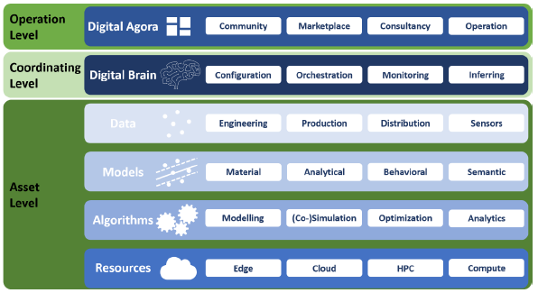
What experiments are we looking for?
Experiments can cover all segments of the entire manufacturing sector, e.g. discrete manufacturing, continuous production, or construction.
Pan-European teams of manufacturing end-users, technology providers, research organisations, High Performance Computing providers and / or Digital Innovation Hubs - together implementing an individual use case-based Digital Twin → Match-making: by DIHs
They will be integrated into a Digital Marketplace, which provides the necessary graphical user interfaces (GUIs) in view of configuring and monitoring the Digital Brain for an industrial-product instance.
More information on eligible experiments / applications
in our first webinar!

Slide 8
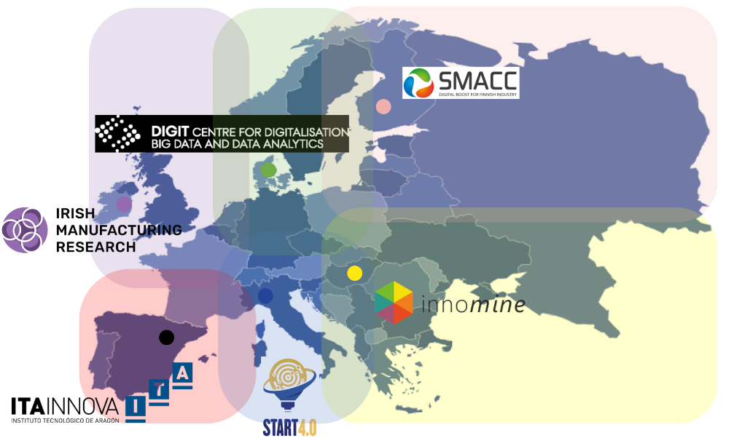
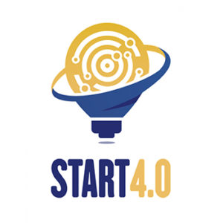
Role of Digital Innovation Hubs (DIHs)
Promote the Open Call in their region / network
Co-work on the experiment proposals with the interested parties
making sure the proposal idea is in-line with the project objectives, is innovative, is beneficial to the experiment proposers, and has an impact beyond the experiment).
Make sure that the experiment is feasible with regard to time, costs, technology.
Accompany the experiment proposers once the experiment is selected and started.

Slide 9
The DIGITbrain consortium
Core technical and administrative partners
Experiment partners
Network of DIHs

Slide 10
Get in contact with us!
Follow us:
Andreas Ocklenburg
CEO cloudSME U.G. & Work Package Leader
"Communication & Outreach“ in DIGITbrain
andreas.ocklenburg@cloudsme.eu
+49 203 363 999 55
www.digitbrain.eu
www.linkedin.com/groups/12439191
www.twitter.com/digitbrain_eu
www.facebook.com/DIGITbrainProject

