Slide 1
DIGITAL INNOVATION HUB
DATA SCIENCE, HPC & AI
Southwestern Region Bulgaria

Slide 2
About the DIH
Founded in 2020
Founders: ICT Cluster, Sofia Tech Park, Lab Complex, Sofia Municipality, NEVEQ, SCAI, institute GATE, Center of Excellence in Mechatronics and Clean Technologies, Cleantech Bulgaria, Digitech 4.0 and Technical university-Sofia
Successor of Bulgarian Technology and Innovation Hub – DigiTech 4.0
The main goal of the hub is to bring together actions and know-how to:
support the process of digital transformation of the Industry and society in the Southwestern region of Bulgaria;
organize initiatives for exchanging experience with other European digital innovation hubs;
conduct projects, related to supporting the application of digital technologies in SMEs and help their successful implementation;
support the development of human capital by improving their digital skills and competences;
The vision: to become a regional one stop shop supporting digital transformation of industry & society based upon Data Science, High Performance Computing and Artificial Intelligence

Slide 3
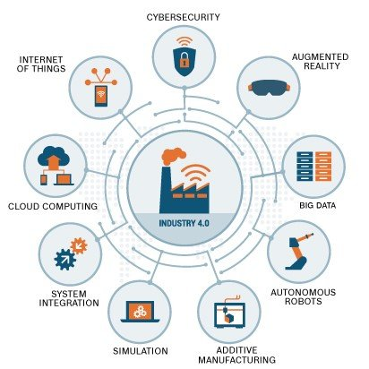
Geographical coverage, technological and Industrial Focus

Slide 4
Meaningful experience, knowledge and networks for supporting SMEs digital transformation

Slide 5
Challenges identified
Bulgaria is significantly lagging behind in adopting digital technologies
Lack of awareness among manufacturing companies from non ICT sectors
Underestimation of complexity of digital transformation, frequently considered as purchase of machines with Machine learning and Artificial intelligence capabilities
Lack of necessary skills and competences of the employees
Reluctance to change
Lack of financing supporting digital transformation
Companies are not aware how to grow, how to innovate and how to use the new business models
There is available infrastructure, but companies are not aware about it and how to use it for testing, prototyping and validation
Limited cooperation between different stakeholders, as well as limited communication between companies in the digital and non-digital sector.
In terms of open data, management, support services, infrastructure, finance and digital competencies – the most developed city - Sofia shows a low level of maturity

Slide 6
Opportunities coming from the DIH
Awareness raising
A number of events are planned for promotion of the added value of the digital transformation and the circular and low-carbon economy.
SMEs, public enterprises and institutions will have the opportunity to participate in monthly webinars and online broadcasts sessions, open days in the laboratories, open innovation events, conferences, workshops and round tables.
Identification of needs of SMEs, public enterprises and institutions
Organization of specialized and customized trainings for digital skills improvement
Advanced manufacturing assessment, transformation plan development and implementation support
Brokerage for boosting collaboration between technology and non-technology companies
Access to expertise and infrastructure for development, testing and validation of products and technologies
Financial support for SMEs for implementation of new business models, feasibility studies, innovation development and access to the market

Slide 7
Thank you
for your attention!
Anna Naydenova
Executive Director of EDIH DS-HPS-AI

