Slide 1




26 February 2021
Tools and services supporting digital innovation of manufacturing SMEs"
I4MS ICT Innovation for
Manufacturing SMEs in a nutshell
Opportunities for SMEs & DIHs
Maria Roca – I4MS Project Manager
maria.roca@fundingbox.com

Slide 2
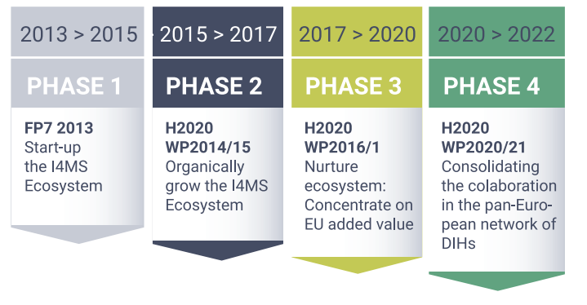
Tools and Technologies for Transformation: accelerate digital uptake by manufacturing companies
What is the I4MS initiative?
I4MS (ICT Innovation for Manufacturing SMEs) is the initiative promoted by the European Commission to foster the digital innovation of manufacturing SMEs in Europe in order to boost their competitiveness in the digital era.
THE I4MS GOAL
Contribute to the adaptation of European SMEs to the current digital transformation challenges
Promoting knowledge exchange.
Encouraging cross-border cooperation.
Providing access to funding opportunities.

Slide 3




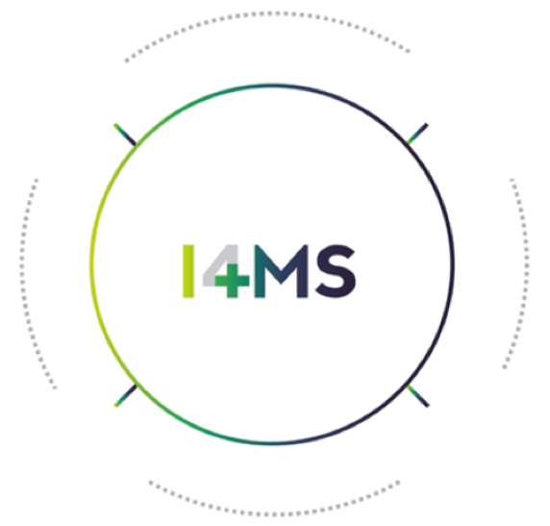






BRINGING THE I4MS INNOVATION ECOSYSTEM TO THE MARKET
I4MS Phase 4 – Innovation Actions
SMART MODELLING,
SIMULATION AND OPTIMIZATION
FOR DIGITAL TWINS
COGNITIVE AUTONOMOUS SYSTEMS & HUMAN-ROBOT INTERACTION
TECHNOLOGIES:
AI
DIGITAL TWINS
HPC
LASER-BASED ADDITIVE MANUFACTURING
HUMAN-ROBOT INTERACTION
COGNITIVE AUTONOMOUS SYSTEMS
SENSORS
CPS
IOT
ROBOTICS
HPC
LASER-BASED
ADDITIVE MANUFACTURING
INNOVATIVE
ARTIFICIAL INTELLIGENCE
Notes:
Slide 8 unir proyectos de slide 7 y 8. Faltará añadir los enlaces y logos de los proyectos. Podemos con la info que nos manden elaborar una slide con cada proyecto con info.
MWC: Hemos intentado unir la información, sin embargo, creemos que genera confusión unir los dos slides – añadiremos los logos de los proyectos una vez estén disponibles-

Slide 4
ICT Innovation for
Manufacturing SMEs in a nutshell
Opportunities for SMEs

Slide 5


Tools and Technologies for Transformation: accelerate digital uptake by manufacturing companies
I4MS Journey for SMEs
1
2
3
4
5
Access I4MS Community
Apply
for funding
Receive
premium
services
Test
new tech
Win a Disruptors Award
Network with other SMEs and find the best fit in service providers for your needs via the
Brokering System.
40 Mil € via 16 open calls for manufacturing SMEs.
Appear in the I4MS tech catalogue
I4MS/SAE Innovation label.
I4MS Disruptor Award
Pilot and test new technologies
Premium services, such as business and technical mentoring.
Notes:
Brokering System will help you network with other SMEs and find the best fit in service providers for your needs.

Slide 6








I4MS Open Call Calendar
2021
January
February
March
April
May
June
July
August
September
October
November
09/2021
28/01/2021 - 29/03/2021
EoI - 18/01/2021 - 18/03/2021
30/03/2021 - 30/06/2021
04/2021 - 08/2021
08/02/2021 - 22/04/2021
01/05/2021
01/03/2021 – 30/04/2021

Slide 7
ICT Innovation for
Manufacturing SMEs in a nutshell
Opportunities for other stakeholders

Slide 8
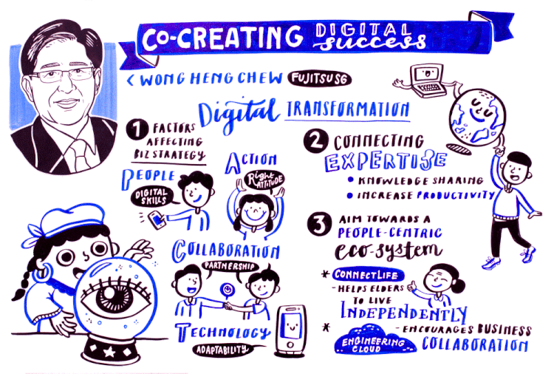
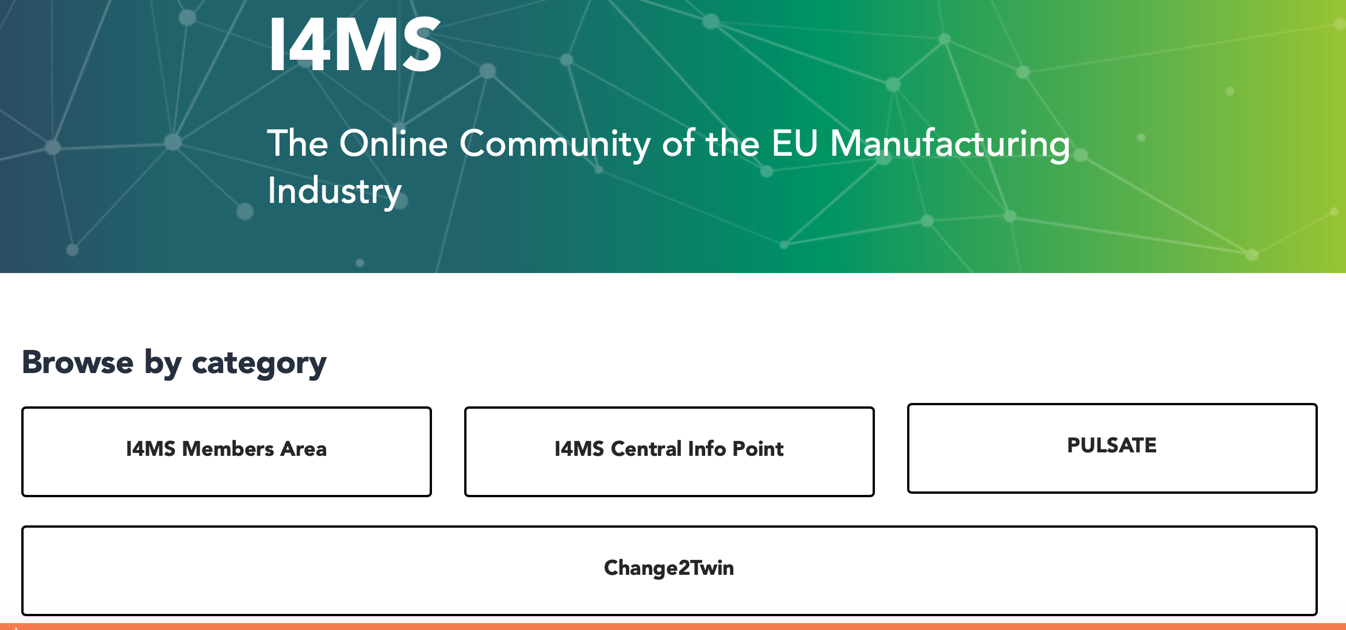
I4MS Opportunities for DIHs
Working Group on Best Practices and supporting Mechanisms on Digital Transformation.
Working Group on Upskilling challenges.
I4MS Contact Points Network
Contribute to our catalogue of trainings
Participate in I4MS online community
Join! https://i4ms.eu/join-i4ms/
maria.roca@fundingbox.com

Slide 9







What does I4MS offer to the ecosystem?
Business Services
Success stories & Best practices
Access to additional funding.
Consultancy on new business models.
Ideas incubation and business acceleration.
Experiments catalogue.
Best practices.
I4MS Label.
Disruptors Awards.
Community matchmaking & Brokerage
Communication services
Dissemination of Open Calls.
Webinars and Q&A.
I4MS channels for the communication and marketing of projects and initiatives.
Access Networking and information about all services at I4MS Community: https://i4ms.fundingbox.com/
Access to New Markets
Trainings & Working Groups
Promotion in world class events.
Technologies Observatory.
Market intelligence.
IPR & Patent management.
Working groups.
Catalogue of Trainings
Culture matching for I4MS
DIHs and Culture matching online course for IAs
Regional workshops in underrepresented regions.
Notes:
Slide 11: me gusta, hay que adaptar el contenido a la nueva propuesta que aún estamos definiendo, quizás podemos incluir las open calls, los nombres de los trainings ya.
MWC: De acuerdo, incluidas Open Calls + nombres de los trainings

Slide 10
I4MS Online Community
https://spaces.fundingbox.com/c/i4ms

Slide 11

THANK YOU!
i4ms.eu

