Slide 1
Open Calls in KITT4SME
I4MS - ICT Cluster Bulgaria
Themis Kolyvas | European Dynamics Feb.26 2021

Slide 2
KITT4SME specifically targets European SMEs and mid-caps to provide them with scope-tailored and industry-ready hardware, software and organisational kits, delivered as a modularly customisable digital platform, that seamlessly introduce artificial intelligence in their production systems.

Slide 3
Why join our Open Calls
Technology Providers
SMEs in manufacturing sector
Access to EU funding
Validate your products
Reach potential customers
Be part of a growing ecosystem of solutions for the industry (RAMP)
Access to EU funding
Integrate customized AI solutions to current production
Find a solution developer (matchmaking service)

Slide 4
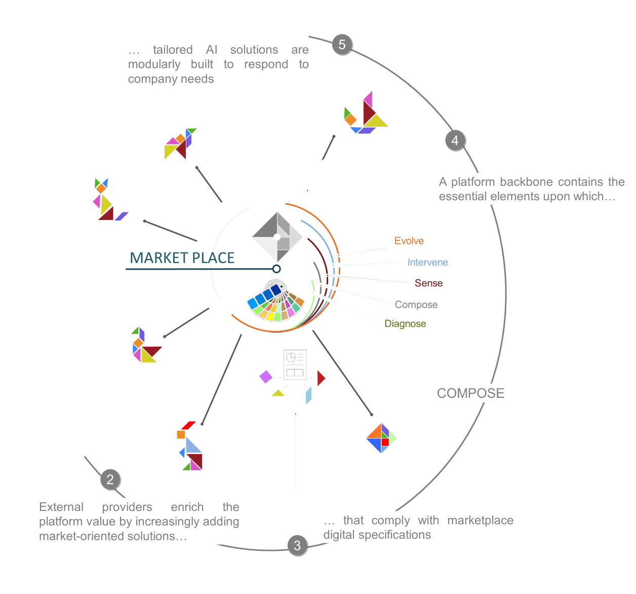
Our five pillars span over the wider area of AI for production
We invite solutions in the broader scope of:
AI for Quality assurance
AI for Reconfiguration (product personalization)
Man-machine interaction
other relevant* topics
* will need to show explicitly relevance to the concept of ‘AI for production’ & the factory floor

Slide 5
Our five pillars span over the wider area of AI for production
We invite pilots* with the same scope
*Small Consortia (2-3 partners) of solution developers & end-users

Slide 6
Some high level characteristics of the envisaged solutions:
Self-contained software modules, with a clear description of the input-output data (the technical integration to the platform will be supported by the partners)
Solutions are strongly encouraged to have a high maturity level (tested in a similar environment)
We also value:
Scalability (ability to grow and influence greater number of end-users)
Proof of real-life implementation (added value)
Replicability of the solution across different pilots (through DIHs)

Slide 7
Things to know
Individual winners will be able to receive funding up to 100,000€ (in total from EU)
Each pilot will be eligible for up to 200,000€
Implementation phase of the action will last ~10mo.
The call addresses all entities eligible for Horizon 2020
Call to open between May. 2021 – Oct. 2021

Slide 8
Contact Points
Open Call Manager: Themis Kolyvas ( themis.kolyvas@eurodyn.com )
KITT4SME Website: http://kitt4sme.eu/
KITT4SME Social media accounts ( follow/ subscribe for updates! ):
Twitter : twitter.com/KITT4SME
LinkedIn : linkedin.com/KITT4SME
YouTube : youtube.com/KITT4SME
ResearchGate : researchgate.com/KITT4SME

Slide 9
Thank you for your attention
Presenter: Themis Kolyvas
themis.kolyvas@eurodyn.com

