Slide 1


Grow your manufacturing business
Anca Marin
Deputy Project Manager
FundingBox Accelerator Z.o.o.

Slide 2


What is Better Factory?
GROW YOUR MANUFACTURING BUSINESS
Better Factory is an initiative under the European Commission H2020 programme that invites manufacturing Small and Medium-sized companies, artists and technology suppliers to engage in collaborative experiments to redesign manufacturers’ current product portfolio.
By participating in a collaborative experiment The teams – 1 SME + 1 artist + 1 tech provider - can receive up to EUR 200,000 equity-free funding.
Our goal is to provide manufacturers with key knowledge, innovation and tools to respond to new market demands through digitalisation and product innovation.

Slide 3



Who can join Better Factory?
GROW YOUR MANUFACTURING BUSINESS
At this stage, individual applicants from one of these three categories can submit their online application and have the opportunity to become part of a future consortium.
Manufacturing SMEs and Mid-Caps looking to redesign their current products and services together with product design Artists and automation Technology Suppliers and optimising their production cost.
1
Artists willing to collaborate with Manufacturing SMEs/Mid-Caps and Technology Suppliers for the redesign and co-creation of new products and services.
2
Tech Suppliers interested to use advance robotics and optimisation technologies for the optimisation of factory logistics, space, material, energy, labour, etc. for Lean-Agile production in collaboration with Manufacturing SMEs/Mid-Caps and Artists.
3

Slide 4





How can you join Better Factory?
EXPRESSION OF INTEREST AND OPEN CALLS
Start your journey - Phase one: the individual application
Individual calls for all applicants are open from 18 January 2021 until 18 March 2021.
Call for SMEs, Artists and
Tech suppliers
Expression of Interest
Expression of Interest / Application Submission
Joint Proposal
SMEs, Artists, Tech suppliers Respond
Teams Matchmaking
Open Call
The main objective of this Call is to select the most innovative challenges addressed by Manufacturing SMEs
and Mid-caps and to identify Artists and Tech Suppliers to address and collaborate on those challenges.

Slide 5





OUR VALUE PROPOSITION
What can Better Factory offer you?
Apply now for a chance to enter one of the successful consortia that will:
Explore new markets using digital technologies
Test & develop new Lean-Agile production technologies with RAMP
Access training to re-skill staff
Get business support and mentoring
Receive up to EUR 200,000 equity-free funding

Slide 6
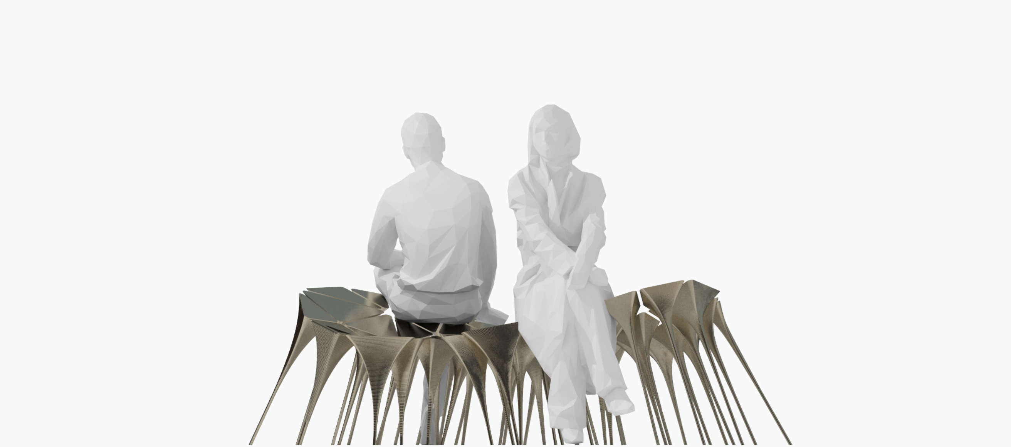
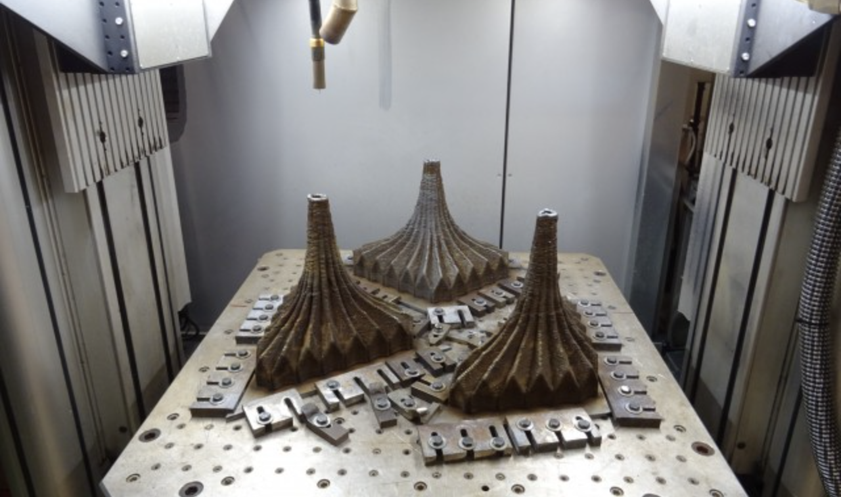
Industry + artist an example!
INSIGHTS
Print pioneers x Sebastien Wiernick
http://www.swws.net/wp4/project/os-waam/

Slide 7
Expressions of Interest Submission
How to apply?
  Manufacturing SMEs / Mid-Caps
  https://betterfactory-sme.fundingbox.com/apply
  Artists
  https://betterfactory-artists.fundingbox.com/apply
  Technology Suppliers
  https://betterfactory-tech.fundingbox.com/apply
Find our Guides & Documents here: https://better-factory.fundingbox.com/pages/documents
If you cannot find the answer you need in the provided documents, you can submit your question(s) through Q&A Space at Better Factory online community Helpdesk:
https://spaces.fundingbox.com/spaces/better-factory-helpdesk-1

Slide 8
Thank you!

