Slide 2
What is RIMA
Network of Digital Innovation Hubs and Industrial Organizations
Supporting and facilitating the uptake of robotics by industry
Gathering information into one knowledge base
Tech transfer, proof of concept, access to testing facilities
Path to market, market deployment
Communication, dissemination
Links with stakeholders, actors of value chain: asset owners or operators, techno and service providers, investors, certification bodies
Offer of services by DIHs
Advising, coaching, training, matchmaking
Sharing practices
EU-funded project, 2019-2022
Total budget 16M Euros
8M Euros distributed to SMEs via 2 Open Calls

Slide 3
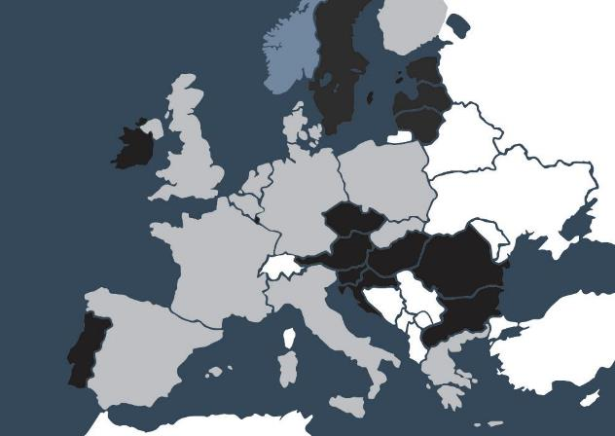
Who We Are
Digital Innovation Hubs and Industry Organizations from across Europe

Slide 4
Industry Sectors Covered by RIMA
Energy generation and distribution
Transport, cargo and mobility
Includes wind, solar, hydro, coal, and power distribution, covering both off-shore and on-shore infrastructure
Includes large transport hubs like ports, airports and interchanges.
Oil & gas and chemical
Water supply and sanitation
Refining and distribution infrastructure, including off-shore infrastructure and decommissioning.
Sustainable, safe water infrastructures include clean water, wastewater and storm water infrastructures
Urban and suburban transport routes connected with cities
Nuclear
Including decommissioning, waste disposal, maintenance and life extension
Local transport systems such as trams, track and trackside equipment, bridges, tunnels and roads
rolling stock and geo-physical maintenance

Slide 5
Vision
Reinforce European leadership in I&M robotics by connecting technology to industrial/sectorial needs and fostering cross border co-operation through the RIMA Network

Slide 6
Goals
Connect research, technology & service providers, end users, investors and certification bodies under one roof
Support end user to share their challenges
Provide education and training on robotics
Support SMEs to commercialize their solutions

Slide 7
The Open Calls

Slide 8
1st Open Call

Slide 9
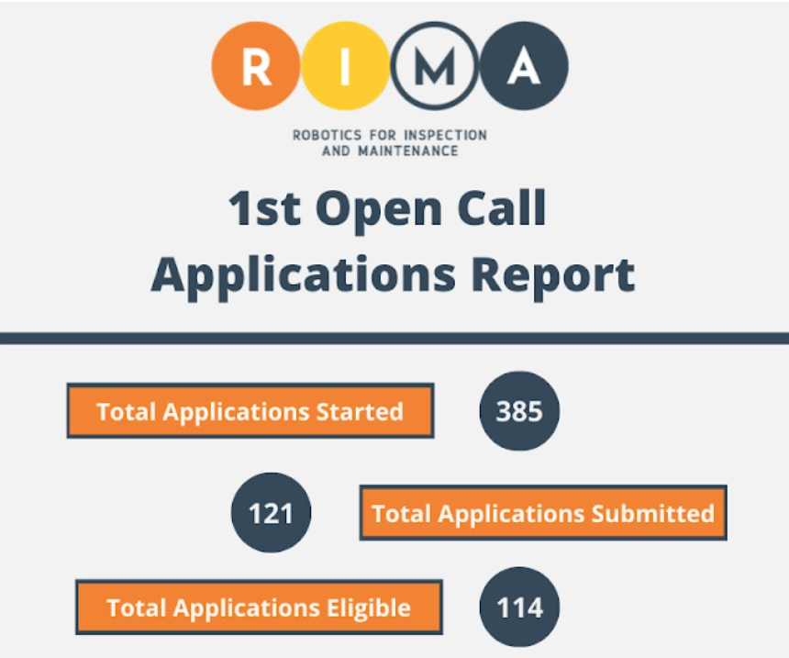
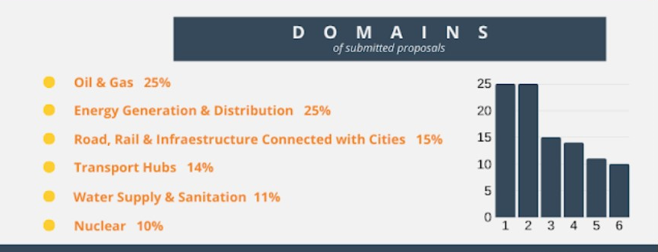
1st Open Call
19 funded projects within the 6 domains
Technology Transfer Experiments (TTE)
Developing, testing and validating the technical and economic viability of a robotic-based representative model or prototype system to be applied in ‘Target Use Domain’ operational environment.
Max 300k Euros per TTE and project timescale max 14 months
Technology Demonstrators (TD)
Validating the technical and economic viability of a new or improved Robotic-based technology, product, process, service or solution in a ‘Target Use Domain’ operational environment, whether industrial or other, involving where appropriate a larger scale prototype or demonstrator.
Max 100k Euros per TD and project timescale max 6 months

Slide 10
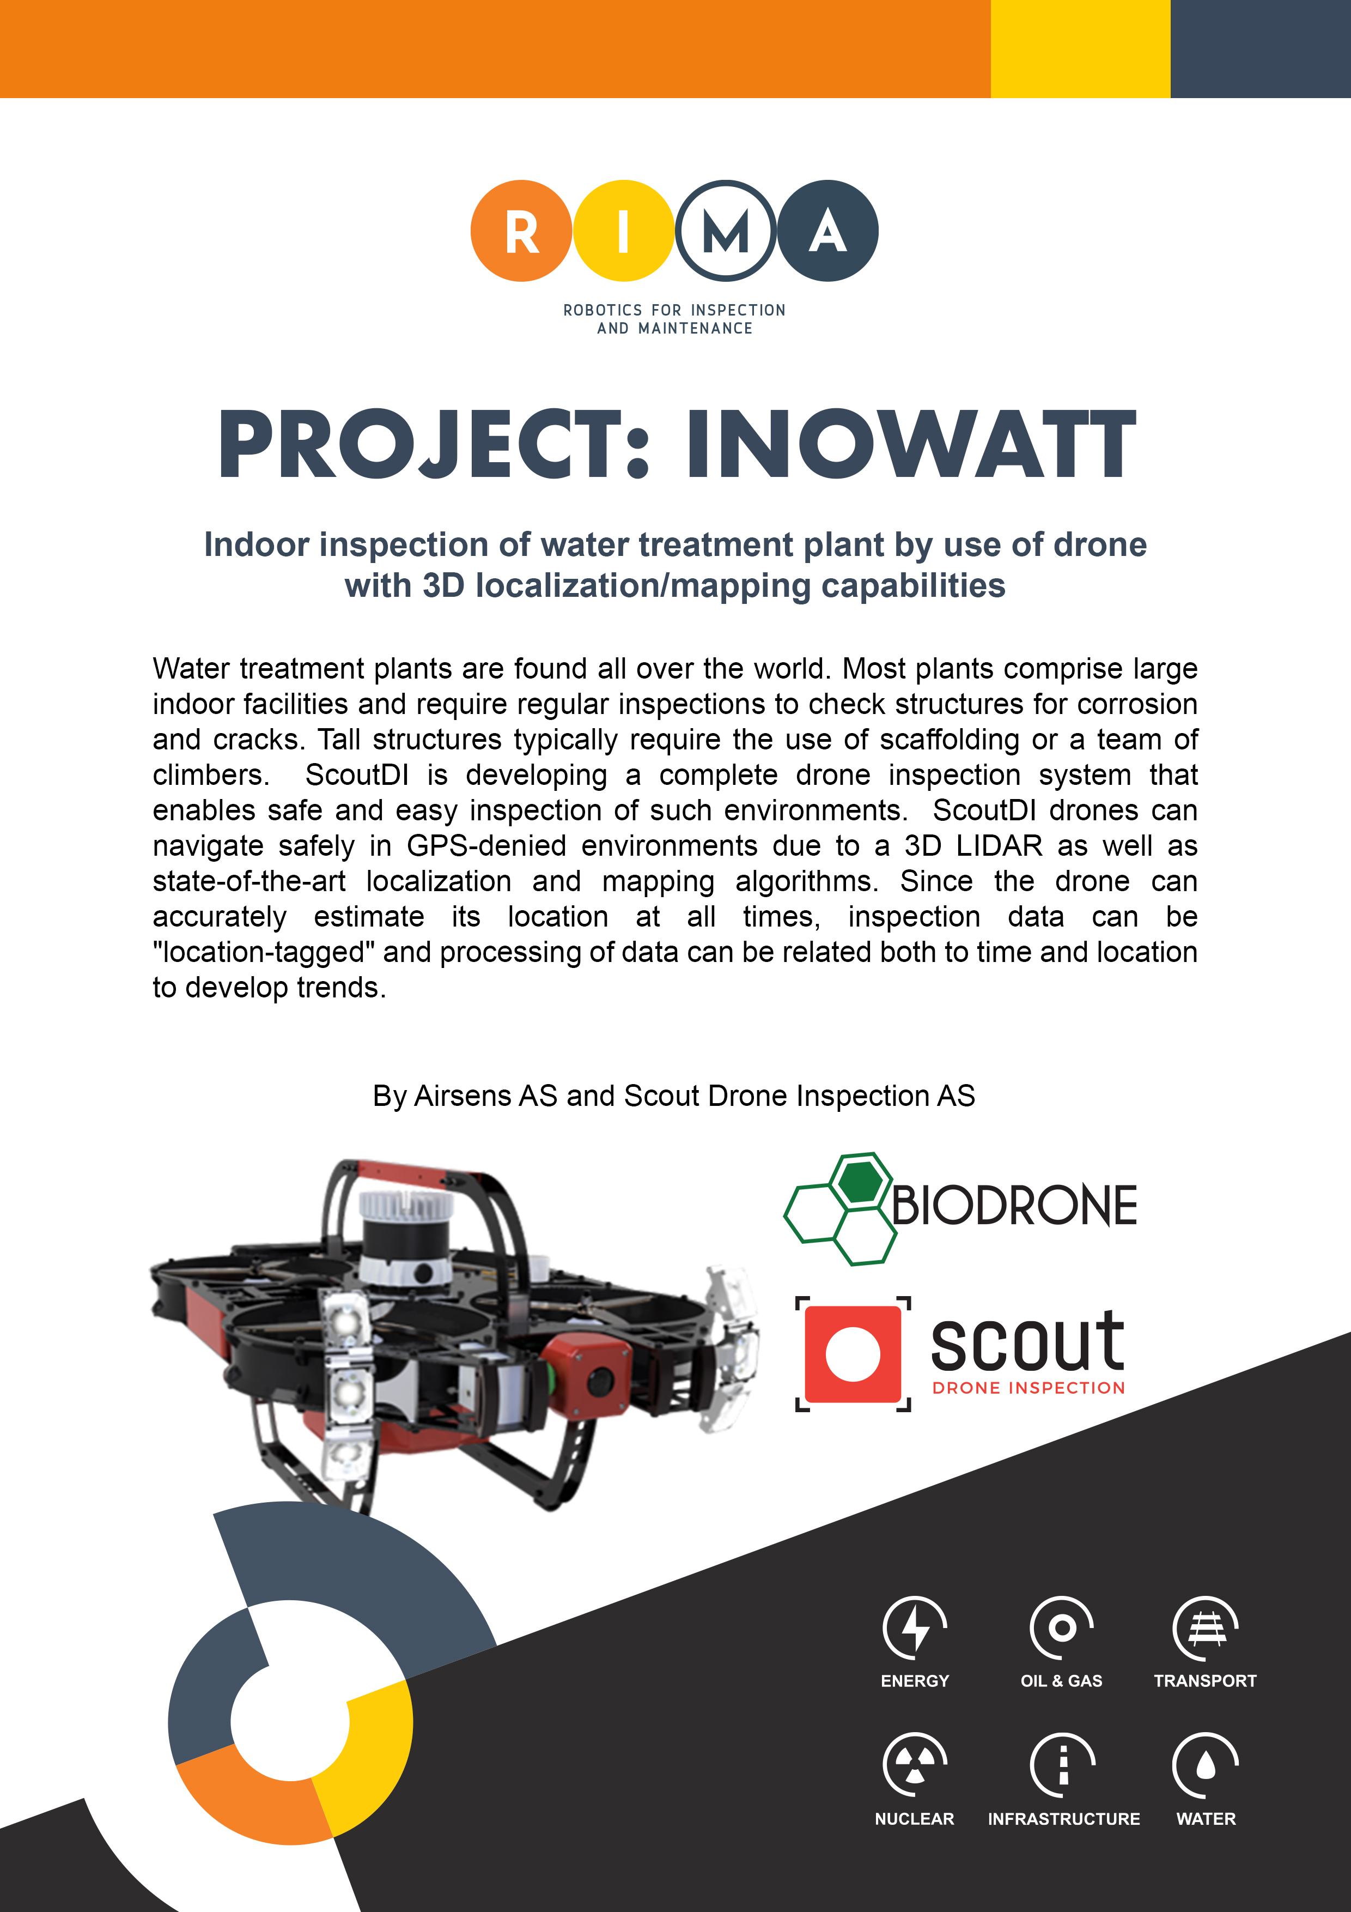
1st Open Call
Take a look at the funded proposals in more details on the RIMA website
https://rimanetwork.eu/rima-knowledge-base?kbcat=open-call-dissemination

Slide 11
2nd Open Call

Slide 12
2nd Open Call
The open call started on 15 December 2020 at 00:00 (CET)
Submission of applications
Deadline: 17 March 2021 at 16:00 (CET)

Slide 13
2nd Open Call
RIE (Robotics Innovation Experiment)
Duration: RIE (up to 14 months)
Funding: up to €150 k
Beneficiaries
Minimum of 2 independent entities
TRL
SMEs or slightly bigger companies from EU member states or associated countries
Min TRL 5

Slide 14
2nd Open Call
WHO CAN APPLY?
Minimum two candidates forming a micro-consortium
Independent entities that can be technology providers or service providers
Including an end user to micro-consortium is recommended
Multiple submissions
Possibility to submit multiple applications participating in several micro-consortia
Multiple funds by RIMA may be received however this cannot exceed 300k per entity
Project execution team must be dedicated to one project only (one project - one team).
Submission system
Only proposals submitted through the Open Call submission tool at https://rima-opencall.fundingbox.com/ and within the call duration will be accepted.

Slide 15
Join us!
LinkedIn | #RimaNetwork
Twitter | @NetworkRima
Web | https://rimanetwork.eu
Email | info@rimanetwork.eu

Slide 16
Thierry.louvet@systematic-paris-region.org

