Slide 1
Laser-based advanced and additive manufacturing technology
Looking for innovations in:
Izabela Zrazinska
Senior Project Manager @Fundingbox
26.02.2021

Slide 2
About US
48 Projects, 9 as coordinator

Slide 3
https://www.pulsate.eu/

Slide 4
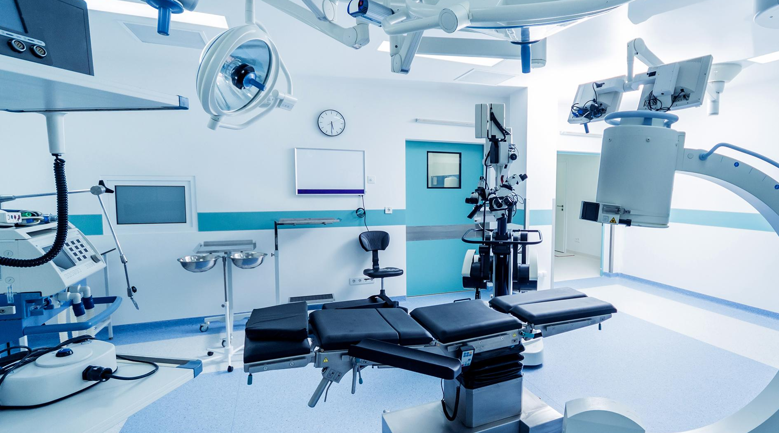
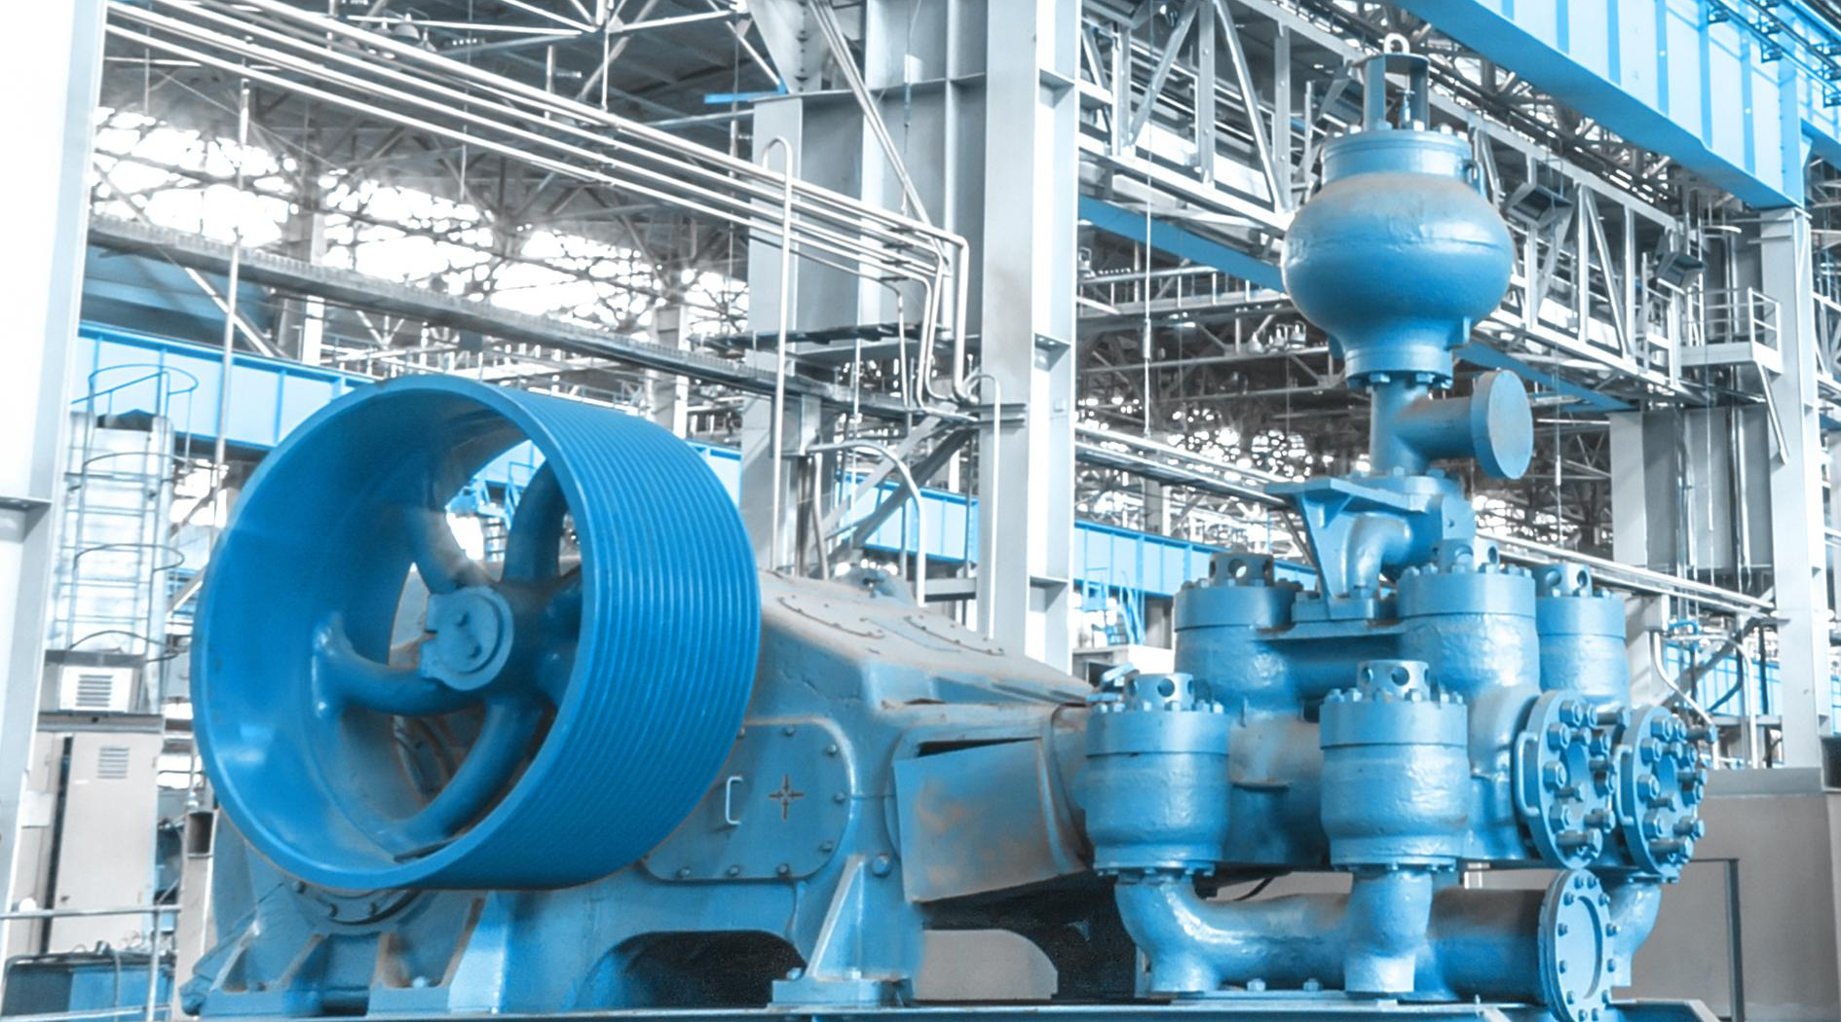
Revolutionising Markets
LBAAM provide maximal benefits towards flexible manufacturing and highly digitalized production environments
LBAAM technology is particularly beneficial for sectors like aerospace, automotive, medical devices, industrial machinery, customised electronics, and textiles & clothing.
Notes:
LBAAM technology is particularly beneficial for sectors like aerospace, automotive, medical devices, industrial machinery, customised electronics, and textiles & clothing

Slide 5
About us
We are a strong consortium to support you with any need for implementing LBAAM technologies
This project has received funding from the European Union’s Horizon 2020 research and innovation program under grant agreement No 951998

Slide 6
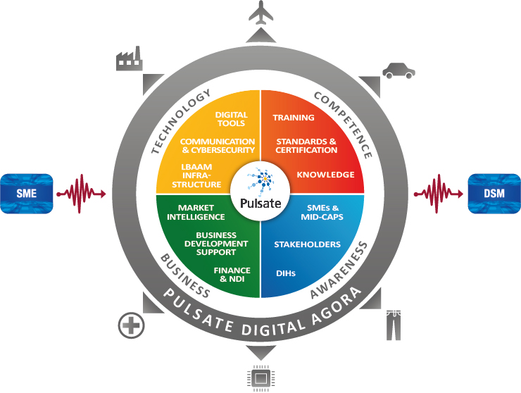
Notes:
The main objective of PULSATE is to set up and consolidate a robust and open PAN European Network, sustainable beyond the project timeframe, to promote and facilitate the adoption of Laser-Based Advanced Additive Manufacturing (LBAAM) technologies by SMEs and Mid Caps.
The network will connect DIHs, top class Competence Centres, Public Institutions, Standardization Organizations, Financing and Business Development entities through a Single Entry Point.

Slide 7
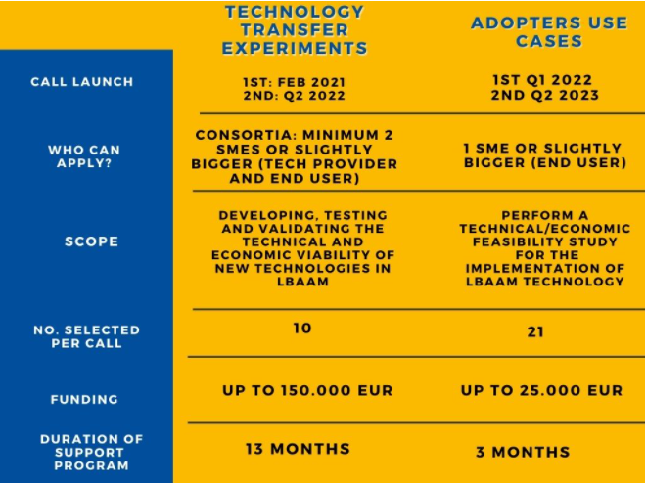
Open Calls in a nutshell
4 Open Calls
62 projects
LBAAM technology
4.07 million EUR
https://pulsate-opencalls.fundingbox.com/
Notes:
Please note the figures are for the whole Project – i.e. for the 2 calls together.

Slide 8
What are the benefits?
Technical support from industry experts
Business Mentoring led by FBA
Up to €150k funding per experiment
Media exposure
Access to private & public investment

Slide 9
Who are we looking for?
At least one
Experimentation areas
Minimum one Manufacturing SME
Consortium Composition
TRL
From 5 up to 7
Legal Status
ONLY SMEs or Sligthly Bigger from EU + assosiated + UK
YOUR PROPOSAL

Slide 10
Technology Transfer Experiments Consortia
The TTEs have to be proposed by a Consortium including minimum 2 SMEs and/or Slightly bigger companies acting as :
Technnology Provider
Manufacturing company
Minimum 1
compulsory
System Integrators,
Technology Providers
End-User, Manufacturer, Technology Adopter
Notes:
Technology provider (System Integrators): any entity which designs, builds or rebuilds, programs, installs, modifies, distributes, or supplies systems and/or technology for LBAAM.
Manufacturing company (End-user/Technology adopter): any entity that deals with the physical or chemical transformation of materials or components into new products.

Slide 11
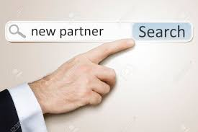
Do not have a partner to apply with?
Submit Expression of Interest: https://pulsate-matchmaking.fundingbox.com/
Write a post in Matchmaking Community: https://spaces.fundingbox.com/spaces/i4ms-pulsate-networking-matchmaking-1

Slide 12
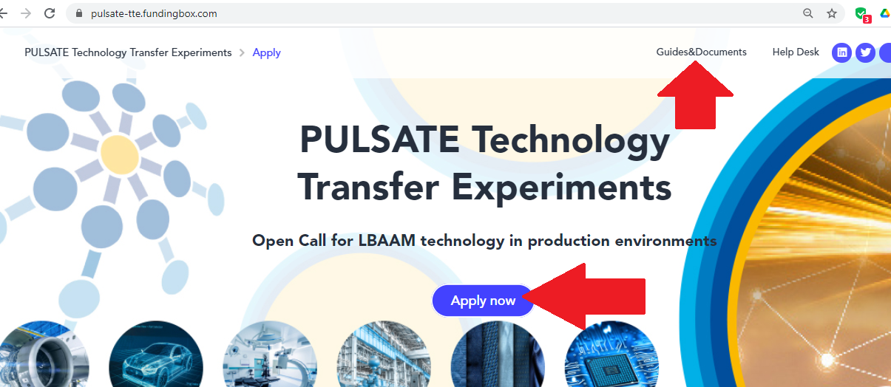
https://pulsate-tte.fundingbox.com/
How to apply?

Slide 13
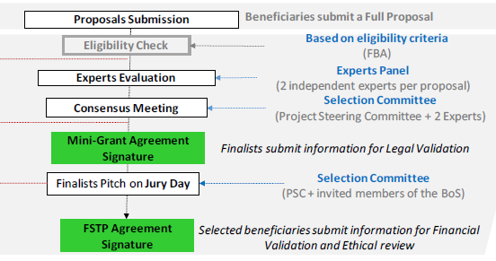
Selection Process
WHEN?
HOW?
22nd April
14th May
3rd week of June
End of July
Notes:
Worth mentioning that Mini Grant (1000k EUR) is aplicable only in case if the Jury Day will be a presential event

Slide 14
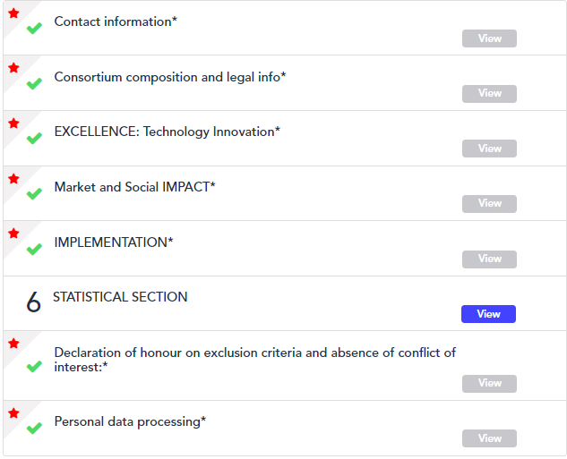
Application Form
Guide for applicants section 5

Slide 15
Follow our series of webinars
Partner/Title | Country | Date and Hour
FRA | Germany | 23rd Feb at 9am
AIMEN | Spain | 25th Feb at 12
CEA | France | 2nd March at 3pm
SINTEF | Norway | 9th March at
MTC + FBA: Innovations in LBAAM & Technical Support | ALL | 10th March at 3pm
FTMC: Industry Week | Lithuania | 23rd March
FBA: Final Countdown Q&A and Tips | ALL | 12th April

Slide 16
Q&A
Notes:
In case of question you are not able to answer you can always say that they will be updated in the FAQ document after the webinar.

Slide 17
APPLY BEFORE 22nd APRIL!
https://pulsate-tte.fundingbox.com/
Mail: pulsate.help@fundingbox.com

