Slide 1
UFO Open Call matchmaking event and B2B sessions

Slide 2
UFO Call #02 – Open Call Matchmaking event & B2B sessions
OBJECTIVES
To identify partners in order to build a collaboration
SFOs (Nanosats, HAPS, Drone) technologists
Data management
Potential users
To identify projects to integer a consortium
By default, to develop its own network
REMEMBER
Last opportunity to get fundings through UFO Open Call
Great opportunity to (re-)discover B2match.io tool

Slide 3
On Wenesday 30th June 2021
09:30 AM – 04:00 PM (UK)
10:30 AM – 05:00 PM (France)
11:30 AM – 06:00 PM (Greece/Bulgaria/Romania)
)
Sessions
1 to 1 meeting
20 minutes
Online
Register now!
https://ufo-project-open-call-matchmaking.b2match.io/

Slide 4
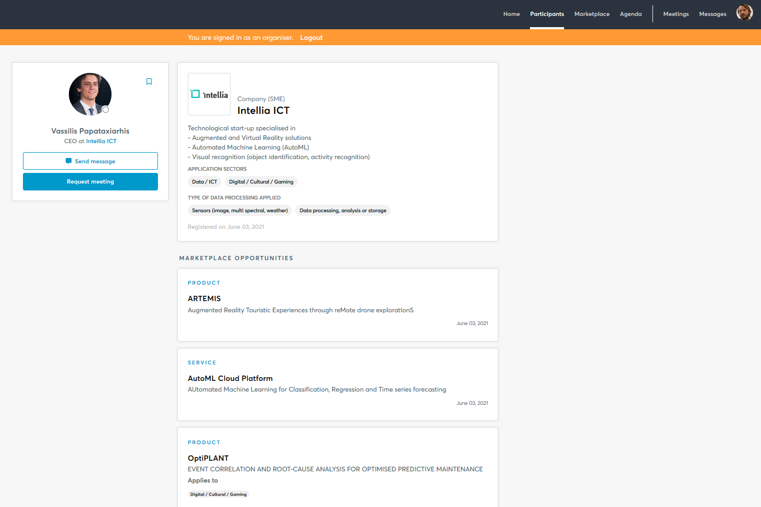
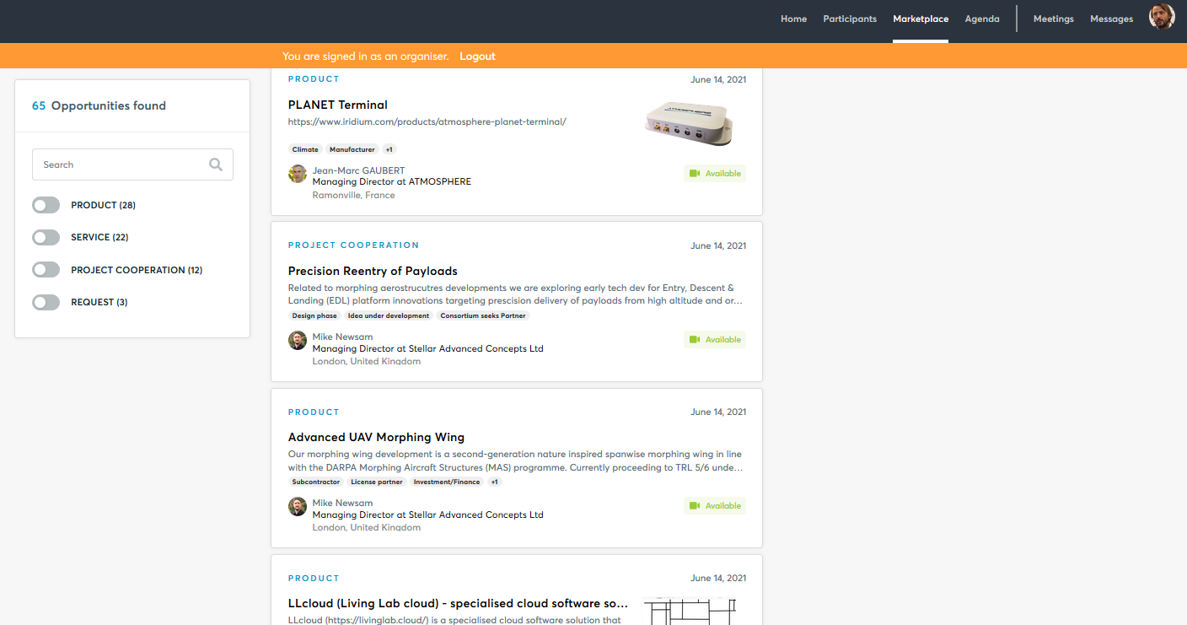
UFO Call #02 – Open Call Matchmaking event & B2B sessions
From your Profile…
Identity
Product
Services
Project cooperation
Request
… to the marketplace
Products, services, project cooperations and requests as opportunities
Profile selection for meetings
Smile !
Photo
Function
Coordinates
Conciseness
Logo
Description
Main activity
Keywords
Opportunities
identification

Slide 5
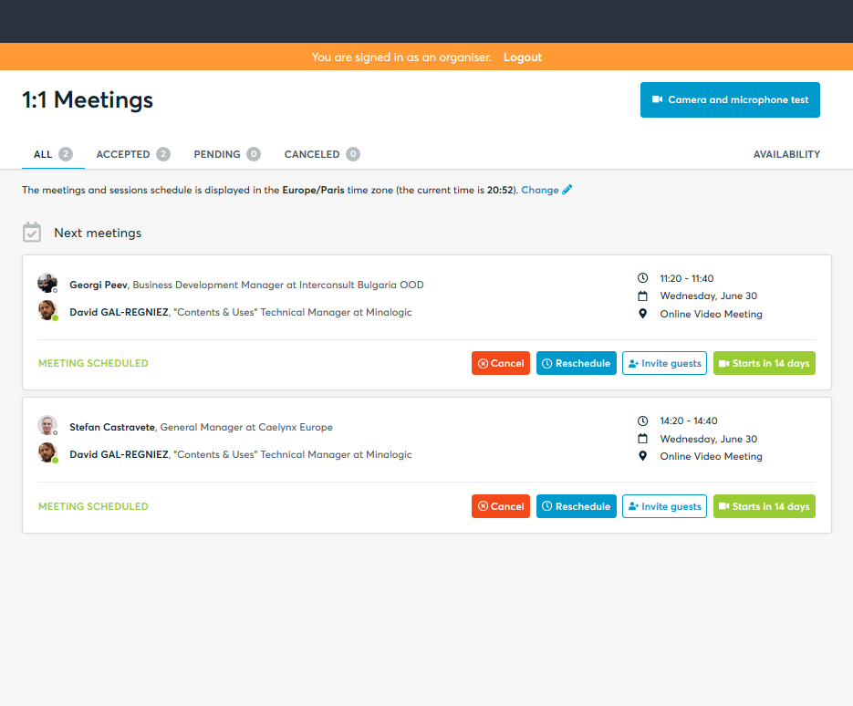
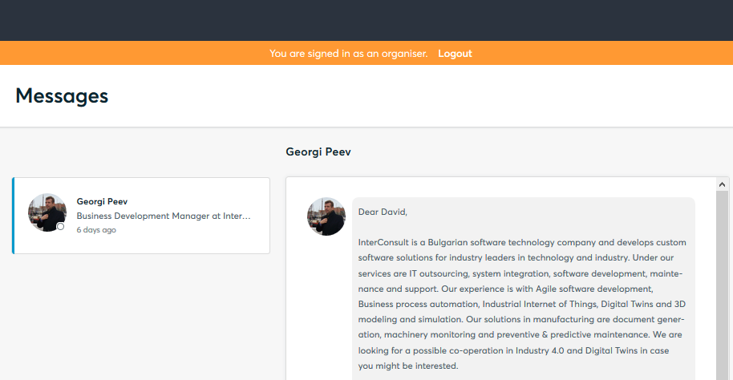
UFO Call #02 – Open Call Matchmaking event & B2B sessions
Book
Your meetings
Schedule
Communicate
Be pro-active
Be on time & Enjoy!
Interact

Slide 6
Already around 100 participants !
From
Bulgaria (5), France (29), Greece (11), Romania (5), UK(43)
Czech Republic (2), Denmark (1), India (2)
Registration closed on 27th June
More information on :
UFO Project : http://www.ufoproject.eu
B2Match : https://ufo-project-open-call-matchmaking.b2match.io/

Slide 7
Partners

Slide 8
contact@ufoproject.eu
www.ufoproject.eu

