Slide 1
Acronym for:
Emerging indUstries new value chains boosted by small Flying Objects

Slide 2
Presentation : June 16
Project UFO overview : Thaddé Bouchard
Second Open Call : Panagiotis Tsatsoulis
Matchmaking Event : David Gal-Regniez

Slide 3
European Project INNOSUP-01 AEROSPACE VALLEY
Horizon 2020
Orientation SMEs
Participation of European clusters
Transnational cooperation

Slide 4
Objective:
Aim at financing European SMEs to develop innovative (products and services) by integrating new embedded technology solutions in Small Flying Objects (SFO): drones, high altitude platforms systems, small satellites.

Slide 5
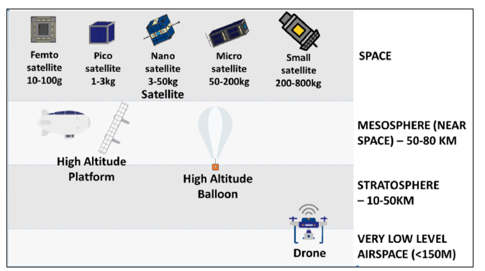
Scope of UFO activities
Use of the Small Flying Object targeted for 6 industries
 | Mobility
 | Environnement
 | Blue Growth
 | Finance and Insurance
 | Climate
 | Digital and Creative / Gaming

Slide 6
Embedded technology aimed
Example of embedded technologies
« Digital and nano technologies »
Data management
(internal storage, down stream, processors, AI)
Embedded sensors
(positioning, communication, sensors SAR / Optic)
Key Enabling Technologies (KETs)
(KETs : nano et microelectronic / nanotechnologies / biotechnology / advance materials / spectroscopy / sustainable development

Slide 7
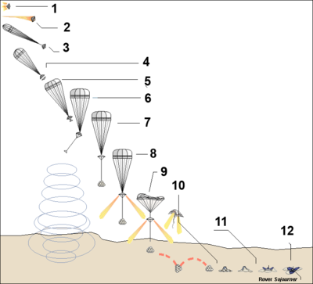
Information on the projet
Collaboration between
2 SMES or
Congestion, roadworks & asset monitoring
V2X (Vehicle to everything)
Last mile deliveries
Crisis management
Energy optimisation
Renewable Resources management
Air quality
Land quality
Fresh water quality
Combatting illegal, unlicensed and unreported (IUU) fishing
Managing coastal water quality
Metocean monitoring and forecasting
Architecture and Urban planning
Tourism / augmented and new touristic experiences
Gaming; realistic games, advanced virtual and augmented reality
Insurance sector (flooding monitor)
Real State sector / new building construction areas
Economic development / analyse city development
Industries &
Examples of applications

Slide 8
Support and Services
For a period of 33 months, we are offering :
financial support up to a maximum of 60K € / SME under two Open Call
Acceleration support for financed SMEs
Aerospace Valley (coordinator – FR)
Minalogic (FR)
Finance Innovation (FR)
ICT Cluster (BG)
CLUJ IT (RO)
Corallia (GR)
MSE (GB)
KTN (GB)
Climate – KIC (associate partner - FR)
With a budget of 4 300 000 €
75 % in Financial Support to Third Parties (FSTP): 3 000 000 €
To distribute:
Financial support | Acceleration support
Feasibility studies: 10 – 30 K€ Demonstrator : 60 K€ | Relations inter-cluster Cross-fertilization sessions (B2B) Perennation of the projects with support to Private / Public additional opportunities

Slide 9
Methodology
The project consists of 2 Open Calls, and support to SMEs
From 1 June 2021, the first funded projects started to emerge
Phase 1 – 1st Open Call
From November 27 to February 18, 2021 (closed)
Phase 2 – First Implementation of the financed projects
From May 1st to a maximum of 12 months
Phase 3 – 2nd Open Call
From 15 June to 22 September, 2021
Phase 4 – Second Implementation of the financed projects
From December 2021 to a maximum of 11 months

Slide 10
Next Actions
Open Call application
Website UFO : https://www.ufoproject.eu/
B2B inscription
B2Match
https://ufo-project-open-call-matchmaking.b2match.io/

Slide 11
Contact
Information about UFO et follow news :
Website: https://www.ufoproject.eu/
LinkedIn : https://www.linkedin.com/company/69253612/admin/
Facebook : https://www.facebook.com/ufoproject2
Twitter : https://twitter.com/UFOProject2
Youtube: https://www.youtube.com/channel/UC5dfi56Uup7W254GaSDARHg
Contact : contact@ufoproject.eu

Slide 12
Partners

Slide 13
contact@ufoproject.eu
www.ufoproject.eu

