Slide 1

Danube DNA
WeldWise
Smart energy and production monitoring for spot welding machines
ICT Cluster

Slide 2
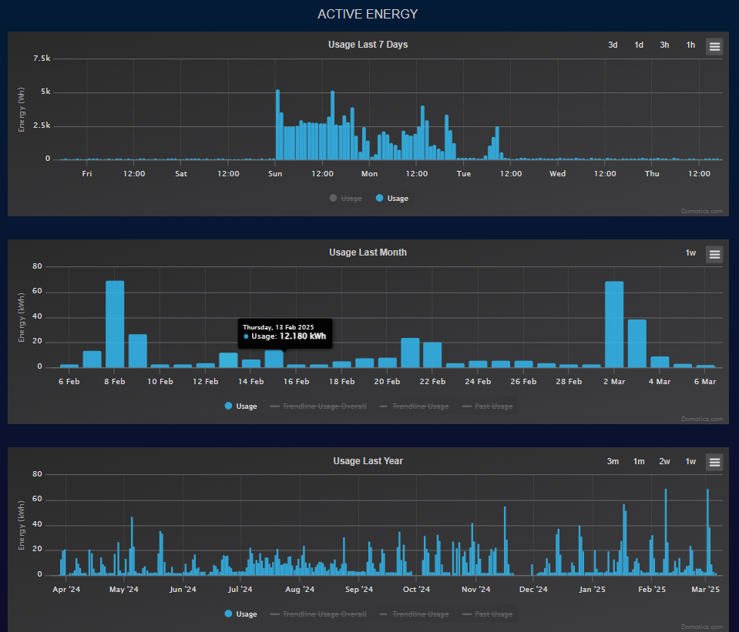
What will the tool do?
The Energy Monitoring and Management System (EMS) is designed to track, analyze, and optimize energy consumption in various industries.
Key functions include:
Real-time monitoring of energy consumption
Automated metering of electricity, gas, heat, and other utilities
Detection of inefficiencies and excessive energy use
Cost allocation among production units and departments
Alerts and notifications for anomalies
Data-driven decision-making for energy optimization
Detailed data and trends visualisation

Slide 3




For what kind of SMEs can it be beneficial?
The system is beneficial for SMEs with high energy consumption, including:
Manufacturing companies: factories, electronics, machinery production
Agri-food industry: dairy processing, meat processing, food packaging
Hospitality & Retail: hotels, shopping malls, supermarkets
Office & Administrative buildings: energy-efficient lighting, heating, and cooling management

Slide 4
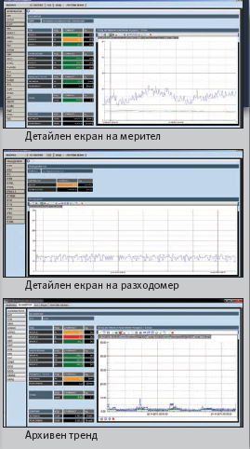
Expected benefits of implementation
Implementing will provide multiple benefits:
Optimized energy costs through data-driven analysis
Increased energy efficiency and sustainability
Automated energy cost allocation to different business units
Reduced carbon footprint and better energy planning
Detailed data and trends visualisation

Slide 5




Implementation through pilot actions
The system will be tested in SMEs through pilot actions: WeldWise
SMEs
from manufacturing
Training
of personnel
Installation
energy monitoring devices
communication networks
Evaluating impact
cost reduction
efficiency gains
Modular
implement with minimal to no costs

Slide 6
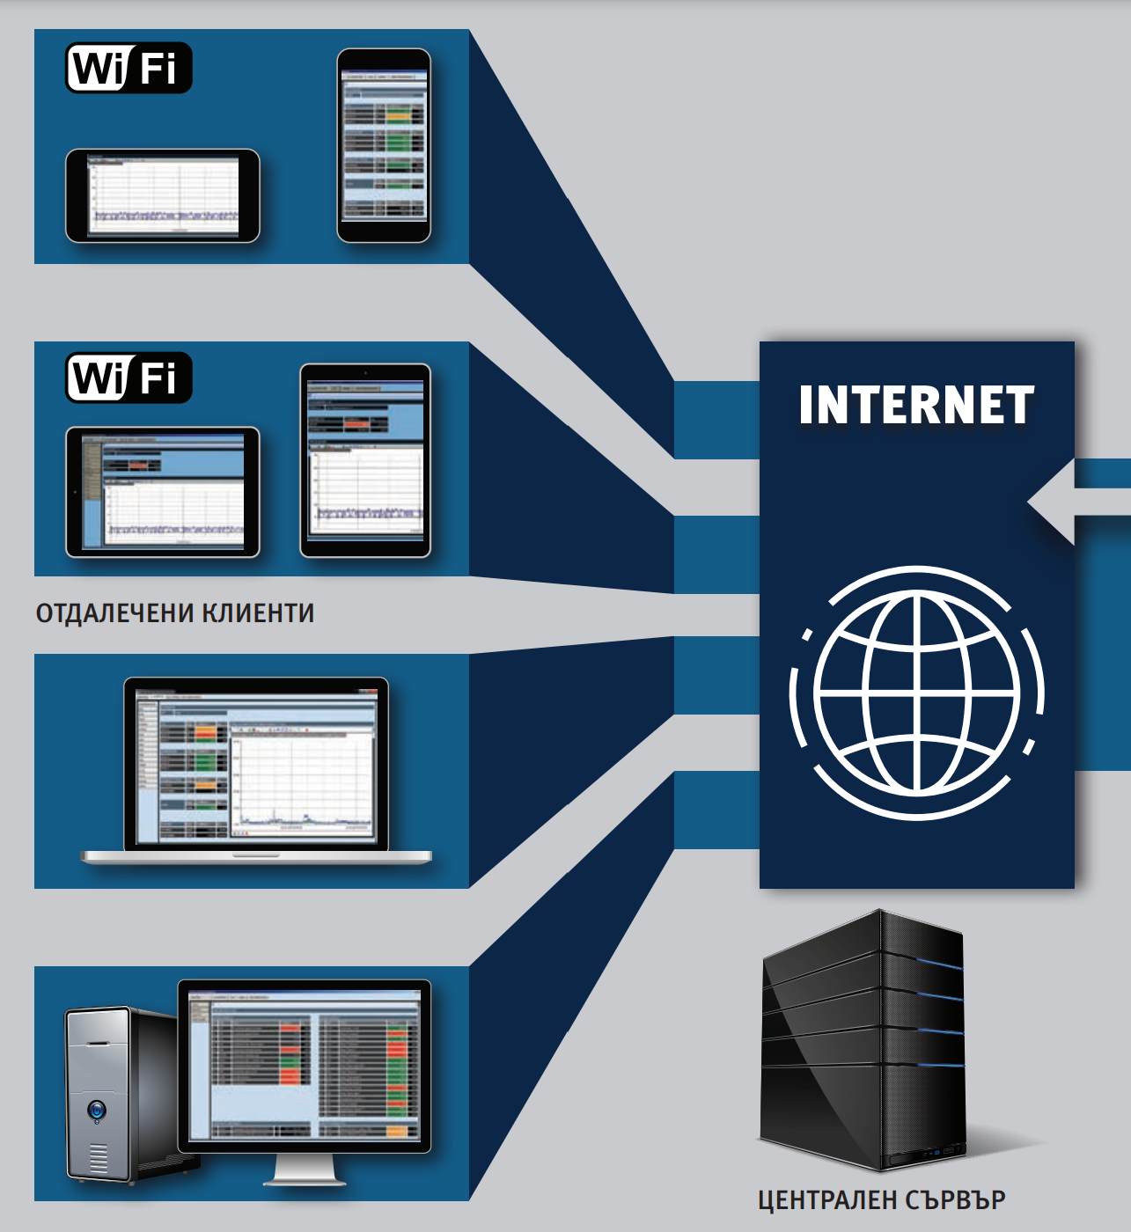
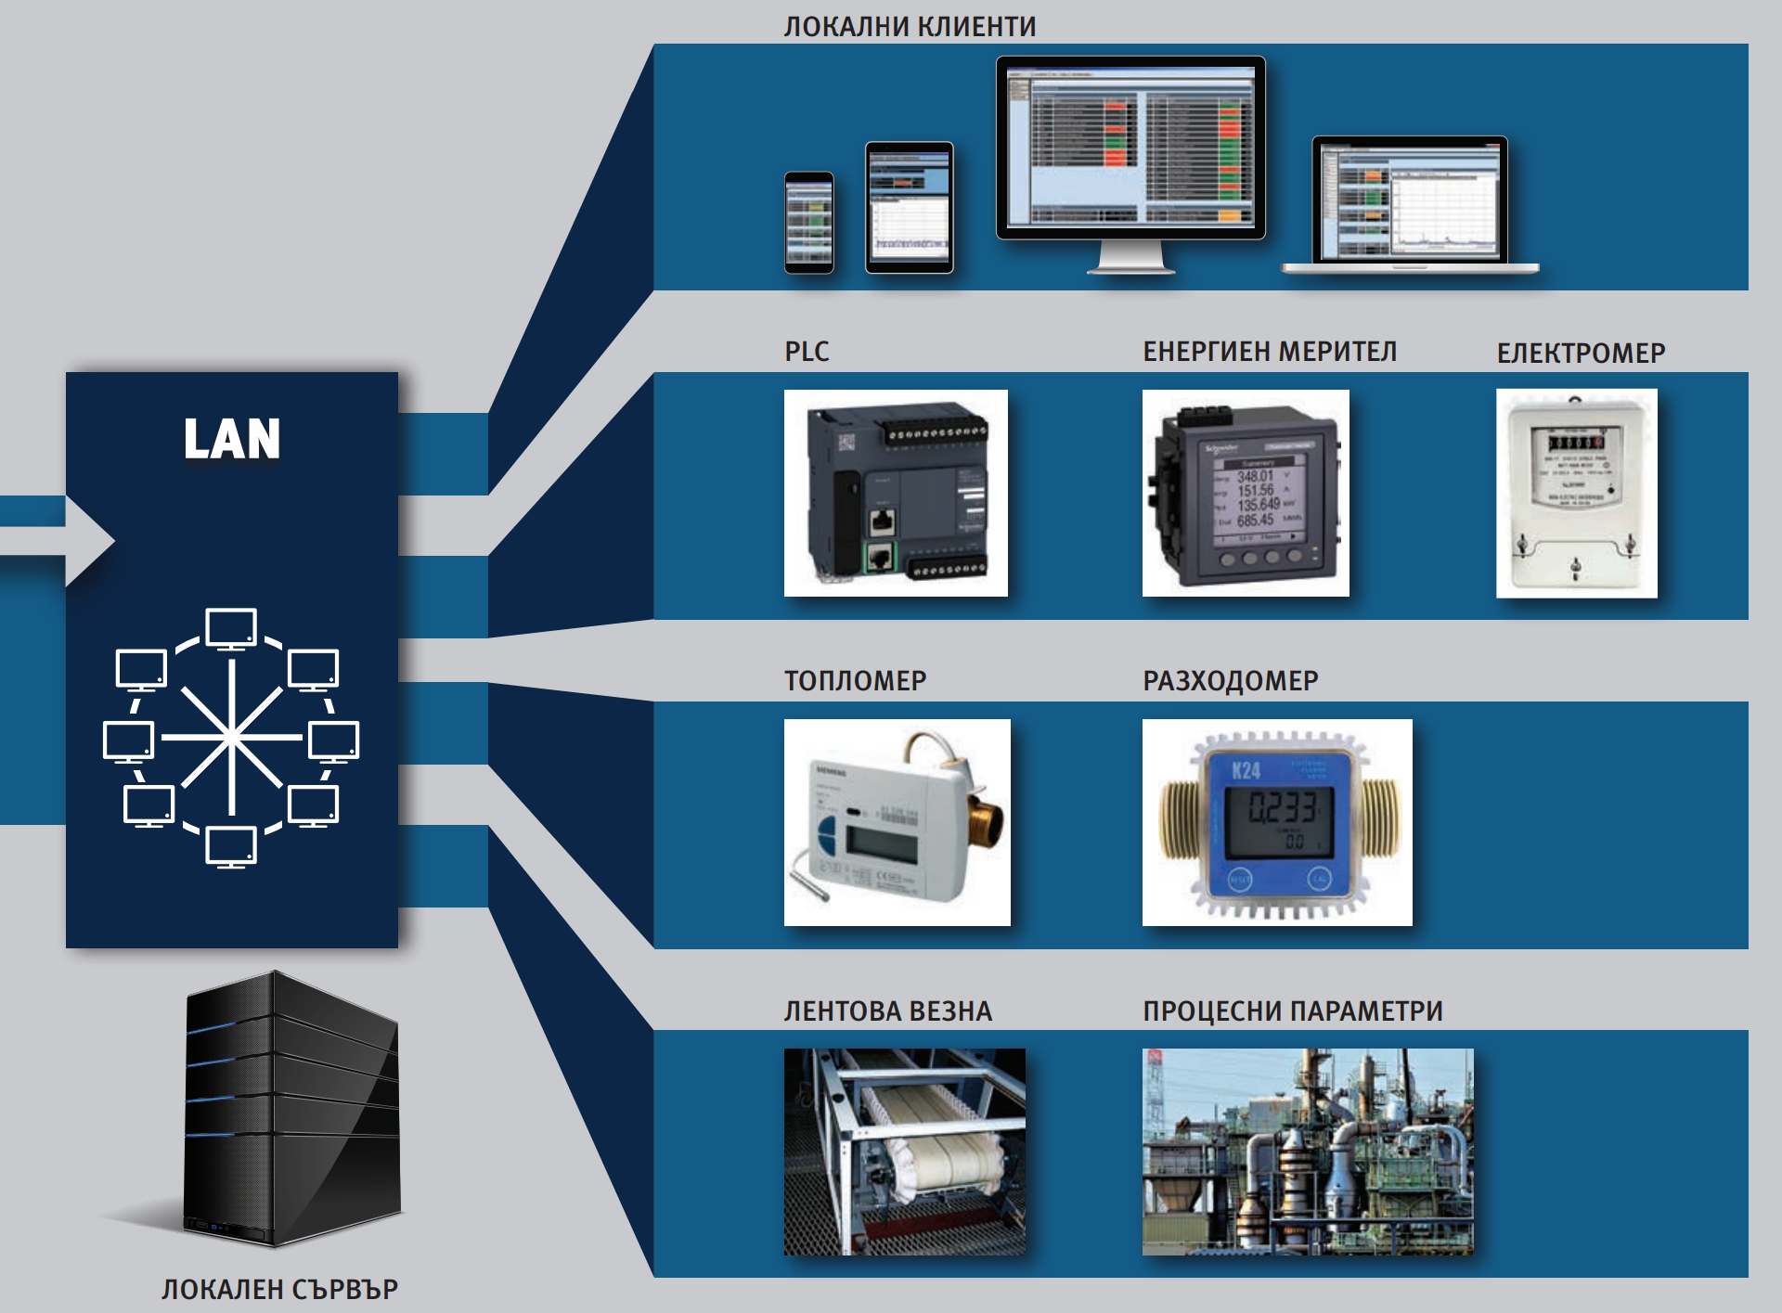
The WeldWise system is modular
Distributed clients
Local measurement nodes

Slide 7
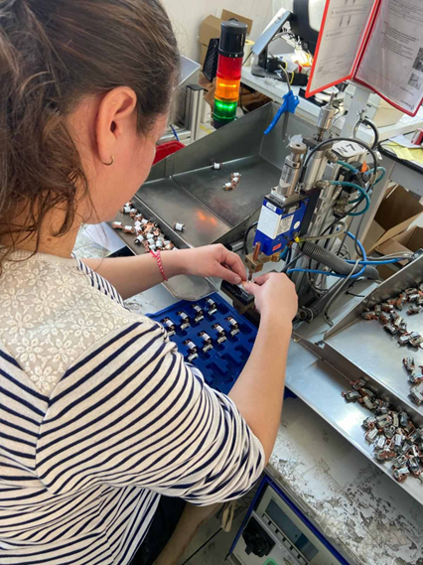
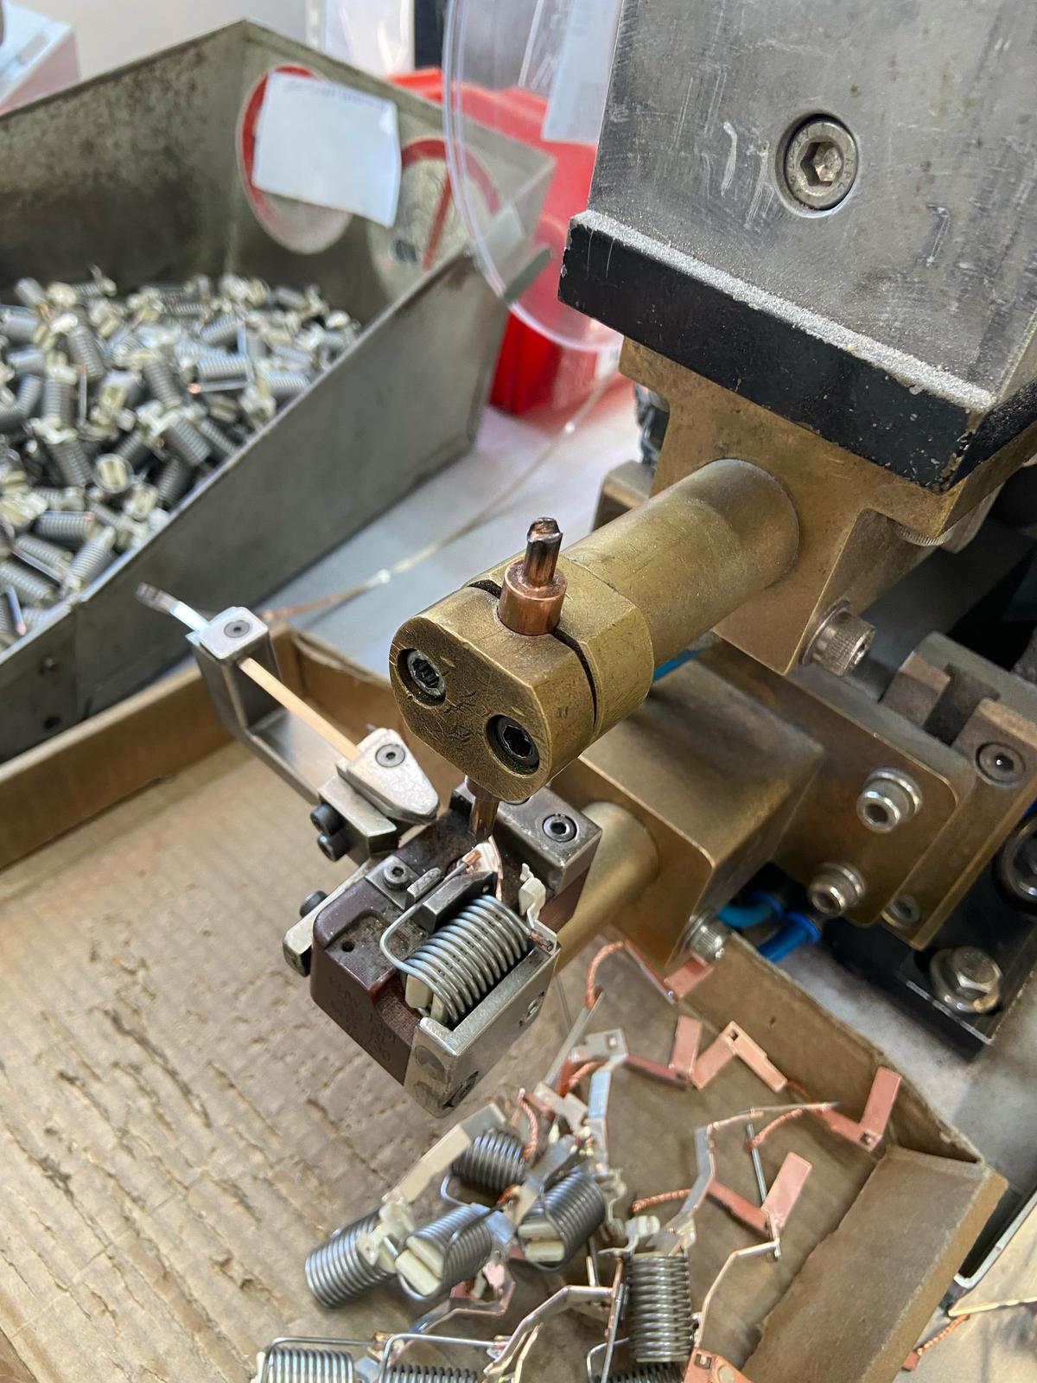
WeldWise implementation example
SME with semi-automated workstations
Main energy consumption is electricity
Production activities mainly involve manual operations, most of which are through semi-automated workstations equipped with spot welding machines
Work is completed in 2 shifts
The main consumers of electricity are:
spot welding machines
air compressor
heating
air conditioning
lighting and other general loads

Slide 8
Optimization potential
Optimization gap
No centralised system for individual production accounting
No information on the electricity used in the production of each part
No detection of the causes of poor-quality spot welds leading to defective production

Slide 9








WeldWise Project goals
Collect information on consumed electrical energy and number of produced parts per shift at a spot-welding machine
Measure the electricity used to produce workpieces for each workstation for a work shift
Detect correlation between defective production and energy consumption
Detect correlation between production volume and energy consumption
Detect correlation between machine setup and energy consumption
Detect unjustified energy costs for the whole plant
Prepare informed decisions on changing the form of participation in the free electricity market
Create base conditions for the introduction of an EN ISO 50001 Energy Management System

Slide 10
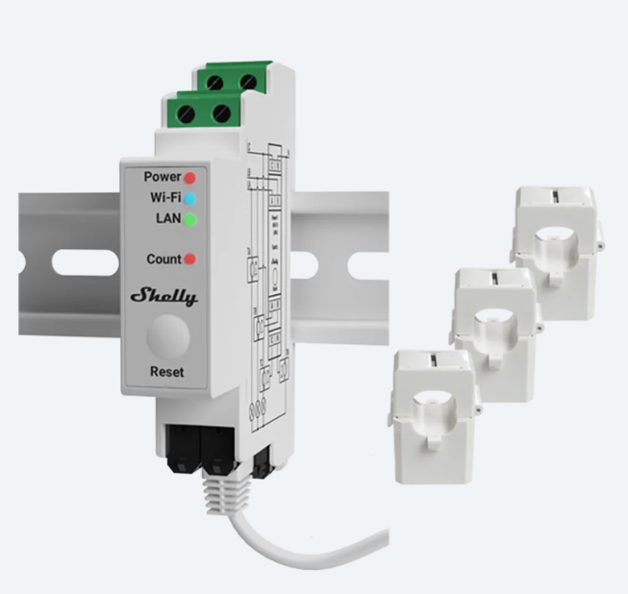
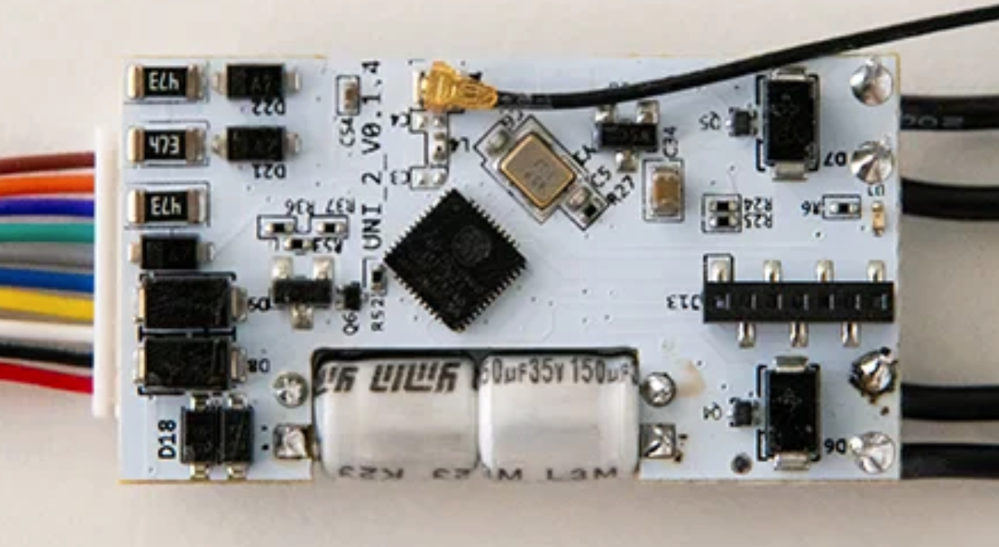
Technical solution - Hardware
Three-phase electricity meters with detachable current transformers
Communication over Wi-Fi or LAN
Communication protocol: MQTT or Modbus TCP
(Optional) operation counter for spot welding machines
Single-board computer (low-cost server)
Box for mounting the measuring equipment with accessories
Computer with monitor for real-time visualization of measurements
Communication equipment
Three-phase electricity meters with detachable current transformers
Operation counter

Slide 11
Technical solution - Software
The EMS provides the ability to:
visualize current measurements,
report and export data in an appropriate format.
Upon analysis, choice of software platform is possible between:
Open-source software like Domoticz, Grafana,...
SCADA or specialized energy monitoring software
Development according to project specifics
Grafana visualization

Slide 12
Conclusion:
The system offers a comprehensive solution for SMEs looking to optimize their energy consumption, reduce costs, and improve efficiency. By providing real-time monitoring, automated data collection and advanced analytics, the system enables businesses to make informed decisions that lead to cost savings and sustainability.
Key takeaways from the service:
✅ Enhanced Energy Efficiency – Reduces waste and improves overall operational performance.
✅ Cost Reduction – Identifies areas for cost savings and streamlines energy consumption.
✅ Early Fault Detection – Prevents equipment failures through predictive analytics.
✅ Data-Driven Decision Making – Empowers SMEs with accurate consumption insights.
✅ Sustainability & Compliance – Supports green initiatives and regulatory compliance.
The WeldWise system, integrated within the Danube DNA platform, provides a data-driven solution for optimizing production costs and quality in industrial welding processes. By leveraging energy monitoring, WeldWise enables real-time tracking of Cost per Unit production, identifying correlations between energy consumption, production volume, and defect rates. This approach allows SMEs to detect inefficiencies, reduce unnecessary energy expenses, and improve overall manufacturing quality. Through pilot implementation, we will validate and refine the system, ensuring precise insights for cost optimization and a smarter, more sustainable industrial ecosystem.
By adopting EMS, SMEs can reduce their carbon footprint, optimize production costs, and gain a competitive edge in an increasingly energy-conscious market.

